Slide 1
The Election of 1800
Adams vs. Jefferson
Adams and the Federalists went on the defensive with a mudslinging campaign against Jefferson.
Jefferson still won with 73 electoral votes to Adams’ 65.
He was criticized by Northern states as an embodiment of “the slave power that southern states wielded” since his victory was all but assured by the 3/5 Clause.

Slide 2
The Revolution of 1800
The governing party had changed: Federalists → Dem-Reps.
Jefferson had a goal to return to the same spirit that had created the American Revolution.
He did this through moderation though; he knew how he was viewed, especially after the campaign, and wanted to make sure he could appeal to everyone.

Slide 3
Things Jefferson Did:
Naturalization Act of 1802 (pg 210)
Repealed the excise tax (210)
Kept the National Bank, payment of debts (210)
Attempted to impeach a Supreme Court justice (211)
Fought some pirates (212-213)
The Louisiana Purchase (213-214)
Lewis & Clark Expedition (215)
The Embargo of 1807 (218)
Notes:
Create a cartoon that shows TJ in a good light. On the back, compare how the Feds and Dem-Reps would interpret your work.

Slide 4
Marbury v. Madison
The Judiciary Act of 1801 was passed in Adams’ last days as president, resulting in the appointment of several “midnight judges” who were appointed by Adams on his last day in office.
The newly elected Dem-Rep Congress did their best to repeal the act and replace the judges appointed by Adams.
This meant that the appointment papers for the judges appointed by Adams did not get delivered.

Slide 5
Marbury v. Madison
This did not sit well with William Marbury, who was supposed to be a new federal judge in DC, and he filed a lawsuit against Secretary of State James Madison who should have been tasked with delivering the appointments.
The case was presented to the Supreme Court, who needed to make decisions on several issues, including whether or not they could force Madison to give Marbury his job and how this issue should be addressed using the Constitution.

Slide 6
Marbury v. Madison
The Court ultimately decided:
The Judiciary Act of 1801 now supplemented the Judiciary Act of 1789, making Marbury’s basis for his case obsolete.
In terms of the Constitution and constitutional matters, the Supreme Court has the final say. This is called judicial review.
Finally, no, they could not force Madison to deliver the appointment so Marbury did not get the job.

Slide 7
Jefferson vs. the Federalists
The Supreme Court was the only remaining part of the Federalist government.
Marbury v. Madison represented an indirect conflict between the Dem-Reps (Madison) and the Federalists (Marbury). Chief Justice John Marshall, however, made the case a win for the Court rather than anyone else.
Jefferson and the Dem-Reps then went after Supreme Court Justice Samuel Chase, leveling impeachment charges against him in 1804.
While the House brought charges, the Senate could not muster enough votes to actually remove Chase from office.

Slide 8
Jefferson vs. the Pirates
Jefferson reduced the size of the military, favoring the tactic of “peaceful coercion” over physical violence and wars.
Jefferson also stopped payments for the protection of American ships from the pirates of North Africa.
The pirates unofficially declared war on the US, and Jefferson sent a very reduced Navy to Tripoli.
After four years of fighting in the Tripolitan War, a treaty was secured in 1805, which granted $600,000 to the pirates in return for captured sailors and ships.

Slide 9
Jefferson vs. France
In 1800, leader of France Napoleon made a deal with the king of Spain to cede most of the Louisiana Territory, along with New Orleans to France, unbeknownst to the US.
This was only confirmed to the US in 1802, when some of the rights granted by Spain to the US in Pickney’s Treaty were denied.
This angered Western farmers who depended on the Mississippi River for trade purposes.
It also posed a threat to the US, with the farmers threatening to march on New Orleans with their rifles and the megalomaniac ruler of France being in control of a large area so nearby.

Slide 10
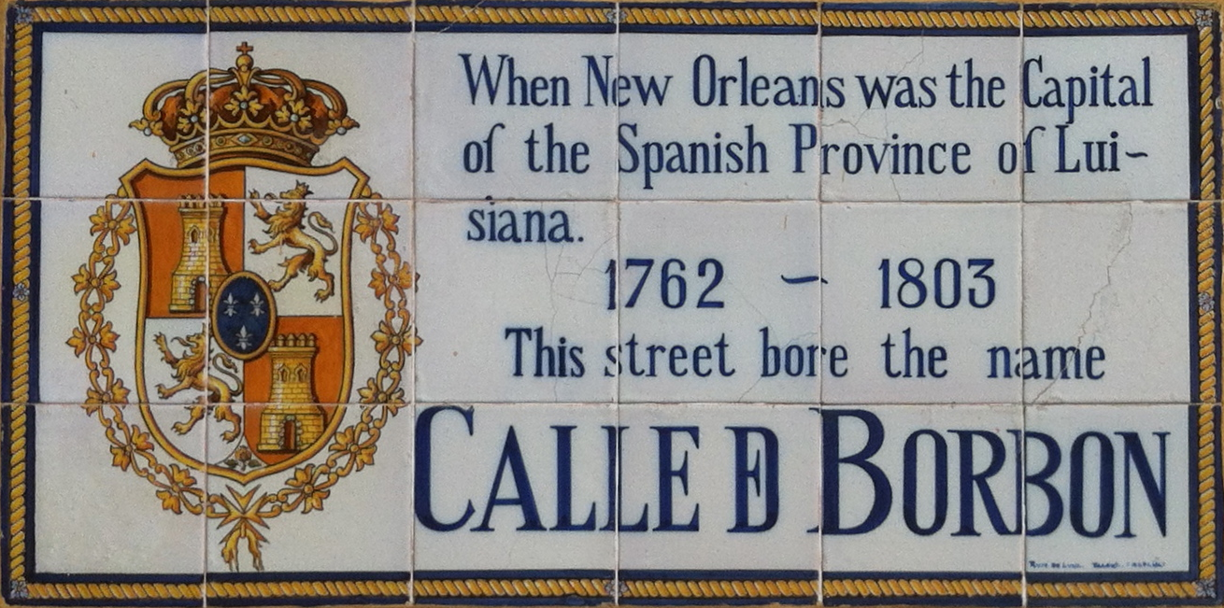
The Louisiana Purchase
Jefferson sent fellow Virginian James Monroe to join Ambassador Robert Livingston in France with instructions to purchase as much territory around New Orleans as they could for $10 million.
This also came with the provision that if France turned on the US, they were to leave and begin negotiations for an alliance with Great Britain.
“The day France takes possession of New Orleans,” Jefferson wrote, “we must marry ourselves to the British fleet and nation.”

Slide 11
The Louisiana Purchase
Much to everyone’s surprise though, Napoleon decided to sell the entirety of the Louisiana Territory to the US for $15 million.
Rather than risk an alliance between the US and Britain, Napoleon was more willing to give up the entire territory.
This was prompted by two events:
The Haitian Revolution
Reignited conflict between France and Britain

Slide 12
The Louisiana Purchase
Jefferson was both thrilled and conflicted.
Agreeing to the price would mean avoiding conflict with France and an alliance with Britain, and doubling the size of the US allowing for the spread of the American experiment.
However, Jefferson was also quick to note that while the Constitution allowed for the president to make treaties, it did not directly allow him to purchase land, which could make this move unconstitutional.
As we all know, Jefferson ultimately decided the pros outweighed the cons, and purchased the Louisiana Territory.

Slide 14
Lewis & Clark Expedition
Jefferson sent his personal secretary Meriwether Lewis and army officer William Clark to explore the new territory.
Their journey yielded vast knowledge about the land, people, and animals of the territory resulting in a number of maps, scientific observations, and the possibility of a land route to the Pacific.
This would lead to further exploration of the West, including Colorado, and a greater American claim to the Oregon Territory.

Slide 16
The Notorious Aaron Burr
Despite the long-term promise of riches that Louisiana could bring, the short-term fears were much greater.
Many feared the US government would not be accepted in the new territory, or lead to entanglements in foreign affairs.
Federalist extremists in NY and New England, including Jefferson’s former VP Aaron Burr, plotted to secede from the US.
This plot was exposed to Jefferson by Alexander Hamilton, whom Burr challenged to a duel as a result.

Slide 17
The Notorious Aaron Burr
Burr was part of a similar secessionist plot with the military governor of the LA Territory.
Their plot was to split the new west from the US and create a new confederacy that could invade Spanish Mexico.
Jefferson found out about these plans too, causing the military governor to betray Burr by leaving him stranded in Natchez, MS.
Burr was arrested and tried for treason. He was acquitted, and fled to Europe.

Slide 18
Jefferson vs. Britain and France
Jefferson was re-elected in 1804, but celebration was short-lived thanks to Napoleon’s rekindled battle with Britain.
Despite this renewed conflict, the US maintained neutrality and trade with both countries.
Battle of Trafalgar, 1805: Horatio Nelson and the British Navy secure superiority at sea by crushing the French and Spanish fleets.
Battle of Austerlitz (aka, the Battle of Three Emperors), 1805: Napoleon secures supremacy on land by taking out the Austrian and Russian armies.

Slide 19
Jefferson vs. Britain and France
Britain and France enact laws against each other’s trade.
Orders in Council, 1806-1807: British edicts that worked to close French ports to foreign shipping, unless the vessel first stopped at a British port.
France orders the seizure of all merchant ships entering British ports.
“There was no way to trade with either nation without facing the other’s guns.”
Also British impressment of American sailors continues.

Slide 20
The Chesapeake Affair
British naval frigate HMS Leopard hailed the American ship Chesapeake off the coast of Norfolk, VA on June 22, 1807.
The Chesapeake welcomed aboard the Lieutenant from the Leopard who presented the American captain with a search warrant to look for British deserters.
After some discussion, the captain of the Chesapeake refused to allow the search and the Lt. returned to his ship.
The Leopard fired three broadsides into the Chesapeake, killing three crewmen and wounding 18 more.

Slide 21
The Chesapeake Affair
Britain was clearly in the wrong, as later admitted by the government in London.
Americans, including Jefferson, were livid. Many rallied for war against Britain for this and the continued impressment of American sailors, and would have supported a declaration of war by Jefferson…had he actually called for it.
Instead, this event and the Orders in Council marked the beginning of a series of events leading to the War of 1812.

Slide 22
Jefferson vs. Britain and France
Jefferson now had to come up with a way to avenge American honor and teach the British and the French a lesson.
The answer became clear upon reflection; both countries depended on the US for food and raw materials.
The Embargo of 1807: Forbade all exports from the US, on any kind of ship.

Slide 23
The Embargo of 1807
As it turned out, America felt the effects of the Embargo before either Britain or France.
New England ships sat in their harbors with nowhere to go, and piles of unexportable cotton, grain, and tobacco looked like wasted time and money in the South and West.
Illegal trading grew, particularly along the Canadian border where goods could be traded with Britain.
Congress repealed the Embargo in 1809, days before the end of Jefferson’s second term, and replaced it with the very targeted Non-Intercourse Act.
The Non-Intercourse Act allowed the US to trade with anyone EXCEPT Britain and France.

Slide 24
The Embargo of 1807
What was the problem with the Embargo? Jefferson had miscalculated.
He overestimated both countries’ dependence on US goods: Britain managed to grow enough grain themselves for just long enough to outlast the embargo, and with most Europe under French control, France could just look east instead of west.
This was not helped by revolution-happy Latin America opening ports to take over the trade in America’s place.
Economic coercion would be the new American “neutrality” until they were finally pulled into war in 1812.
Notes:
He also underestimated the impact it would have on America. Every region and trade suffered. But, necessity is the mother of invention, and New England re-opened old factories and created new ones to take the place of shipping. They attempted to manufacture their own finished products with goods from other regions, showing a weak first go at an industrial foundation.

Slide 25
President Madison
James Madison took office as president in March, 1809.
Madison did not have the benefit of party solidarity that Jefferson, or even Adams, had had as president.
This meant he often found himself executor “for risky foreign policies not of his own making.”

Slide 26
Macon’s Bill No. 2
An economic policy aimed again at Britain and France, which stipulated that whichever country repealed its commercial restriction first, America would restore its embargo against the other.
Madison felt this was a sell-out: it blatantly showed Britain and France that the US needed them economically.
Napoleon, however, saw an opportunity to create a blockade against Britain: Britain had implied in the Orders in Council that their trade restrictions would be lifted if French restrictions were also lifted.

Slide 27
Macon’s Bill No. 2
Although Madison could see Napoleon’s intent, he accepted the French offer of repeal.
This also gave Britain three months to make good on their implied repeal of the Orders in Council, with Madison hoping the British would do so rather than see the US trade almost exclusively with France.
Britain made no move to repeal the Orders, giving Madison no choice but to reinstate the embargo against them.

Slide 28
The War Hawk Congress
Elections had made the Congress young, sweeping out the older “submission men” and replacing them with “young hot heads” from the South and West, dubbed “war hawks” by the Federalists.
The war hawks hated Britain’s continued mistreatment of America and the “Indian threat” to westward expansion. They were anxious to fight one, the other, or both.

Slide 29
The Battle of Tippecanoe
Off in Indiana, two Shawnee brother were eager to meet the Americans in battle. Tecumseh and his brother, Tenskwatawa (aka The Prophet), had built a Native American confederacy they felt could rival the Americans they were bound to face.
This happened at the Battle of Tippecanoe in 1811: William Henry Harrison, gov. of IN, marched on the brothers’ headquarters. Tenskwatawa retaliated and lost the settlement and much of his respect.
Harrison was deemed a hero, but the whole event drove Tecumseh into an alliance with the British.

Slide 30
The War
The path to war was paved with…
The Chesapeake Affair
The Orders in Council
The Embargo of 1807
The Non-Intercourse Act of 1809
Macon’s Bill No. 2
Tecumseh’s War/Battle of Tippecanoe
The War Hawk Congress

Slide 31
The War
Madison was pushed into a precarious position.
The British were continuing to arm Native Americans against American settlers in the West, cause the war hawks in his own party to call for an invasion of Canada.
International trade with anyone had been made iffy by impressment and backhanded moves by France.
But above all Madison felt that America’s place as a country, and its entire republican experiment, was being invalidated. If America could not fight to protect itself, he reasoned, everything they had done to that point would be discredited, and then what?
He asked Congress to declare war in June of 1812.

Slide 32
The War
The Congress passed the measure for war 79 to 49 in the House, and 19 to 13 in the Senate.
The divisions within the country had been made all the more clear by the vote.
The South and West had voted for the war, as had the larger middle states.
The North, and Federalists in the South, abhorred the conflict, just as they had Jefferson’s sympathies for France.
It was said that America had two enemies during the War of 1812, old England and New England.

Slide 33
The War of 1812
1812-1815
The US was largely unprepared for war as Jefferson had downsized the military.
Anger toward Britain had also subsided around the time Madison asked for a declaration of war.
Britain had been fighting in the Napoleonic Wars for years, and were already seasoned to fight again.

Slide 34
The War of 1812
The major battleground of the war was the Great Lakes.
America first decided to fight the British in Canada were they were weaker.
The British, however, quickly captured several American forts along the Great Lakes and in the West.

Slide 35
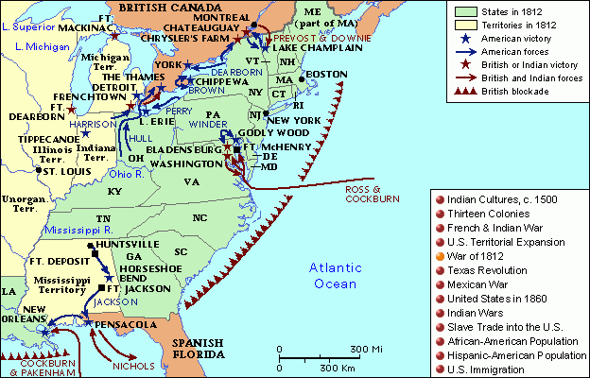

Slide 36
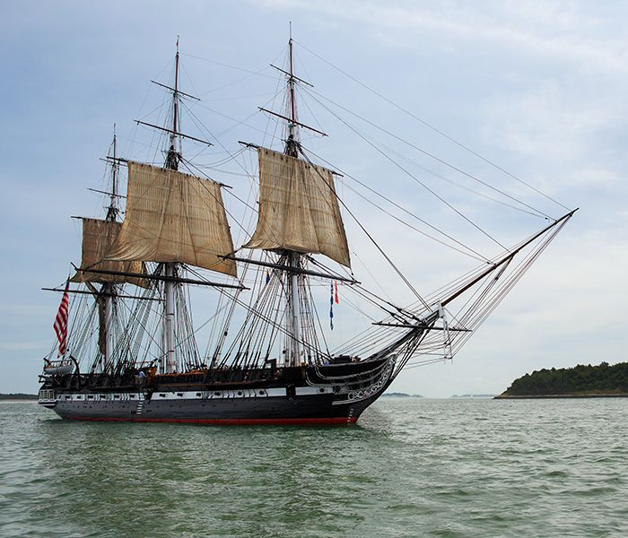
The War of 1812
After failing to invade Canada, the US made an…interesting move to fight the British at sea.
The ships that America did have were well-fortified with adequate arms, and thicker sides.

Slide 37
The War of 1812
Battle of Lake Erie (1813):
Commanded by Oliver Perry (US), who had recently set up a new fleet of ships on the Lakes. They looked very similar to the East Coast frigates but had green sides.
Perry and his fleet were able to capture or sink six British ships, resulting in an American victory that shifted morale during the war.

Slide 38
The War of 1812
Battle of the Thames (1813)
After defeat at Lake Erie and Fort Detroit, the British were forced inland, where they were met by William Henry Harrison.
This would be a two-fold battle for Harrison who first overran the British, forcing a retreat. The second stage was against Tecumseh’s Confederacy, who had allied with the British after the Battle of Tippecanoe.
This would be second major American victory in six months.

Slide 39
The War of 1812
Britain regrouped after the capture and exile of Napoleon in Europe, which allowed them to turn their focus to America.
They made a direct invasion of the nation’s capital, the first America had truly experienced, in August of 1814. This resulted in the burning of Washington.
The occupation of Washington lasted 26 hours, before the British moved toward Baltimore.

Slide 40
The War of 1812
Battle of New Orleans (1815)
Leader of American forces in the West, Andrew Jackson, was quickly placed in charge of retaliation once it was discovered another British force was headed south.
Jackson’s force of 7000 was a rag-tag bunch of soldiers, sailors, former slaves, and thieves, who would be somewhat evenly matched against the 8000 British headed their way.
This decisive battle was over quickly, resulting in American victory and the worst British defeat of the war.
The British lost 2000 troops within the first half hour.
The British responded by reinforcing their blockade around the East Coast.

Slide 41
The War Ends
Treaty of Ghent (1814): formal armistice between Britain and the US that brought the war to a halt.
Negotiations had started at the behest of Tsar Alexander I of Russia in 1814.
As it appear they would be victorious, the British asked for heavy concessions from the US, which adamantly refused by US representatives John Quincy Adams and Henry Clay.
Terms were finally agreed upon in December of 1814, BEFORE the Battle of New Orleans; Britain had become exhausted by war and was preoccupied by the Congress of Vienna.

Slide 42
Hartford Convention
Before the Treaty of Ghent and the Battle of New Orleans, the Federalists in New England, fed up with the war, set up the Hartford Convention.
At the convention, delegates from MA, RI, and CT wrote up a list of demands for a US government they thought would be faltering.
Included in their demands were
Financial compensation for trade
A proposal for a constitutional amendment that would require a 2/3 majority vote in Congress before an embargo could be enacted, a state could be admitted, or war could be declared
Abolishment of the 3/5 Clause

Slide 43
Hartford Convention
When messengers arrived in Washington, it was just in time to hear the news of victory in New Orleans.
Their demands now seemed “petty at best and treasonous at worst.”
They were never formally introduced to Congress.
This does mean the secessionist thought would again spring up in New England, and was more dangerous here than anywhere leading into the 1840s.

Slide 44
Impact of the War
Globally unimportant, but extremely important to the US.
America had earned its respect as an independent nation, if not for winning then for standing up for themselves against the major powers of the day.
A new military elite had emerged: Jackson, Harrison, Perry. They created a strong enough military to promote less scorn for American ambassadors abroad.
Sectionalism was dealt a blow: most of America had pulled together for the war, and those who hadn’t (*cough* New England *cough cough*), were quickly losing respect and prestige.
America gained a greater sense of self-reliance. Domestic manufacturing had emerged and supported the US through the war, and were encouraged to continue this path.

Slide 45
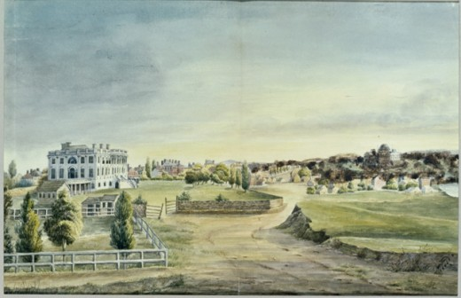
Impact of the War
Rush-Bagot Agreement (1818): disarmed the Great Lakes to a vast extent.
America would be free of conflict started by Europe long enough to look West.
A new sense of American nationalism/patriotism emerged, and encouraged all things American, including literature, artwork, textbooks, and more.

Slide 46
American Manufacturing
During the war, America became more self-reliant when it came to manufacturing goods. They had previously gotten most of their finished products from Europe.
After the war, the British were hoping to re-create that dependence. However, America was already putting things in place to prevent this.
Tariff of 1816: enacted for protection rather than revenue, created a 20-25% on imports.

Slide 47
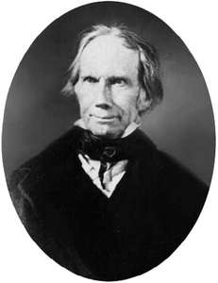
Henry Clay’s American System
Supplemented the Tariff of 1816.
Included three parts in the hopes of promoting American manufacturing and domestic trade:
A strong banking system
Protective tariffs
Improved internal transportation

Slide 48
Henry Clay’s American System
Clay reasoned that with a stronger banking system, more people could easily obtain credit to buy land or equipment, or start a business.
By instituting protective tariffs, he said, American businesses and manufacturers would have greater chances of succeeding because imported products would be too expensive.
He said that the money saved and/or earned with the protective tariffs should go to improving domestic transportation.
Clay argued that “these new arteries of transportation would flow foodstuffs and raw materials from the South and West to the North and East. In exchange a stream of manufactured goods would flow in the return direction, knitting the country together economically and politically.”

Slide 49
Transportation
This call for improved transportation struck a cord with many.
Part of the reason the American invasion of Canada had failed was because there was no direct route to travel and carry supplies.
The West was all but begging to be better connected with the rest of the country.

Slide 50
Transportation
Securing federal funding for transportation was more difficult than originally imagined though.
Re-elected President Madison vetoed congressional efforts to disperse funding to states for roads and canals as he considered the measure unconstitutional.
Therefore individual states picked up the slack and did it themselves.
New York completed a major feat of engineering, the Erie Canal, in 1825.

Slide 51
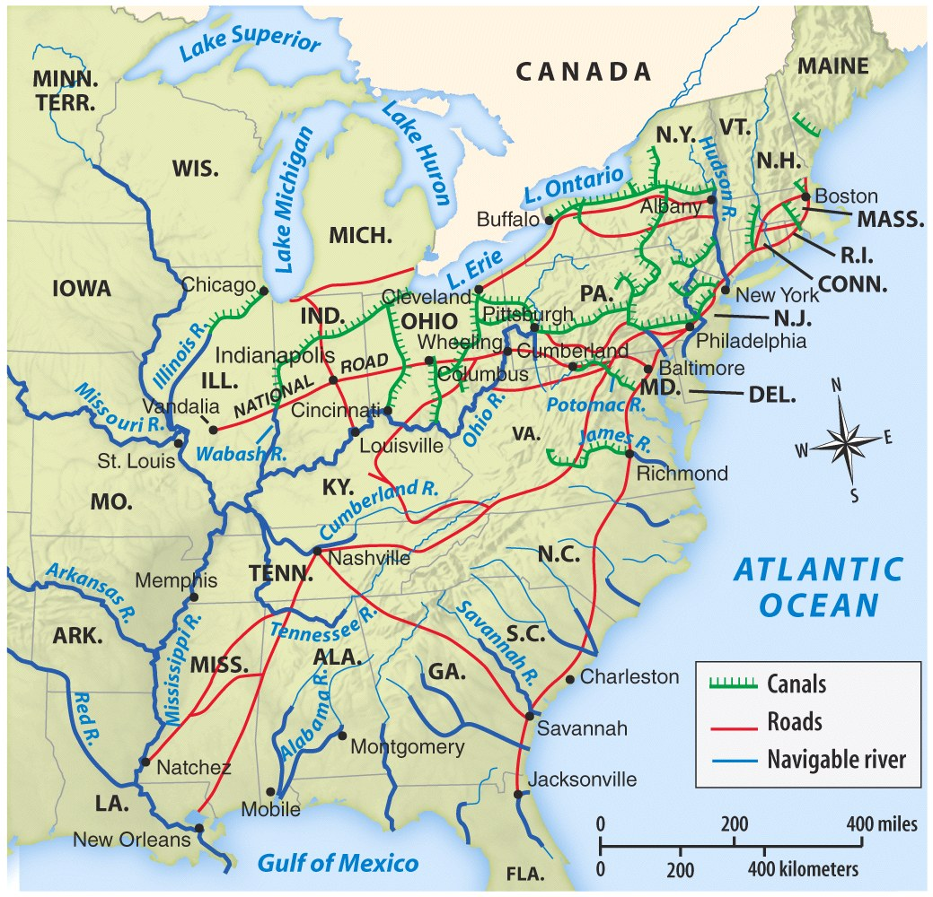

Slide 52
Era of Good Feelings
1816: James Monroe is elected president.
Dem-Rep
President #5
#3 in the “VA Dynasty”
Bridged two generations of politics
The majority of his presidency was referred to as the Era of Good Feelings, as there was/had been only one political party in charge and there was an overwhelming feeling of consistency in government.

Slide 53
Era of Good Feelings
This is somewhat of a misnomer:
Conflicts about slavery, internal improvements, and the national bank continued.
Panic of 1819: economic crisis caused by the National Bank trying to decrease land speculation in the West by calling in loans and demanding metallic currency.
Land speculation: purchasing land in order to resell it for greater profit as land becomes scarce.
Forced banks in the West to foreclose on land, or declare bankruptcy on their own .
Marked the beginning of a true US commercial economy.

Slide 54
The West
Developed by immigrants, land exhaustion in the South and East, cheap land, and improved transportation.
1811: Steamships
Crop rotation
Had to declare their affiliation with slavery when applying for statehood.
The West was not politically strong, and often had to side with either the North or South to get things through Congress.
Things they often wanted: cheaper land, improved transportation (roads).

Slide 55
The West
Land Act of 1820: promoted the settlement of the Northwest and MO Territories through lowering public land prices and prohibiting its purchase through credit thereby eliminating one of the causes of the Panic of 1819.
80 acres @ $1.25/acre
The Tallmadge Amendment represented the North and South’s fight for influence over the West.
Prohibited the further importation of slaves into the MO Territory with gradual emancipation for those already there.
The South saw this as a threat to the sectional balance, and it failed to pass through Congress.

Slide 56
The Missouri Compromise
1820
Allowed MO to enter the Union as a slave state and ME as a free state to maintain the balance of slave and free states.
Prohibited the expansion of slavery in territories north of MO’s southern border.
The issue of slavery would be “settled” for another 30+ years.

Slide 57
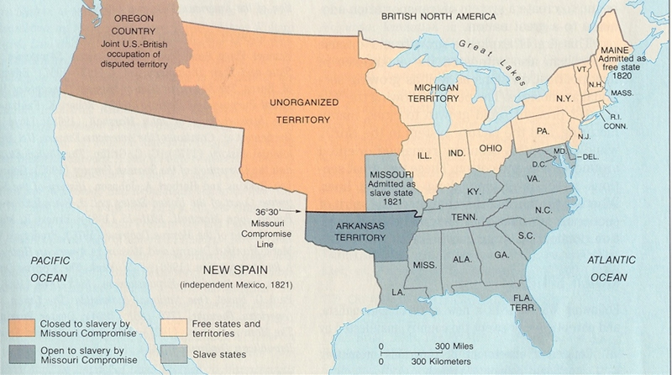

Slide 58
Federalism in the Supreme Court
McCulloch v. Maryland (1819)
The National Bank is constitutional and not subject to state taxes.
Cohens v. Virginia (1821)
State laws may not oppose federal laws.
Gibbons v. Ogden (1824)
Congress controls interstate trade.

Slide 59
Foreign Policy
Anglo-American Convention (1818): created the modern Canadian border and established joint settlement of the Oregon Territory
General Andrew Jackson seizes Florida to drive Spain completely west of the MS River.
Many Americans argue that Jackson was in the wrong, and Florida should be returned, but Secretary of State John Quincy Adams argued that Florida should concede to the new American power.
Adams-Onis Treaty (1819): Spain gives up FL and its claims to OR to the US in exchange the US’s claims to TX.

Slide 60
Foreign Policy
Around 1822, Britain tries to make a deal with the US to renounce interest in colonizing Latin America, and defend the area against anyone who may be.
John Quincy Adams sees through this quickly: Britain was afraid US claims in Latin America would threatened British islands in the West Indies.
Monroe Doctrine (1823): a warning from the US to Europe not to further colonize or interfere in the Western Hemisphere, it keeps the US present as a police power against these actions.

Slide 61
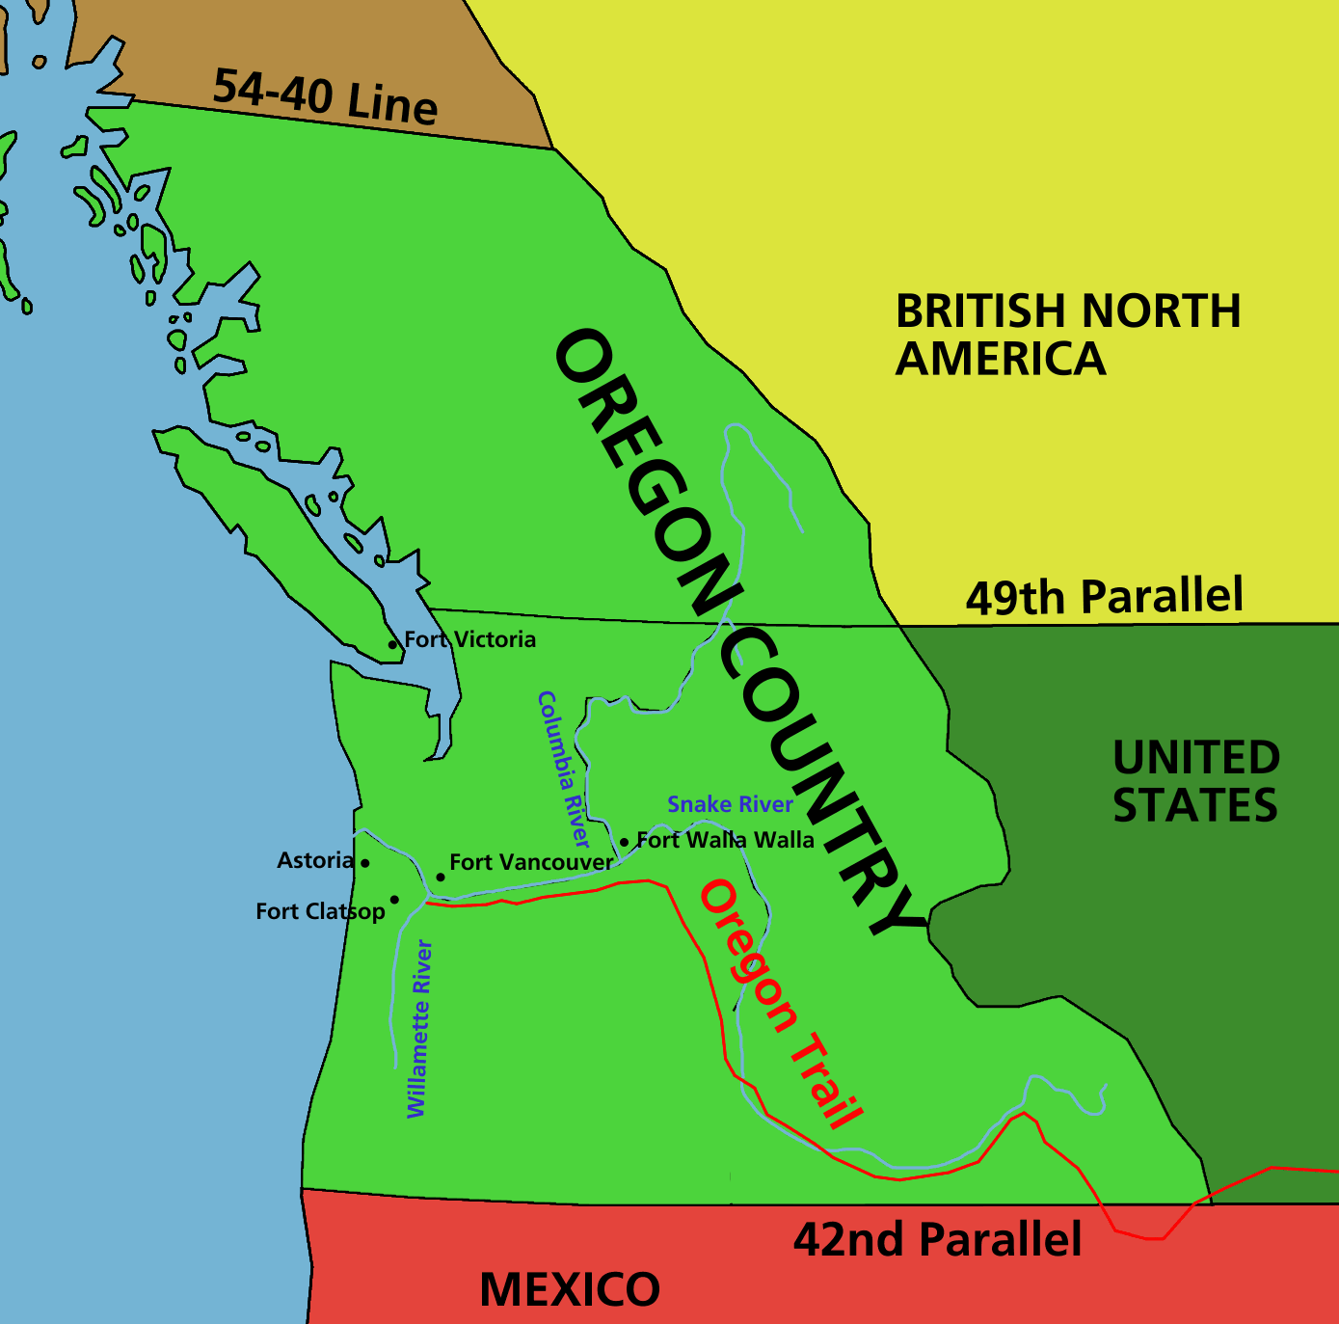
Foreign Policy
Russo-American Treaty (1824): agreement with Russia that established boundaries between Russian Territory and that of the US

