Slide 1
Chapter 13
AP US History

Slide 2
The Election of 1824
Monroe had retired.
The new candidates were: John Quincy Adams, Henry Clay, William H. Crawford, and Andrew Jackson.
No one candidate won a majority, so the election moves to the House of Representatives.

Slide 3
The Election of 1824
The choice was ultimately narrowed down to John Quincy Adams and Andrew Jackson.
The “Corrupt Bargain” of 1824: Speaker of the House Henry Clay threw his support behind Adams, who wound up winning the election, and Clay became his Secretary of State.
Jackson supporters accuse Adams and Clay of reaching some kind of deal to broker this result.
The Democratic-Republicans split into the Democrats and the National Republicans.

Slide 4
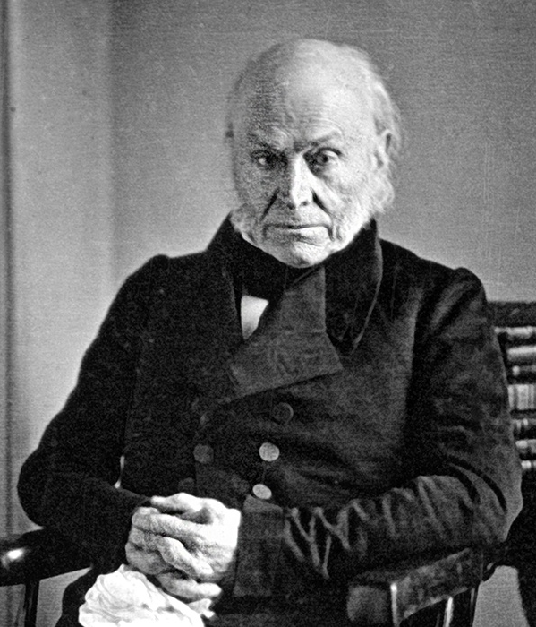
The (Second) Adams Presidency
Highly supportive of Clay’s American System.
Many of his policy proposals were defeated in Congress.
Signed the Tariff of 1828/the Tariff of Abominations.

Slide 5
The Election of 1828
Jackson wins.
The vote was largely sectional: Jackson gained most of the South and West, while Adams held the North.

Slide 6
Jackson & the Spoils System
Spoils system: the policy of rewarding political supporters with public office.
Widely employed by Jackson at the federal level, whereas previous presidents had been more merit-based.
This policy was highly criticized, though most federal offices had not been “thoroughly cleaned” since 1800.
Policy was highly abused by office-seekers, but helped solidify party loyalty.

Slide 7
The Tariff of Abominations
AKA the Tariff of 1828, raised duties on imports even more
Appreciated by the North, HATED by the South.
The North directly benefitted from them; their products and prices were protected.
The South, as consumers, were forced to pay the same high prices as everyone else.
The South also had their own goods to export, crops, which were not protected by any tariff. So while the North was being protected, the West was getting rich off land, the South was just being left behind.

Slide 8
The Tariff of Abominations
The South was also upset that slavery had become a federal issue with the MO Compromise.
The federal government was banning slavery in some places, which threatened the South and the institution of slavery.
The South Carolina Exposition voiced opposition to the Tariff in the South. It called the Tariff of 1828 unconstitutional and encouraged states to nullify it.
Nullification had first been brought up in the Virginia and Kentucky Resolutions, which called for the nullification laws passed by the Federalist government of John Adams.

Slide 9
The Nullification Crisis
1832-1833
The SC state government was gathering votes to nullify the Tariff of 1828, meanwhile the federal government passed the Tariff of 1832.
The federal government had lowered the rates with this tariff, but it failed to meet the standard of the South, and South Carolina especially still pushed for nullification.

Slide 10
The Nullification Crisis
The state election in 1832 gave SC the majority they needed for nullification, and a showdown with the federal government began.
SC declared the tariff void and said they would rather secede than pay.
In attempting to nullify a federal law, South Carolina was directly challenging the federal government’s authority.
They were challenging Congressional authority because Congress created the tariff.
They were challenging the President’s authority to enforce the tariff by stating they would not pay.
They were challenging the Supreme Court’s authority by deeming a law unconstitutional on their own.

Slide 11
The Nullification Crisis
Jackson was not the president on whom to test the idea of nullification.
He returned SC’s threat of secession by advocating for use of the military to collect tariff dues in the South.
Henry Clay stepped up to create a compromise, the Compromise Tariff of 1833, which provided a way for tariffs to drop to 1816 levels.
Passed alongside the Compromise Tariff was the Force Bill, which said the President could authorize the use of force to collect federal tariff duties in the future.

Slide 12
Jackson & Indian Removal
Jackson and the Democrats were highly committed to westward expansion. Jackson saw an opening with removing Native Americans that still resided east of the MS River.
The Supreme Court had recently ruled in favor of the Cherokee in GA, a decision which Jackson disagreed with. In a double-faced move he said Chief Justice John Marshall “had made decision, now let him enforce it” and then to the people that he felt “some obligation to rescue this ‘much injured’ race,” and proposed their emigration west.

Slide 13
Jackson & Indian Removal
Jackson provided that tribal emigration would be voluntary, but this later changed.
Indian Removal Act (1830): ordered the removal of tribes residing east of the MS River to the newly established “Indian Territory” west of AR and MO; resistant tribes would be forcibly removed by the military.
Voluntary migration became forced marches west after the Indian Removal Act. These marches became known as the Trial of Tears.

Slide 14
Jackson & Indian Removal

Slide 15
Jackson & the Banks
The National Bank held a lot of power on its own.
Its notes were more stable, it was where the federal government made deposits, and basically controlled the nation’s economy.
Like most banks at the time, it was a private institution.
Like most banks at the time, Jackson HATED it.

Slide 16
Jackson & the Banks
In 1832, Henry Clay and Daniel Webster decided to push the renewal of the National Bank’s charter through Congress, four years early.
The was a secret plan by Clay to make the Bank an election issue in 1832, as he was running for president and hoped to force Jackson’s hand on the issue.
If Jackson signed the bill, allowing for the bank’s renewal, he would alienate many of his western voters. If he vetoed it, he would alienate the wealthy bank investors.
Thus begins the Bank War.

Slide 17
Jackson & the Banks
Congress passed the bank’s renewal and Jackson vetoed it.
This had been one of the first vetoes that rested on presidential power alone, as Jackson had ignored another Supreme Court ruling by saying in his veto that the bank was unconstitutional.
Jackson’s veto “essentially argued that he was vetoing the bill because he personally found it harmful to the nation.”
This allowed the power of the president to expand, and greatly appealed to the average citizen.

Slide 18
Jackson & the Banks
Jackson won re-election in 1832, and decided that letting the National Bank’s charter was not enough.
He refused to deposit federal funds in the Bank, instead splitting it up between pet banks in various states.
The National Bank called in loans, hoping to create a financial crisis and bring the government back to its side. This instead caused banks across the country to close, and a greater loss of support for the National Bank.
Temporary of “wildcat” banks began appearing in the West to fill the void, and helped to flood the country with unreliable paper currency.

Slide 19
Jackson & the Banks
Specie Circular (1836): US Treasury decree requiring all public lands be purchased with metallic currency.
This quickly curbed land speculation in the West brought on by wildcat banks.

Slide 20
The Election of 1836
Jackson wants to retire, but he doesn’t want to give up control. His best option is to pick someone that would easily follow his orders.
That person is Martin Van Buren.
Because he is advertised as Jackson’s protégé by the Democrats, he easily wins the election.

Slide 21
The Election of 1836
Jackson’s followers are called the Democrats.
Their opposition, and everyone else who does not identify as a Democrat, are called Whigs.

Slide 22
Panic of 1837
The real effects of the National Bank closing.
Caused by:
Elevated wheat prices
Continued land speculation in the West
Speculation over slaves, roads and canals
Wildcat banks
Unstable banks in Britain that began to call in loans owed by Americans

Slide 23
Panic of 1837
Many banks in the US closed, including a number of Jackson’s pet banks.
Land sales dropped, factories closed, and unemployment rose.
Van Buren’s solution was the “Divorce Bill”.
Passed in 1840 as the Independent Treasury Bill, it separated the government’s money from the banking system. The law struggled to survive and was repealed years later.

Slide 24
Texas
Mexico won its independence in 1821, and continued plans for the settlement its most northern region, Texas.
A deal was made with Stephen Austin, who promised to bring Catholic families to the area who would then become Mexican citizens.
Austin ignored all of these stipulations, but still brought settlers into the area.

Slide 25
Texas
Conflict grew between the Texas settlers and the Mexican government over several issues including racism, slavery, immigration, and the settlers’ loyalty to the American government.
Texas declared their own independence in 1835, and Mexico raised an army against them. Texas placed their own forces in the hands of Sam Houston.

Slide 26
Texas
Mexico won victories in at the Alamo and Goliad, but in doing so supercharged the Texan cause.
The Texans won a decisive battle at San Jacinto, which forced a treaty that granted Texas its independence.
Though they had petitioned for annexation to become part of the US, Texas only received recognition from the US.

Slide 27
The Election of 1840
Whig candidate William Henry Harrison won. Harrison and his VP, John Tyler, were enemy-less candidates who could carry more votes than Clay and Webster, and were easily more well-liked than Van Buren.

