Slide 1
Unit 2: Building a New Nation
Chapters 7 and 8

Slide 2
The Proclamation of 1763
Britain had to protect its new lands gained from the French and Indian War.
Step 1: The Proclamation of 1763
Step 2: Station troops in the colonies
Step 3: Answer this big question—How are we going to pay for all this?
If this is being done for the colonies, they should share in the cost.
This means that new policies will be created.

Slide 3
Colonial Cautiousness
“This change in British colonial policy reinforced an emerging sense of American political identity,” as the distance between Britain and America had allowed for the permeation of new ideas.
Republicanism: government comes from the people so hierarchy is nothing.
Look out for corruption: this warning brought to you by the radical Whigs.
The colonies were largely self-reliant, so the new string of policies from Britain seemed like too much all at once.

Slide 4
Reinforcing Mercantilism
Greater enforcement of the Navigation Laws
The Royal veto
Banning colonial currencies
But is this really something the colonies should be upset over?
Colonial monopolies over tobacco and ship building.
Easy access to trade, or smuggling, whichever.
Easily upheld the colonial economy.

Slide 5
Reinforcing Mercantilism
So why were they upset?
They could only trade with Britain for British goods from various parts of the British Empire.
Not to mention that Britain is the main one profiting.
Colonial economic independence was not possible.

Slide 6
War Debts
Policies created to reinforce mercantilism AND pay off war debts:
Sugar Act (1764): increase tax on sugar from the West Indies.
Quartering Act (1765): required colonists to house and care for British troops at their own expense.
Stamp Act (1765): all paper must be stamped to show tax paid.

Slide 7
War Debts
These weren’t new policies to Britain; they were simply extended existing policies to the colonies.
Colonists perceived these to be targeted strikes against colonial self-government.
Most colonies had created taxes on their own.
Failure to adhere to these new policies resulted in a jury-less trial in an admiralty court.

Slide 8
Colonial Retaliation, part 1
Stamp Act Congress (1765)
Sent a list of complaints to the King and Parliament.
Took a step toward colonial unity by bringing leaders together.
Instituted nonimportation agreements against British goods.
These were particularly successful since the whole point of these new policies and taxes were to make money to pay off war debts.

Slide 9
Parliament Reacts
Repeal of the Stamp Act in 1766
New policies
Declaratory Act (1766): states that Parliament is the legislative body in charge.
Townshend Acts (1767): required import tax on paint, glass, tea, some other things.
Suspension of the NY Legislature (1767): they failed to uphold the Quartering Act.

Slide 10
Colonial Retaliation, part 2
Less successful nonimportation agreements instituted.
Mainly because of the tea, even though it was smuggled in instead of bought from Britain.
Britain responded to this by stationing more troops in major port cities.
Boston Massacre (1770):
Clash between unruly Bostonians and British troops who fired into the crowd, killing/wounding 11.

Slide 11
Colonial Retaliation, part 2
Britain repealed most of the Townshend Acts, but kept a small excise tax on tea.
Colonial rage was kept flaming through letter exchanges started by the Committees of Correspondence.
Most prominent in MA, thanks to Samuel Adams.

Slide 12
Let’s Talk Tea
By 1773, it’s cheaper just to buy tea legally, with the tax.
But suddenly, the British East India Company (those who supply the tea), found themselves with too much tea.
The Company was huge, therefore its financial collapse would create even more debt for Britain, which had to be avoided.
To unburden the Company of its excess tea, it was given exclusive ownership over the American tea trade.

Slide 13
Let’s Talk Tea
The colonies protested, causing some ships to turn around instead of landing and unloading their cargoes of tea.
Supplies of tea were seized by the government in Charleston until the city had paid for them.
Ships in Boston were ordered to stay in port until they had unloaded.
Boston Tea Party (1773): colonists disguised as Native Americans dumped 342 chests of tea into Boston Harbor.

Slide 14
Let’s Talk Tea
Parliament closed Boston Harbor until they could repay the East India Company for their loss.
This effectively closed Boston from all other trade.

Slide 15
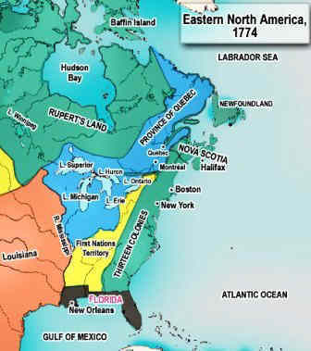
Parliament Continues…
Post-Boston Tea Party, Parliament created more new policies aimed at the colonies:
Intolerable Acts (1774): series of laws that closed Boston Harbor and further punished MA, and expanded the Quartering Act.
Quebec Act (1774): everything true about Quebec before the French and Indian War could stay in place, except the boundaries, which were extended to the Ohio River.
The French in Quebec hadn’t really planned on changing, but the original colonies felt attacked since this gave land in the Ohio Valley to essentially the French/British of Canada.
More importantly, it kept in place the arbitrary government established in Canada by the French, meaning no courts, no local assemblies, no chance at self-government.

Slide 16
The First Continental Congress
Formed in 1774 as a response to the Intolerable Acts.
A consultative body staffed by representatives from 12 of the 13 colonies, which drafted and sent letters out to the colonists, Britain, and the King.
Also established The Association to oversee complete boycotts of British goods: nonimportation, nonexportation, nonconsumption.
The last thing this Congress had on its mind was independence—don’t get ahead of yourself—they simply wanted the offensive policies repealed in favor of localized taxation.

Slide 17
The First Continental Congress
Parliament rejected the Congress’ petitions and refused to act.
The British commander in Boston sent troops to seize colonial military supplies in Lexington and Concord after seeing the colonial militia drill openly.
Both Lexington and Concord fought this advance, giving their names to the first battles of the American Revolution when this took place in 1775.
The British pushed through Lexington after a skirmish with minute men, but met greater resistance in Concord.

Slide 18
Sides of War: Britain
Pros
Cons
Large empire with England alone boasting a 3:1 population compared to the colonies.
Super wealthy.
World’s greatest navy, plus substantial well-trained land forces.
Still a fairly loyal population in the colonies.
This was a civil war.
Lots of enemies; France, Ireland.
Very disorganized government.
Troops stationed in colonies lacked supplies.
Full-scale conquering needed; mind, body, soul, with orders coming from 3000 miles away.
Geography.
Low popular support.

Slide 19
Sides of War: Colonies
Pros
Cons
Great leaders emerged.
France agreed to help.
Geography was on their side, as this was a defensive fight.
Self-sustaining agriculture.
Belief in cause.
Poorly organized in many ways.
Congress had no real power.
Colonial disunity/sectionalism.
No real military to speak of.
No money without Britain.
Low popular support.

Slide 20
The Second Continental Congress
Met after the Battles of Lexington and Concord.
Even though there is fighting going on, there is no discussion or move toward independence.
The Congress drafts and sends petitions to Britain in hopes of having their grievances addressed.
The Olive Branch Petition, 1775: professed American loyalty and hope for an end to hostilities; rejected by the King who proclaimed the colonies in open rebellion
They will also take measures to create an army and navy for defensive purposes.

Slide 21
Battles, 1775-1776
Ticonderoga, NY
Colonial win
Bunker Hill, MA
Colonial win (but with heavy losses)
Norfolk, VA
British win

Slide 22
Colonial Plans
The colonists’ main plan involved invading Canada.
This plan depended on Canada being on their side, which they were not, so this didn’t really work out.
Instead they wound up almost following the British.
North and South Carolina mainly. The colonists did manage to prevent an invasion of Charleston.

Slide 23
No Need for Independence
Even with all this fighting, there is still no outcry for independence.
Yes colonial unity was growing, but the colonists were still British at heart.
It wasn’t until Thomas Paine’s pamphlet, Common Sense, was published in 1776, that this thought started to shift.
Paine asked colonists questions that promoted independence, especially when combined with republicanism and the warnings of the radical Whigs.
He also stressed that they should fully embrace a republican form of government since it had already served them well.

Slide 24
Independence!
The motion for independence in the Second Continental Congress was made by Richard Henry Lee of Virginia on June 7, 1776.
It was not fully adopted until July 2, 1776, when a written explanation, presentable to the other American colonists and the rest of the world, was read,
This declaration of independence was formally adopted on July 4, 1776,

Slide 25
Independence!
The American Revolution was still, for the most part, a civil war based in a minority movement.
The larger part of the population was fairly uninterested. Either side could still win over the heart of the population.
The British proved they could control areas through a large military presence, which was not exactly practical or heart-warming.
Rebel militias spread revolutionary ideas better than they fought, which was useful but also not useful.

Slide 26
Independence!
American Patriots maintained a united front through persecution of Loyalists.
Loyalists were those still loyal to Great Britain.
Some worked as spies, but most just kept to themselves.
Their best option overall was to leave and some 80,000 did.

Slide 27
Battles, 1776
Long Island, NY
Battle for control of New York City. British win.
Trenton, NJ; Princeton, NJ
Colonial wins. Substantial boost for colonial morale.

Slide 28
Britain’s Plan for Invasion
Large-scale invasion of New England, that would sever the area from the rest of the colonies.
Three lines to meet and surround:
Gen. Burgoyne from Canada
Burgoyne wound up trapped by winter and Benedict Arnold’s forces.
Gen. Howe from New York
Howe took it upon himself to invade Philadelphia and got too comfortable there.
Col. St. Leger from East NY
Repeated stopped by colonial militias.

Slide 29
Britain’s Plan for Invasion
When Burgoyne was finally able to move his forces, his back-up—Gen. Howe—was stalled in Philadelphia.
Battle of Saratoga, 1777: American forces surrounded Burgoyne and forced him to surrender. This colonial win help secure support for the war from France.
MAJOR TURNING POINT IN THE WAR.

Slide 30
Support from France
Hoping to get foreign aid, the Congress drafted the Model Treaty as a guide for diplomats abroad.
Ben Franklin was sent as an emissary to France but rarely consulted the Model Treaty.
Instead he used the idea of Anglo-American reconciliation as a way to persuade France to the American cause.
France promised 3 things:
Military aid
Financial aid
Recognition of American independence

Slide 31
Support from France
Most Americans involved in the war were grateful to France for their support.
However they the French were most recognized as former enemies first, allies second.
The alliance combined with the victory at Saratoga continued to boost morale, but took a hit after Benedict Arnold was found to be a traitor.

Slide 32
The Rest of Europe’s Involvement
Spain and Holland both sided with Great Britain.
Everyone else was incredibly unnerved by the situation.
Armed neutrality: loose alliance of nonbelligerent naval powers that sought to protect neutral trading rights due to the increased British naval presence in the Atlantic.
Britain was now forced into minor naval battles that could not benefit them.
The French also reinforced their islands in the Caribbean to supply the Americans.

Slide 33
Britain’s Change in Strategy
The new plan was to start in the South, where commitment to the revolutionary cause was sketchy at best, and work north.
Georgia was easily overran.
SC surrendered in 1780.
NC and Gen. Nathanael Greene put up more of a fight against Gen. Cornwallis.
Greene and his forces would continuously force Cornwallis into battle, leaving them no time for rest. This also forced troops from GA and SC north as reinforcements.

Slide 34
The Western & Naval Fronts
Treaty of Fort Stanwix, 1784: treaty which forced the pro-British Iroquois out of the war in addition to having them cede the Ohio Valley to the Americans.
Westward expansion continued with frontier troops following to take out British outposts.
Naval beginnings
The American Navy was tiny compared to that of the British, and could hardly put up a fight.
The most prominent on the water were privateers, who attacked enemy shipping for profit more than patriotism.

Slide 35
Yorktown
Battle of Yorktown, 1781: George Washington besieged Gen. Cornwallis at Yorktown while the French naval fleet prevented reinforcements and supplies from coming ashore.
Finding himself surrounded on land and at sea, Cornwallis surrendered on October 19, 1781.
ANOTHER MAJOR TURNING POINT as this dealt a huge blow to the British war effort.
Most fighting after this, to King George’s dismay, was between Patriots and Loyalists.

Slide 36
Peace Terms
Peace conference held in Paris, 1783.
France wanted to keep promises it had made to Spain during the war, and wanted to create a weak, but independent, America that could be easily manipulated.
Americans at the conference were told to “make no separate peace,” and consult France all the way.
John Jay instead spoke directly with the British to get America the better deal.

Slide 37
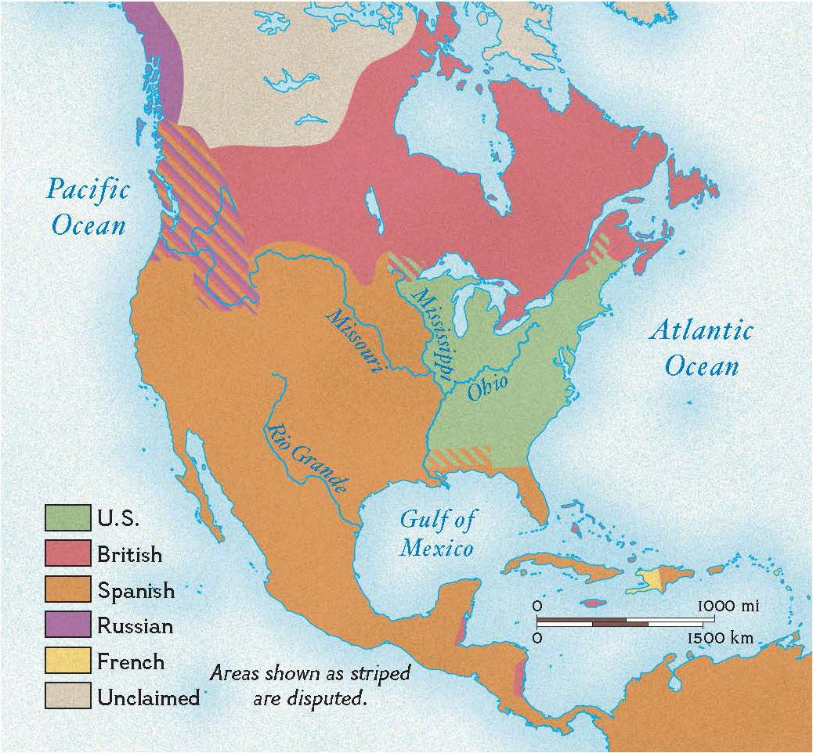
Treaty of Paris, 1783
Britain formally recognized American independence and changed the borders in North American to reflect this.
Americans promised to stop persecution of Loyalists, and allow British creditors to collect debts in America.
France agreed.

