Slide 1
Chapters 9-10

Slide 2
recap: The Revolution
The American Revolution is considered to be a conservative revolution.
Life didn’t change a lot as a direct result of the war.
States made new constitutions during the Revolution.
These often directly limited the government and spelled out rights for citizens.

Slide 3
Direct Changes
Increased American manufacturing
Initially helped with war materials, but couldn’t switch gears afterward and suffered.
Trade Imbalance
The US essentially had no one and everyone to trade with, except Britain. They were now on the other side of the Navigation Acts and saw just how powerful they were. Few countries actually wanted to trade with the US because their money was nothing.
Socio-economic hierarchy
Several groups had benefitted from playing both sides in the Revolution, giving supplies to the Americans while still adhering to trade with Britain. These people had become super rich, along with the already wealthy planters in the South.

Slide 4
The Articles of Confederation
After winning independence, the US had to create a new national government for themselves.
This was done through the first constitution, called the Articles of Confederation.
Gave large amounts of powers to the states.
Congress could do things, but only with consent from the states.
This included collecting taxes and printing money.
The Articles could not be changed unless all states agreed.

Slide 5
The Articles of Confederation
This document kept Congress weak to the point of nearly causing a financial collapse.
It could not control or force states to do anything.
Each state was printing its own money and barely making payments on debts.
States also had their own commerce rights, which meant they could charge other states on imports.

Slide 6
The Northwest Territory
The only good thing to really come from the US government as set forth by the Articles of Confederation was laws regarding the Northwest Territory.
This was land ceded to the US after the Revolution, northwest of the Ohio River, east of the MS River, and south of the Great Lakes.
The Land Ordinance of 1785 provided for the sale of this land in an orderly fashion with the money made from sales going directly to war debts.
The Northwest Ordinance created further policies for this land, including a clear path to statehood, and the prohibition of the extension of slavery into the area.
This meant that slaves who were already there were okay, but that was it, and these could not become “slave states”.

Slide 7
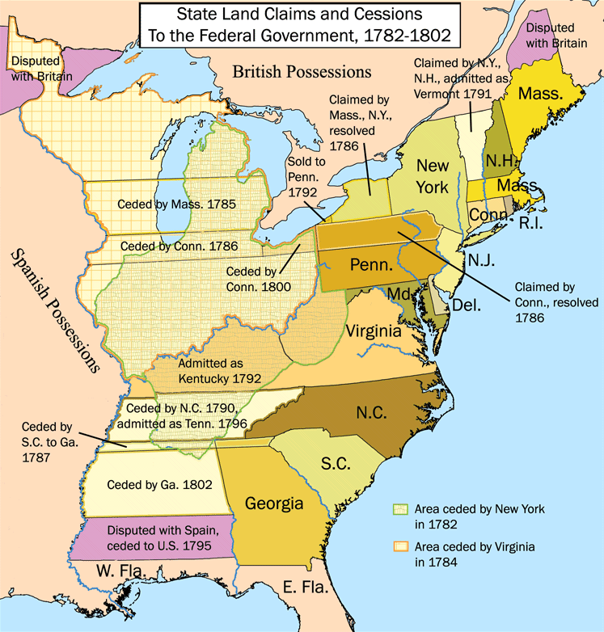

Slide 8
Shays’ Rebellion
While states bore the brunt of debts, individuals were burdened as well, with creditors coming to claim their property when they couldn’t pay.
This affected small farmers more than anyone else.
An armed uprising against this was led by Daniel Shays in 1786 in MA.
Shays, and his band of farmers and veterans, demanded credible paper money, lighter taxes, and an end to property repossession.
MA state government quickly sent in the militia, who fought Shays’ group several times before his movement disbanded.
Even with the trouble gone, MA enacted debtors relief laws to prevent it from happening again.

Slide 9
“Const-Con ‘87”
After Shays’ Rebellion, many were open to at least amending the Articles of Confederation.
Virginia called a convention of state delegates to talk about what could be done, which met in Philadelphia in 1787.
Many of the delegates agreed that the federal government needed to be stronger if the US wanted a long-lasting political system, not to mention if they every wanted to create treaties, foreign policy, and regulate international and domestic trade.
This meant that Congress would have to become stronger, and that maybe an executive office—initially shunned—could be useful, along with a court system.
Delegates found it easier at this point to get rid of the Articles and start over, thus drafting the US Constitution.

Slide 10
Compromises Reached
Connecticut Compromise: reorganized Congress after the VA and NJ plans into a bicameral legislative body.
House of Representatives has proportional representation (VA plan).
The Senate has equal representation (NJ Plan).
Three-fifths Compromise: created a method for counting slaves as part of the population for purposes of representation
Bill of Rights: listed individual rights and tested out Article V of the Constitution in order to secure ratification from Anti-Federalists.

Slide 11
Federalist vs. Anti-Federalists
Two opposing political belief systems threatened to split the Constitutional Convention.
Federalists
Anti-Federalists
Favored a strong federal government.
Argued checks and balances would preserve state and individual rights.
Expected violations of individual liberties to benefit the greater good.
Large land owners, wealthy merchants, professionals.
Washington, Franklin, Madison
Favored strong state governments.
Wanted guarantees on individual rights.
“Rule by the common man”
Generally farmers, small business owners, and laborers.
Sam Adams, Patrick Henry, Richard Henry Lee

Slide 12
The Constitution
Only needed to be ratified by 9 of 13 to take effect.
Achieved in June 1788.
Helped in its quest by “The Federalist Papers” published by Madison, John Jay, and Alexander Hamilton.

Slide 13
Social Changes
Disestablishment
Separating church and state
VA Statute for Religious Freedom: prohibited state support of a religious institution and recognized freedom of worship
Predecessor of the First Amendment’s Establishment Clause
Baby steps in equality
Anti-slavery groups begin; some states decide to outlaw slavery altogether.
The idea of “republican motherhood” stressed the role of women in passing on the ideas of democracy and civic virtue.
NJ gave women the right to vote in certain elections.

Slide 14
The Presidency
The first new office to be filled after ratification of the Constitution was that of the presidency.
George Washington was unanimously elected.
His inauguration was in April 1789. He was not particularly excited.
He created his cabinet of advisors and three executive departments:
Dept of State, Secretary TJ
Dept of Treasury, Secretary Alexander Hamilton
Dept of War, Henry Knox

Slide 15
Finishing the Constitution
Once Washington was in office as president, several other finishing touches on the Constitution were put in place.
The Bill of Rights, which includes the first Ten Amendments to the Constitution, and also picked up a new “craze” in the US, separation of church and state, through the Establishment Clause (Amend. 1).
Judiciary Act of 1789, which created the court system of the US and formally established the Supreme Court.

Slide 16
Hamilton’s Financial Plan
Step 1: Convince Congress to pay the national debt at face value, including war bonds.
Step 1a: Also tell them it’s a good idea to take on state debts too.
This would show other nations the US was serious, and attach the states to the national government through money.
Step 2: Pay off those debts through taxes.
Excise taxes and tariffs taxed domestic and imported products respectively.
Step 3: Create a national bank to keep track of it all.
It would have the ability to print money and take on deposits from the Treasury.

Slide 17
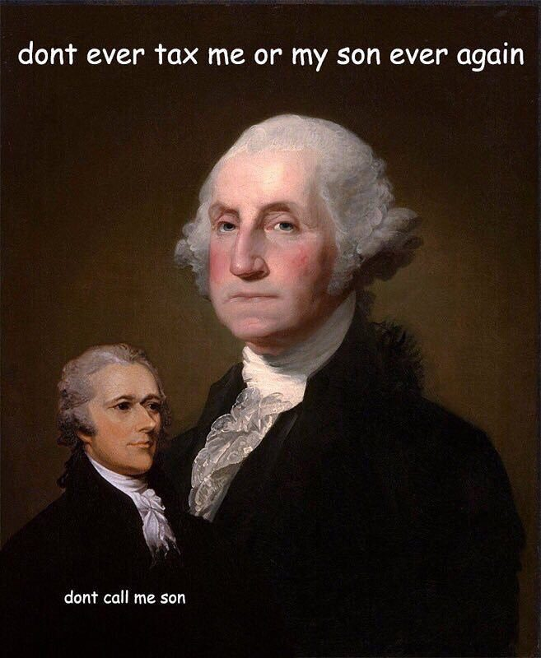
Hamilton’s financial Plan
Congress agreed to both measures, and the national debt totaled around $75M.
Excise taxes were passed in 1791, most notably on luxury products like whiskey.
The National Bank was chartered in 1791 by Congress and established in Philadelphia.
It was created under the “necessary and proper clause” (Art. I, Sect. 8, Cl. 18), even though Democratic-Republicans argued it was unconstitutional.

Slide 18
Whiskey Rebellion
1794, whiskey distillers refused to pay the excise tax on their product.
It was easier and cheaper to distill grain into alcohol and transport it far distances than it was to keep it as grain and transport it.
Their protests would eventually cause the tax to stop being collected, directly defying the new federal government.
They felt specifically targeted, like American colonists did with the Stamp Act in 1765.
Washington chooses to test his power as commander-in-chief and send the military to PA where this is taking place.
The military responded, and 13K marched to PA. No protest was found, but the power of the federal government had been secured.

Slide 19
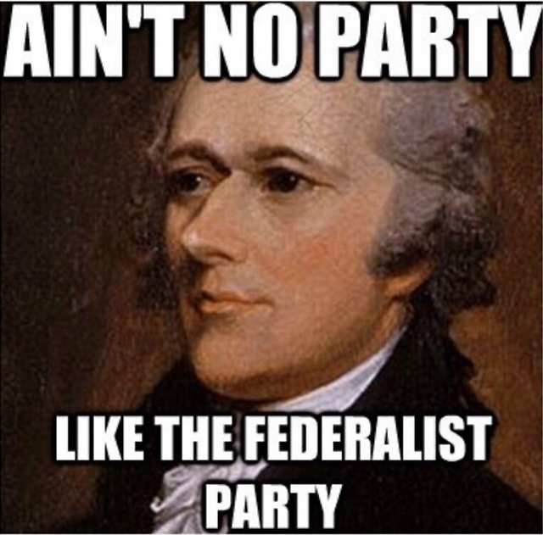
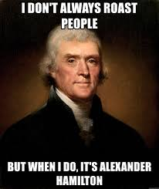
Political Parties?
Started with the Federalists and Anti-Federalists
Now we here:
Federalists, much the same as before.
Democratic-Republicans: vaguely Anti-Federalist, rallied behind TJ, would often go for a loose interpretation of the Constitution when it benefitted them.
Hamilton is very much a Federalist, TJ obviously Dem-Rep, both are in Washington’s cabinet. This was not an accident on Washington’s part. He would often have them argue so he could hear both sides of the argument to make the best decision possible.
No one will use the term “political party” or “faction” in this way, least of all Washington.

Slide 20
America & The French Revolution
A revolution began in France in 1789. This was one of the biggest non-American events to shape the early US.
Started as a peaceful reformation of government, then turned very violent, very quickly.
Both monarchs were executed, and the Reign of Terror over the new French Republic began in 1793.
Other European countries, like Britain and Austria, are getting involved. Many, namely France, is expecting the US to get involved.

Slide 21
America & the French Revolution
Instead, Washington issues the Neutrality Proclamation in 1793.
This states that the US will not become involved in the conflict, and warned Americans to not take sides in the matter either.
Reactions:
Federalists are pleased.
Dem-Reps are angry.
France is furious.
Oddly enough, Hamilton and Jefferson agree on this one; both think it’s the right thing to do.

Slide 22
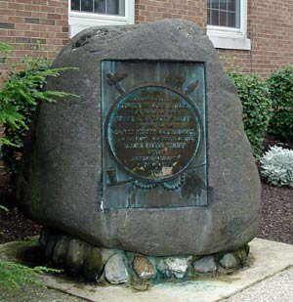
Battles in the NW Territory
Still in Canada, the British often provoked and supplied Native American attacks against the Americans in the Northwest Territory.
These direct conflicts with the Miami Confederation and indirect conflicts with the British led to some of the worst defeats in the early US.
Eventually the British turn on the Miami in 1794, allowing for an American victory.
Battle of Fallen Timbers (1794): decisive battle during which the British refused to shelter or support Native Americans, resulting in an American victory.
Treaty of Greenville (1795): made after the aforementioned battle, in which Native Americans ceded land to the Americans in exchange for money, hunting rights, and formal recognition of sovereignty.

Slide 23
Other British Things…
Impressment: the forced drafting of (neutral) American sailors into the British navy.
Jay’s Treaty (1794): negotiated to stop impressment and keep American ships neutral that didn’t work out so great; Britain promised to pay damages but only in return for American payment on pre-Revolutionary debts and restrictive trade policies toward France.
As a result:
Pickney’s Treaty (1795): signed with Spain who was afraid Britain and the US were on the fast-track to be friends again, gave US navigation rights to the MS River and (officially) the territory of Florida.

Slide 24
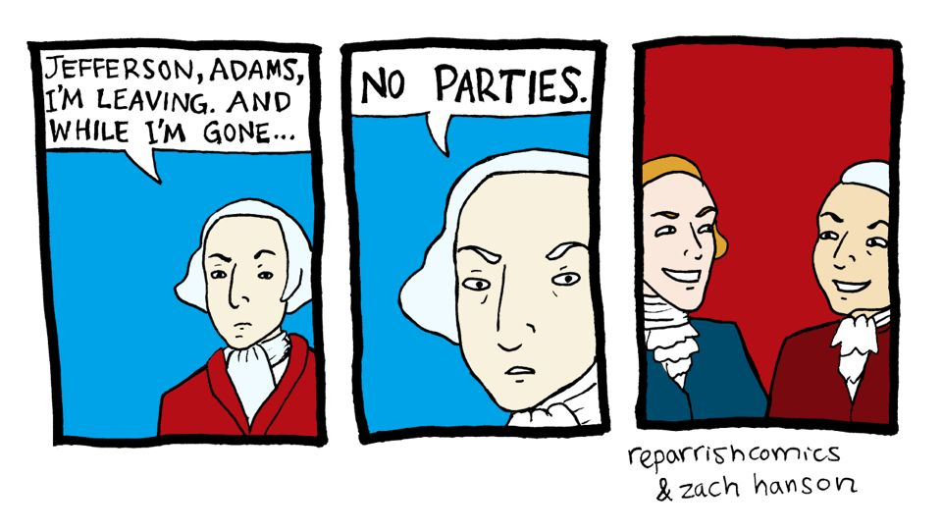
Washington Resigns
Washington resigned after his second presidential term in 1796, setting the precedent of two terms in office.
He wrote an address to the people upon his departure.
He warned them against sectionalism.
He warned them against political alliances of any kind.
With other countries? Yes, the exception would be extreme circumstances, and still only temporarily.
Political parties? Also yes.

Slide 25
Who would be next?
As per the US Constitution, Hamilton was technically ineligible.
So Federalists go with their #2 choice, John Adams.
Dem-Reps obviously pick Jefferson.
Adams is elected, 71 to 68 electoral votes.

Slide 26
Adams Presidency
Uphold the Neutrality Proclamation
The XYZ Affair: American emissaries sent to France were asked to pay a bribe by their French counterparts (known as X, Y, and Z) in order to gain audience with French Foreign Minister Talleyrand.
For some reason this shocked the US, and many called for war against France.
War was never declared, but the seas, full of American, French, and British ships are openly hostile.
This did prompt an upgrade of the US military.
Convention of 1800: Talleyrand, under the prompting of new French leader, Napoleon, agrees to meet with the US. This meeting resulted in the formal dissolution of the Franco-American alliance that had been established during the American Revolution, but still kept good terms between them.

Slide 27
Adams Presidency
Alien and Sedition Acts (1798): laws passed by Congress that raised the residency requirements for those seeking citizenship, and prohibited smack talk against the government or its work under penalty of fines and imprisonment.
The Alien Act was rarely enforced, but handed a nicely sized chunk of power to the president in the form of peace-time deportation.
The Sedition Act was largely contested, and included a clause that it would expire in 1801 so that the Federalist Congress that passed it would not get in trouble should Adams not be re-elected.
The Dem-Reps still fought back with the VA and KY Resolutions.

