Slide 1
AP Government
Unit 4: Political Institutions
Chapter 11 | 29 slides

Slide 2
Functions of Congress
Lawmaking
The process of establishing the legal rules that govern society.
Congress is responsible for make laws
Representation
The function of members of Congress as elected officials representing the views of constituents
Trustee View of Representation: legislators should acted based upon conscience and national need rather than just the views of their constituents
Instructed-delegate View of Representation: legislators should mirror the views of the majority of their constituents who elected them in the first place

Slide 3
Functions of Congress
Service to Constituents
Homestyle: actions and behaviors of a member of Congress aimed at constituents and intended to win support and trust of voters at home.
Casework: personal work for constituents by members of Congress.
Hillstyle: actions and behaviors of a member of Congress in Washington, DC, intended to promote policies and their own career aspirations.
Oversight
The process by which Congress follows up on laws it has enacted to ensure that they are being enforced and administered in the way Congress intended.

Slide 4
Functions of Congress
Public-Education
Informing the public of the multitude of viewpoints through reports, hearings, debates, and trials.
Conflict Resolution
Congress is generally the access point to government for many interest groups and others. “The puts Congress in the position of trying to resolve the differences among competing points of views by passing laws to accommodate as many interested parties as possible.”

Slide 5
Powers of Congress
Enumerated powers: a power specifically granted to the national government by the Constitution, usually done so in list form (ex: Art. I, Sect. 8).
Necessary and Proper Clause
Commerce Clause
Restriction to One Chamber
Senate: confirmations of appointments
House: tax laws must start here

Slide 6
Checks on Congress
Presidential veto
Congressional override: Congress can override a presidential veto with a 2/3 majority vote from both houses
Judicial review
The Supreme Court can declare a law or action of Congress unconstitutional.
“House Politics”
One house of Congress may choose to disagree with the other, limiting the movement of a bill.
Elections
If members of Congress exercised too much power while in office, they can be voted out.

Slide 7
Houses of Congress
The Senate
House of Representatives
100 members
6yr term; chosen from state
Fewer rules and restrictions
More debate
More prestige and media attention
More individualistic
Conducts trial of impeachment
435 members
2yr term; chosen from local districts
More rules
Less debate
Less prestige and individual notice
More partisan
May bring accusations of impeachment

Slide 8
Houses of Congress
The Senate
House of Representatives
Unanimous Consent Agreement: agreement on the rules of debate for proposed legislation in the Senate that is approved by all members
Filibuster: use of the Senate’s tradition of unlimited debate as a delaying tactic to block a bill
Cloture: 3/5 vote to stop a filibuster and limit debate to 1 hr
Rules Committee: standing committee that provides special rules under which specific bills can be debated, amended, and considered by the House.
Rule: proposal by the Rules Committee that states the conditions for debate for one piece of legislation

Slide 9
Houses of Congress
Unorthodox lawmaking: the use of out-of-the-ordinary parliamentary tactics to pass legislation in the face of strong opposition
Prestige: regard for an individual based on their position and/or status
Members of the House do not always receive the same level of prestige as their Senate counterparts due in part to the size of the House.
For a member of the House to be recognized nationally, they are usually in a position of leadership or an expert on a policy.

Slide 10
Notes on Your Own
Using pages 390-394, answer the following questions to include in your notes for this chapter. It will be helpful to copy down the questions.
Was the 2013-2015 Congress representative of the people? How do you know?
Why is the Census important to Congress?
Explain the coat-tail effect as it relates to Congress. What has it looked like recently? Why?
What is an incumbent? Why is it more beneficial to be one?

Slide 11
Congressional Apportionment
Reapportionment: the allocation of seats in the House to each state after a Census.
This is something the government does.
Redistricting: the redrawing of congressional districts within each state.
This is something the states do.
Gerrymandering: the drawing of districts within a state to favor a particular party, usually the one in power in that state, to give that party an advantage in elections.
Non-partisan districts: drawing districts that respect county lines and geography, and are more competitive.

Slide 12
Congressional Apportionment
There are two major forms of gerrymandering.
Packing: when the majority party packs the minority party into as few districts as possible.
Cracking: when the majority party splits the minority party into other districts so that minority party will remain the minority party in those districts.
Also, there is nothing that says districts have to be equal in size or a specific shape.

Slide 13
Here is our state.
R
D
D
Yes, it has a weird shape, but it’s our state and we love it anyway.
Our state has 6 districts.
Our controlling party is Republican.
The areas of large party identifiers has been noted on the map.
D
R
R
R
D
R
D
R
D
D
R
D
R

Slide 14
Congressional Perks
Franking privilege: a policy that gives members of Congress free postage and stationary.
Permanent professional staff.
The average Senate office employs around 30 people; while Representatives’ offices are limited to 18 staff.
Privileges and Immunities under the law.
Arrest Immunity Clause: immune from arrest, except for major crimes, during a session
Speech and Debate Clause: a member can make any allegations without being subject to legal action.
Congressional Caucuses: private groups based on similar political views, minority status, or constituencies within Congress that can plan and support legislation
The party caucuses are the largest and most important.

Slide 15
Committees
Committees usually have the final say on a bill, and can heavily influence floor action on a bill.
Committees are often specialized, and can draft legislation on their own or make changes to an existing bill.
They are also used to sort out bad bills.
Pigeonholing: when a bill is literally ignored to death in committee.
Discharge Petition: procedure by which a bill in the House is forced out of committee that has refused to report it for consideration by an absolute majority

Slide 16
Committees
Types of Committees
Standing: a permanent committee within either house that considers bills on a certain subject area.
Select: a temporary committee within either house that has been established for a special purpose.
Joint: a legislative committee composed of members from both houses.
Conference: a special joint committee appointed to reconcile differences when bills pass the two houses in different forms.
House Rules: gatekeeping committee in the House that decides when legislations comes before the House, the rules of debate, and the potential for amendments to a bill; this committee can also have its resolutions heard immediately and initiate legislation on its own.

Slide 17
Committees
Members for committees are selected by the Steering Committee of their party based on the seniority system.
Seniority system: custom followed in both houses specifying that the member with the longest term of continuous service will be given preference when a committee chairperson or other post is selected.
Reform in the 1970s also allowed this selection to happen through secret ballot.

Slide 18
Formal Congressional Leadership
The Senate
House of Representatives
President of the Senate: position held by the VP who presides over the Senate and only votes in case of a tie.
President Pro Tempore: temporary presiding officer who is usually the member of the majority party with longest continuously term of service.
Junior Senators will typically preside over meetings as both the aforementioned positions are largely ceremonial.
Majority Leader: chief spokesperson of the majority party in the Senate who directs the legislative program and party strategy.
Majority Whip: assistant to the majority leader who maintains communication within the party and promotes attendance
Minority Leader: chief spokesperson of the minority party who commands the minority’s opposition to the policies of the majority party and directs the legislative program and strategy of their party.
Minority Whip
Speaker of the House: the presiding officer of the House who is always a member of the majority party and is the most powerful and influential member.
Majority Leader: selected by the majority party in caucus to foster cohesion among party members and act as party spokesperson.
Majority Whip
Minority Leader: selected by the minority party in caucus to foster cohesion among party members and act as party spokesperson.
Minority Whip

Slide 19
The Legislative Process
Or, how a bill becomes a law.
Steps in the Process
Introduction of a bill
Committee Action
Floor Action
(Bill is sent to other house, steps 1-3 repeat).
Conference Action (optional)
Sent to President

Slide 20
The Legislative Process
Introduction of a Bill
A bill is introduced by name, given a number, and read.
If the bill starts in the Senate, its number begins with S. If a bill starts in the House, its number begins with HR.
All bills regarding taxes, must start in the House.
Committee Action
The bill is given to a committee (or several) for review and report outs.
These reports inform members of the house and the public of the bill’s contents.
They may also make major or minor changes to the bill.
The committee makes a recommendation on next steps.

Slide 21
The Legislative Process
Floor Action
The whole house conducts a formal vote on the bill.
While there may be some debate, the house will usually agree with the committee’s recommendation to pass or vote down the bill.
These first three steps are repeated in each house for every bill.

Slide 22
The Legislative Process
Conference Action
Completely optional, as sometimes it’s not needed.
Conference action is only needed when the houses of Congress pass different versions of the same bill.
A conference committee is then called in reconcile these differences to create one bill that is agreeable to both houses.
Both houses are required to vote again on the new bill if this step is needed. If a bill is voted down here, it dies or must start over at the beginning.

Slide 23
The Legislative Process
Finally, after being passed by both houses, the bill is sent to the president to be signed into law.
This is a check on the Congress to make sure that laws are enforceable and constitutional.
The president does not have to sign a bill into law.
Veto: president does not sign and sends bill back to Congress.
Pocket veto: president does not sign and bill dies if Congress adjourns within 10 days.

Slide 24
Congressional Decision Making
Congressional decisions are often influenced in a number of ways.
Conservative coalition: an alliance of Republicans and conservative Democrats that can form in either house to oppose liberal legislation and support conservative legislation.
Blue Dog Democrats: members of Congress from more moderate states or districts who often or are courted to vote with Republicans on legislation.
Gridlock: a situation where neither side is willing to compromise on public policy resulting in an impasse or shutdown.
Committee reports & party leadership: because it is impossible for every member to read every bill, the recommendations of committees and party leadership are the most influential factors on an individual vote.

Slide 25
Congressional Decision Making
Incentives and Political Favors: “Sometimes, leaders on either side of the aisle will offer incentives to get needed votes for the passage of legislation.”
Earmark: funding appropriations that are specifically designated for a named project in a member’s state or district.
Pork: special projects or appropriations that are intended to benefit a member’s state or district; slang term for earmarks.

Slide 26
The Budget
Congress holds the “power of the purse.”
While the president is obligated to propose a budget, it is actually Congress that has the final say.
Executive Budget: the budget prepared and submitted by the president to Congress.
This makes it easier to estimate how much money will be spent by which pieces of government in the coming year, though Congress rarely uses the president’s outline.
The government operates on a fiscal year (FY), starting in October and ending in September.
FY2020 will begin September 2019, and end October 2020.

Slide 27
The Budget
Office of Budget and Management (Executive Branch): prepares the budget proposal after contacting the various executive departments, looks at budget requests, and monitors federal agencies throughout the year.
Spring review: the annual process in which the OMB requires federal agencies to review their activities and submit the requests for the next year.
Fall review: the annual process in which the OMB reviews requests obtained in the spring, makes changes, and submits recommendations to the president.

Slide 28
The Budget
The president presents the executive budget in the January before the start of the next FY.
Congress then takes over, submitting the first budget resolution in May, which sets the overall revenue and spending goals for the FY.
Committees review appropriations bills for departmental budgets, which must be passed before authorization for the budgets and funds can be distributed.
Continuing Resolution: temporary funding passed when an appropriations bill has not been passed by the start of the FY.
The second budget resolution, which sets limits on taxing and spending for the FY, is passed in September.

Slide 29
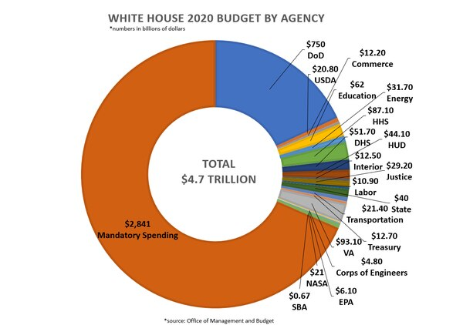
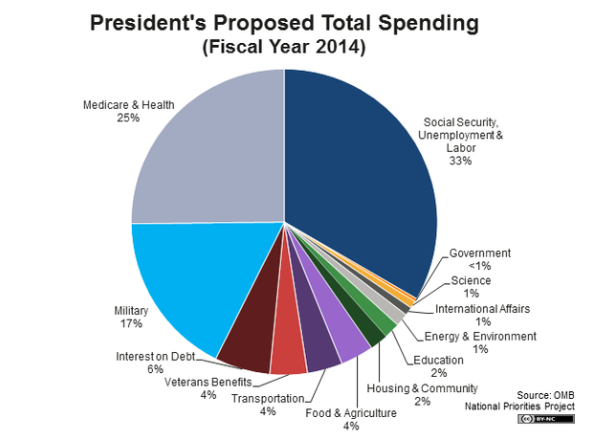

Slide 30
