Slide 1
Chapter 22
APUSH

Slide 2
The Concerns Of Reconstruction
How would the South be rebuilt?
Who would oversee this process?
The States?
The President?
The Congress?
How was the South to be reintegrated with the other states?
How would newly-liberated African-Americans fare in all this?

Slide 3
Freedmen
African-American communities grew rapidly.
Legalized “slave marriages” characterized the importance of the family unit.
Built churches and schools as to have their own ministers and teachers, as well as promote a greater sense of learning.
After emancipation had been forced on the South, many African-Americans took to the road, for various reasons.
Exodusters: African-Americans who moved west to become farmers
Many more went searching for long-lost family.

Slide 4
Freedmen’s Bureau
Created to aid African-American communities by supplying food, medical care, education, legal support, and more.
Went corrupt quickly; forcing many to sign unfair labor contracts and keeping/selling seized Confederate land for personal gain rather than handing it over to former slaves as was intended.
Later replaced by the more effective Union League, which provided education about civic life and defended the interests of African-Americans.

Slide 5
Discrimination
Black Codes: laws passed in the South to restrict the rights of African-Americans with particular respect to labor contracts, property, and related negotiations.
Ku Klux Klan used terrorism and intimidation techniques to prevent African-Americans from voting and/or acting in their best interests.
Both would persist throughout the remainder of the 19th and well-into the 20th Centuries.
While most discriminatory laws have been abolished, the KKK is still active.

Slide 6
President vs. Congress
Johnson adopted much of Lincoln’s plans for Reconstruction.
The “Ten Percent” Plan required only 10% of voters to pledge allegiance to the US and uphold emancipation before that state could rejoin the Union.
Congress felt this was too lenient and passed the Wade-Davis Bill, which would increase the percentage to 50% and create stronger guarantees of emancipation.
Johnson was from TN and had resented the South for secession, but had also misled Congress into thinking he would want to punish the South as they did. Johnson’s plan for Reconstruction would remain in place from 1865 to 1866, when Congress took matters into their own hands.

Slide 7
Congressional Thinking
Congress was largely Republican and had not faced much resistance during the war or the early Johnson administration.
They passed Pacific Railroad Act, Homestead Act, and other laws that explicitly benefitted the North.
Their ideas for Reconstruction showed a division within the Republicans though.
Moderate Republicans favored some aspects of states’ rights and self-government.
Radical Republicans favored greater punishment for the South, starting with a complete dismantling of its social structure and ending with it guaranteeing emancipation.
Their plans for Reconstruction would struggle to incorporate all of these ideas.

Slide 8
Congressional Reconstruction
Civil Rights Bill: passed in 1866 over a veto from Johnson to attack Black Codes and provide African-Americans with citizenship.
Reconstruction Act: passed in 1867, it effectively placed Reconstruction in the hands of Congress.
Divided the South into five military districts to be controlled by Union generals and filled with soldiers.
Disenfranchised former Confederates.
Required former Confederate states to ratify the 13th and 14th Amendments and write state constitutions that upheld both before being granted readmission to the Union.

Slide 9
Congressional Reconstruction
The Reconstruction-era Amendments
13th Amendment (1865): prohibits slavery (except as punishment for a crime).
14th Amendment (1868): extended civil rights to freedmen and provided that such rights could not be taken away without following due process of law.
Also provided that those who had “engaged in insurrection or rebellion” against the US could not hold public office.
15th Amendment (1870): prohibits states from denying the right to vote based on race.

Slide 10
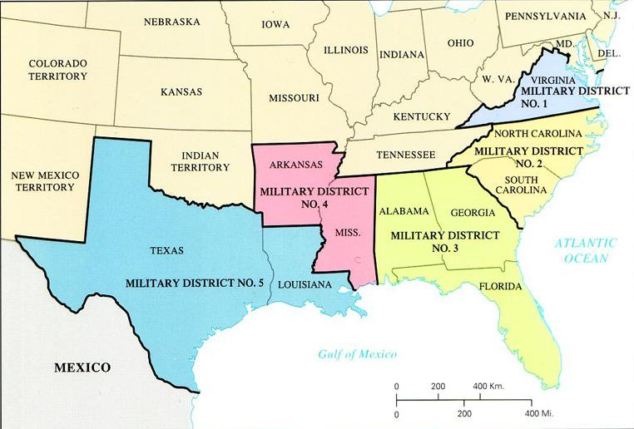
Congressional Reconstruction

Slide 11
Congressional Reconstruction
New governments were established in the South.
These governments were largely Republican and included some of the first elected African-American politicians.
Many much-needed reforms were passed by these governments included infrastructure reforms, the establishment of adequate school systems, and property rights for women.
These had to be put in place and “well-established” before the military zone would close. However, upon the departure of the military, many of these governments would revert to home-rule under Redeemers (Southern Democrats).

Slide 12
Congressional Reconstruction
Other laws:
Force Acts (1870-1871): prohibited membership in groups like the KKK, the use of intimidation to keep African-Americans from voting, and gave authority to the military to enforce these laws.
Tenure of Office Act (1867): a president must seek approval from the Senate to remove an appointed official since the Senate had to approve that appointment in the first place.

Slide 13
The Bitter South
Redeemers took back most governments, but kept a lot of the reforms, leading to a more solid Democratic South.
The South also had the prospect of greater representation in Congress with the removal of the Three-Fifths Clause.
Insulting terms given to Northerners and pro-Unionists.
Scalawags and carpetbaggers were seen as threats to the South as they were typically from the North and/or “in collusion” with the Republican governments.
Upped voter requirements in order to go around the 15th Amendment.
Literacy tests, grandfather clause, poll taxes.

Slide 14
The Impeachment of Johnson
House brought accusations after Johnson dismissed his Secretary of War, violating the Tenure of Office Act.
Johnson said that he wanted to test the act by sending it to the Supreme Court to determine its constitutionality.
The House said this action fell under the “other high crimes and misdemeanors” portion of impeachment, on top of how rude he had been to Congress over the years.
Senate failed to convict.
The House failed to build a compelling case for the president’s removal from office, and so the Senate vote came up seven votes short.

Slide 15
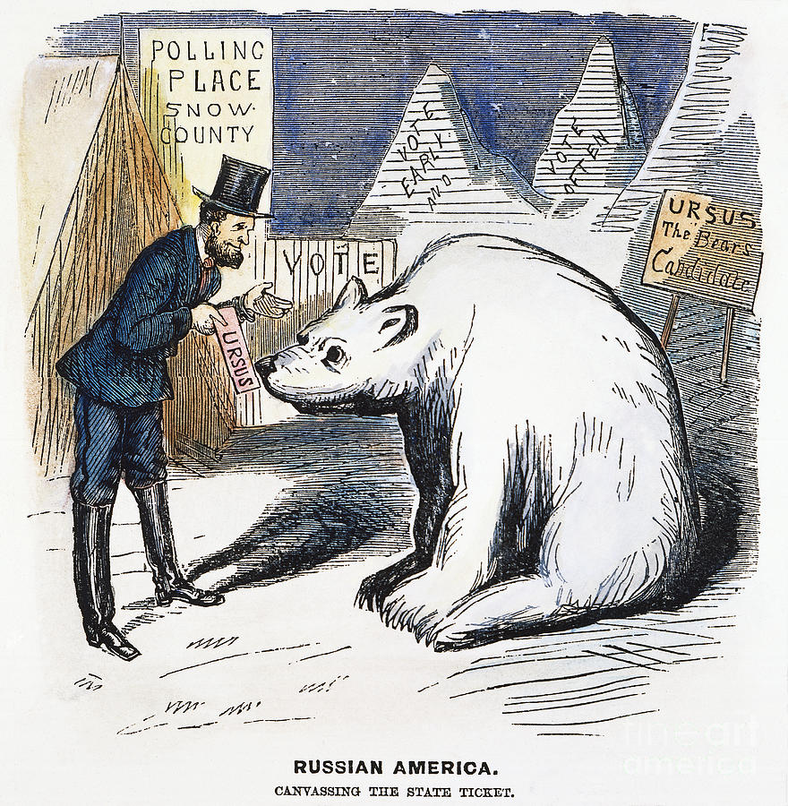
Alaska
Purchased from Russia in 1867 for $7.2 million.
Also known as Seward’s Folly.

