Slide 1
Chapter 24:
Industry Comes of Age
By: Alexis E., Shauna T., Quentin R., and Celine N.

Slide 2
Chapter 24:
Industry Comes of Age
By: Alexis E., Shauna T., Quentin R., and Celine N.

Slide 3
The Iron Colt becomes an Iron Horse
The construction of railroads was a very critical asset to the development of the nation and promised greater national unity and economic growth to the U.S.
Although transcontinental railroad building was very expensive and risky, the railroads had rounded up more land with their further development throughout the U.S
The laying of railroads began in earnest after the Civil War ended in 1865.
The building of the transcontinental railroad was set up in terms of a competition.
The Union Pacific had built 1,086 miles of railway westward, while the Central Pacific had built 689 miles eastward and they had met in Promontory, Utah on May 10, 1869.
Completion of the transcontinental line was one of America’s most impressive peacetime undertakings.
It welded the West Coast more firmly to the Union and facilitated a flourishing trade with Asia.
Spanning the Continent with Rails

Slide 4
Railroad Consolidation and Mechanization
The success of the western lines was facilitated by welding together and expanding the older eastern networks, like the New York Central railroad.
There were two new significant improvements to the railroads:
Steel rails, which Cornelius Vanderbilt helped popularize when he replaced the iron rails with steel. Steel was safer and more economical because it could handle more loads.
Standard gauge of track width came into use because it eliminated the expense and inconvenience of numerous changes from one line to another.
The railroads emerged as the nation’s biggest business, employing more people than any other industry.
It also helped cities figure out their time and created time zones to clear confusions.
On November 18, 1883, the major rail lines decreed that the continent would be divided into 4 times zones.
The railroad also created a raw new aristocracy, known as the “lords of the rail”
Revolution by Railways

Slide 5
Wrongdoing in Railroading
Railroaders inflated their claims about a given line’s assets and profitability, bribed people, and competed amongst themselves.
Wabash, ST. Louis & Pacific Railroad Company v. Illinois (1886) decided that individual states had no power in regulating interstate commerce.
Interstate Commerce Act (1887) compelled railroads to publish standard rates and prohibit rebates and pools.
Didn’t revolutionize anything
Government Bridles the Iron Horse

Slide 6
Miracles of Mechanization
The size of the American market encouraged others to invent mass production methods.
Those who made new things for a good price in large quantities and could market it, thrived.
Between 1860 and 1880 two of the most famous inventions were the telephone, invented by Alexander Graham Bell in 1876 and the lightbulb, invented by Thomas Alva Edison in 1879.
Trust Titan Emerges
Trust: one company grants control of its operations to another company.
Three of the most well known people to use trust were Andrew Carnegie, John D. Rockefeller, and J. Pierpont Morgan.

Slide 7
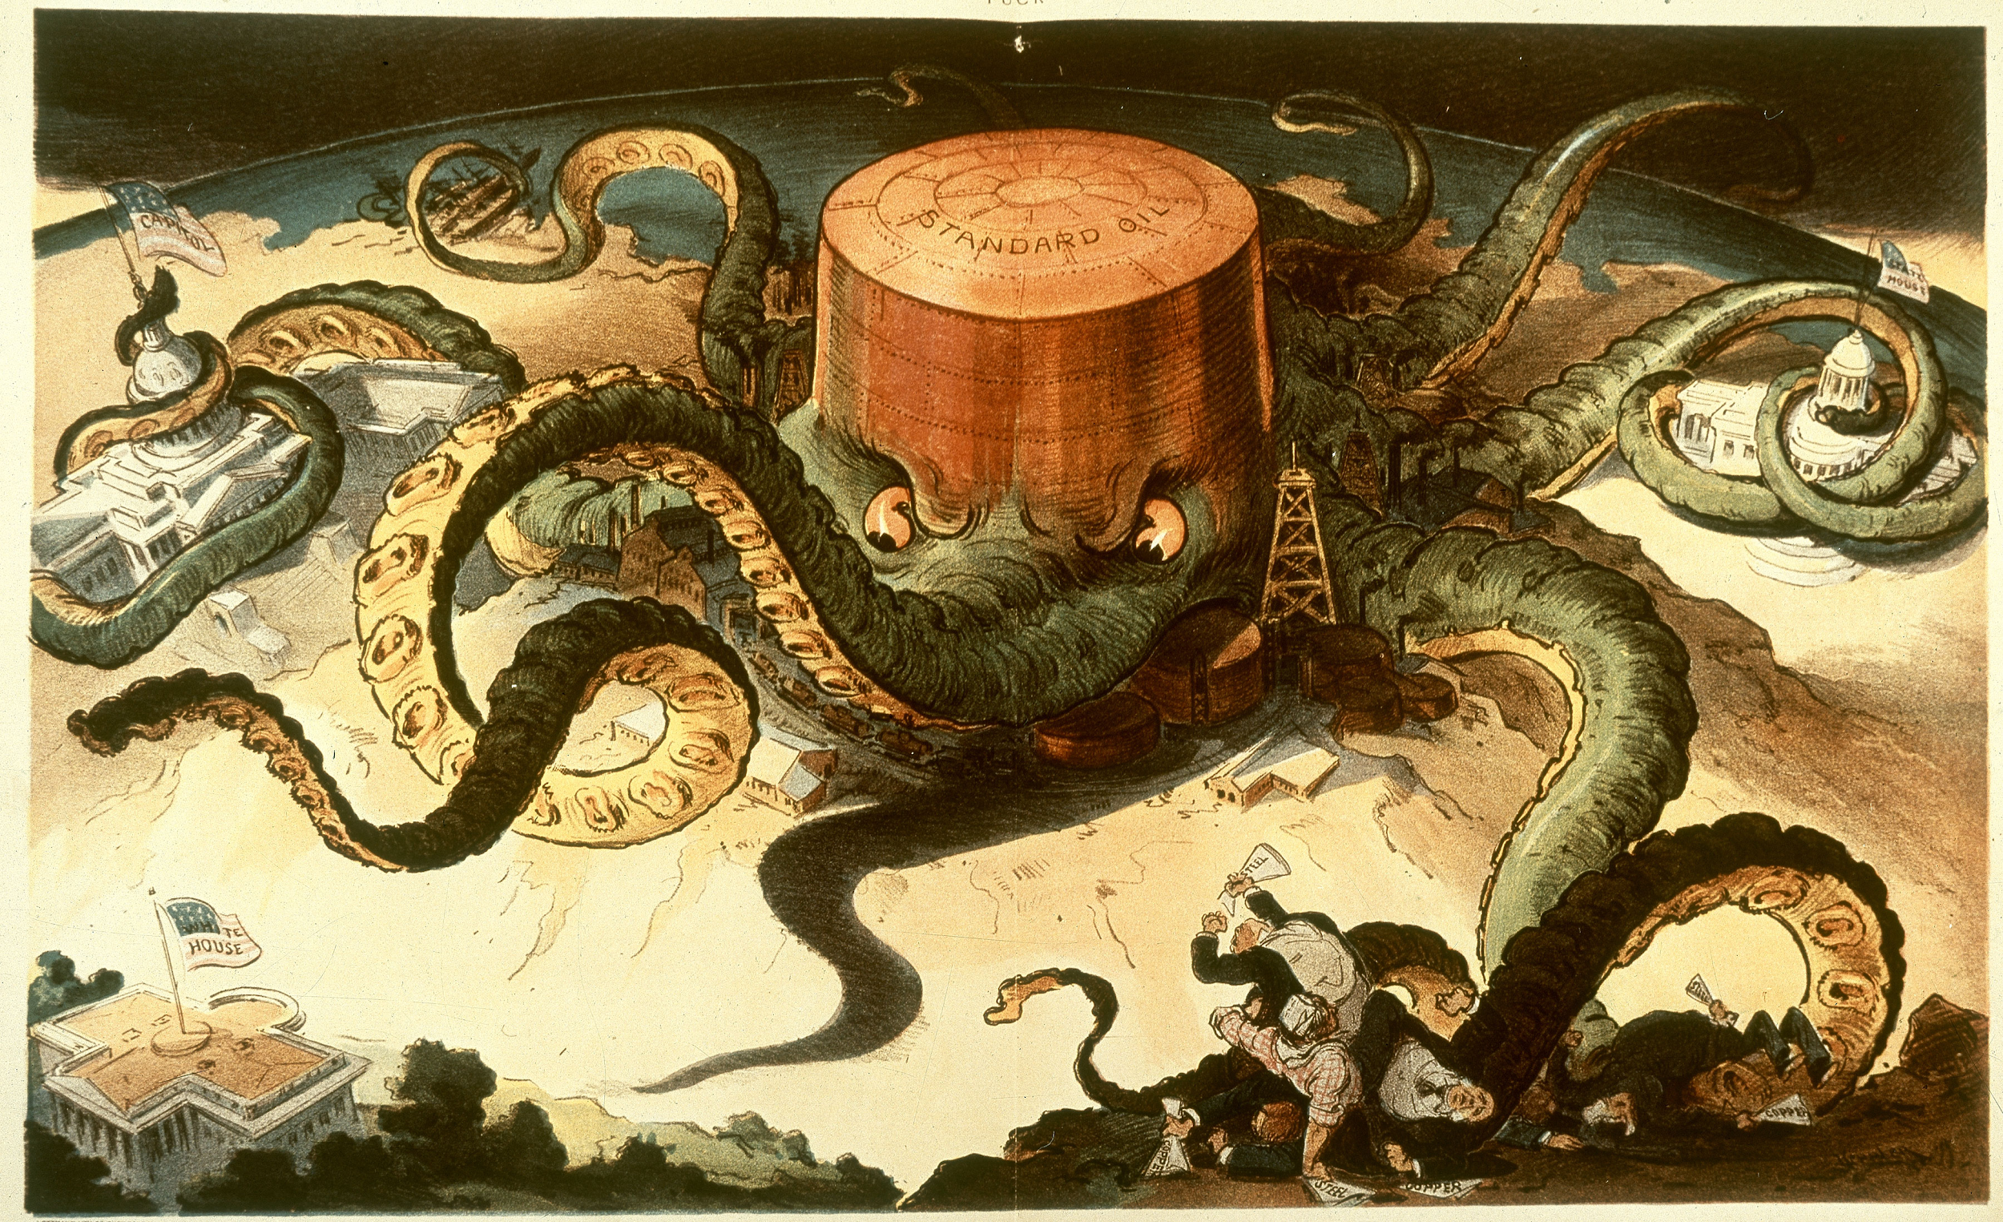
Trust Titan Emerges
Rockefeller's Standard Oil Company grew to dominate competition by using trust.
Supremacy of Steel
During this time steel was scarce
Despite this America grew to one highest suppliers of steel
Bessemer-Kelly process which made making steel cheaper.

Slide 8
Carnegie and Other Sultans of Steel
Andrew Carnegie scaled high in success fast
Got into steel business in the Pittsburgh Area
He then sold Carnegie for over $40 million to Morgan
For the rest of his life he gave money away to libraries, pension for professors,, and other purposes, by the end of his life he still had $350 million left.
Morgan launched the enlarged United States Steel Corporation for $1.4 billion
Carnegie became the first billion-dollar corporation in America
Rockefeller Grows an American Beauty Rose
John D. Rockfeller became the most successful businessman by 19yrs old. He was also known to show no mercy.
1870, he organized the Standard Oil Company of Ohio
By 1877, he controlled 95% of all the oil refineries in the country

Slide 9
The Gospel of Wealth, Government Tackles the Trust Evil, and The South in the Age of Industry
Social Darwinists, theorists argued that individuals won by their stations in life by competing with their natural talents.
This lead to showing how the people in power or the right to dominate were often determined or defined by race.
The 14th amendment gave Congress a sole jurisdiction over interstate commerce
Was used to control the state legislature
Giant trusts also hide behind the 14th amendment
Sherman Anti-Trust Act was signed as a law in 1890
It forbade mixture in restraint trade
Was used to curve labor unions that were deemed to be restraining trade
Was not successful
James Buchanan Duke took advantage of the new technology to produce the Coffin Nails
South trys to industrials

Slide 10
The Impact of the New Industrial Revolution of America.
The standard of living in America rose sharply.
Urban centers was the spot and as the insatiable factories demanded more American labor, immigrants started to swarm in like Navajos on the first. (Except for they’re not aiming for food, rather they are running for jobs.)
The “Gibson Girl,” a magazine image of an independent and athletic “new woman” was created in the 1890s by Charles Dana Gibson.
For middle-class women, careers often meant delayed marriages and smaller families.
However, most women workers never worked hard for independence or even glamour but out of economic necessity.
Insatiable-

Slide 11
In Union There is Strength.
New machines displaced employees, and though in the long run more jobs were created rather than destroyed, in the short run the manual worker was often hit hard.
During 1880s and 1890s several hundred thousand unskilled workers poured into the country from Europe, creating a labor market more favourable to the boss than the worker.
The National Labor Union organized in 1866, and by 1872 there was several hundred thousand organized workers and thirty-two national unions, representing such crafts as bricklayers, typesetters, and shoemakers.
The Union lasted six years and attracted the impressive total of some 600,000 members, including the skilled, unskilled, farmers, and it excluded Chinese and made efforts to include blacks and women.

