Slide 1
Chapter 26:The great west and the agricultural revolution 1865-1896
jewels bahe, autumn James, Janel lamasery, shya Livingston, Philip ilagan

Slide 2
The Clash of Cultures on the plains and Receding Native population
In 1860, approximately 360000 Native Americans populated the grasslands on the trans Missouri west
Trans Missouri west: North western America: MT,WY,ND,SD,ID, and NE
These Natives Americans stood in the way of white pioneers causing a clash between the two cultures demanding migration and conflict
The Indian wars of 1860-1890 caused thousands of refusing Native American to die in the fight for land and against reservations

Slide 3
The end of the trail.
White humanitarians such as Christian reformers pushed to convert and persuade the native Americans to “walk on the white man’s road” even if it meant resulting in forced containment and brutal punishment
These conflicts led to major events ending in the decli9ne of native populations.
At the battle of wounded knee (1890) an estimated 200 Indian men, women, and children were killed as opposed to 29 invading soldiers.
As a final result The Dawes severalty act was created to enforce the policies that stead Indians should behave themselves as good white settlers, and will receive their full title to their holdings as well as citizenship until 1924.

Slide 4
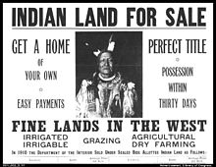
Dawes Severalty act (1887)
Authorized the president of the us to survey native American tribal land and divide it it into allotments ( land deeded by the government to a native American Indian; part of the division of tribally held land
Those who accepted, lived separately from the tribe was granted united states citizenship, only if they behaved as “good white settlers”
Wiped out if tribal ownership of land and set up individual Indian family heads with 160 free acres.
Full citizenship wasn’t granted to all Indians until 1924
Reservation was not allotted to the Indians under the act, was sold to railroads and white settler.
Federal governments duty to “civilize” Natives
1879; Carlisle Indian school was funded
Motto: “kill the Indian, save the man”( General henry Pratt)
By 1900 Indians lost 50% of 156 millions acres ( they had from 2 decades earlier)
Indian reorganization act(“Indian now deal”) 1934
Belatedly tried to restore the tribal basis of Indian life
Indian population slowly increased
The total number had been reduced by 1887 to about 243000 (from bullets, bottles, bacteria) when in 2000 census counted more than 1.5 million

Slide 5
Mining from dishpan to ore breaker
Gold discovered in CA in the late 1840s
In 1858, Gold discovered at “pikes peak” in Colorado
The fifty-Niners traveled there but later the gold was gone because “there were more miners than minerals”
Gold found in Nevada
In Corn stock lode during 1859
Move than $340 million of gold and silver mined
Smaller “lucky strikes” drew fantastic gold and silver and silver seekers into Montana, Idaho and other western states
The “mining industry”: once loose surface gold was gobbled up, one breaking machinery was imported to smash the gold bearing quartz
Operation+ so expensive, undertaken by corporations of wealthy stockholders, so this became a big business.
Beef bonanzas and the long drive
Civil war ended, 7 million long horned cattle were in Texas
“Long Drive”
Texas lowboys, black, white and Mexicans drove herds from 1000 to 10000
Cattle ranchers had to get their cattle to railroads that were sometimes hundreds of miles from cattle ranches
Homestead act (1862) : allowed a settle to acquire as much as 160 acres of land by living on it for 5 years, improving it and paying nominal (small) fee of about $30
Turned to be a hoax, proved pitifully inadequate on rain scarce plains
In devastating drought farmers used “dry farming ( contributed to the “Dust bow” decades later)

Slide 6
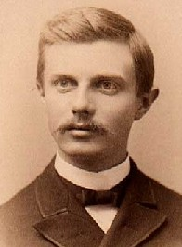
The far west
Migration increased rapidly in the 1870-1890
Republican congress(1889-1890) admitted six new states into the union
North Dakota, South Dakota, Montana, Washington, Idaho, Wyoming.
Mormon church banned polygamy in 1890 was deemed worthy In 1896
Polygamy- practice or custom of having more than one wife or husband at the same time
Oklahoma, NM, AZ remained lifted into statehood from contiguous territory on mainland of north America
The federal government gave plains of land in Oklahoma to settlers, but many “sooners” illegally entered the Oklahoma territory and had to be evicted repeatedly by federal troops.
By the end of 1889, congress made Oklahoma a territory, containing 60000 inhabitants( also known as the “sooner state”,1907)
The Fading Frontier
1890- superintendent of the census announced there will no longer be a frontier line( which meant unsettled area were broken into by isolated bodies of American settlements)
Fredrick Jackson Turner
Wrote “the significance of the frontier in American history, one of the most influential essays written in American history inspired by the “closing” of the frontier

Slide 7
Fading frontier
The secretary proposed in 1827, it would take 500 years to fill the entire west but the nation even had to preserve land for national parks by the nineteenth century (Yellowstone 1872; Yosemite I sequota1890)
Safety value theory: when times got rough, the unemployed would move west.
Trans-Mississippi west: Last chapter to colonizing American wests
Indigenous people struggled the most here
New writers, such as Mark twain and Helen Hunt, and painters George Catiline and Albert Brestad painted the seeds for American civilization
The great frontier
American pioneers who moved westward (1800s) who took land from indigenous peoples and created their ways of life geographically
Many other places in the world near and far had some of the same issues happening in America, such as frontier lines, Russia and Argentina fell into a political pit (1800s), and many native people were robbed by the superior groups who took their lands

Slide 8
Deflation dooms the debtor
Farmers who stayed to one crop began to fail the same as southern growers
In the 1880s, bankruptcy fell like a blight on farm belts.
Product was based on a world market business.
1880-1890 grain farmers began to fall due to wheat fields flourishing.
Unhappy farmers
Seemed as if mother nature conspired against agriculture.
Cotton-bowl weevil’s started wreaking havoc in the south by the early 1890s
Long successions of draughts beginning in the summer.
Land was over assessed, paid high taxes.
High protective tariffs poured profits into packets of manufacturers.
Farmer’s “farmed” by corporations and processors, they were hopelessly disorganized but they made up nearly one half of the population in 1896.

Slide 9
The farmers take their stand
In 186, the grange was organized led by Oliver H Kelly.
His objective was to enhance lives of isolated farmers through social, education and fraternal activities.
Farmers found his teachings and lectures a godsend.
By 1825 it had over 800,000 members.
The grangers new goal was not only to improve self-individual improvements but improve farmers collective plight.
Prelude to Populism
Striking manifestation of rural discontent came through the farmers alliance in the late 1870s
Farmers came to an alliance to break the strangling grip of the railroads and manufacturers.
Although the majority of farmers were blacks, it was still difficult for whites to work with the.
In the early 1890s, a new political party formed which was called the peoples party
Better known as populists
Frustrated farmers who attacked wall street and “money trust”
They were not going away easily because they were leading violent and impassioned campaign to relieve farmers from their miseries

Slide 10
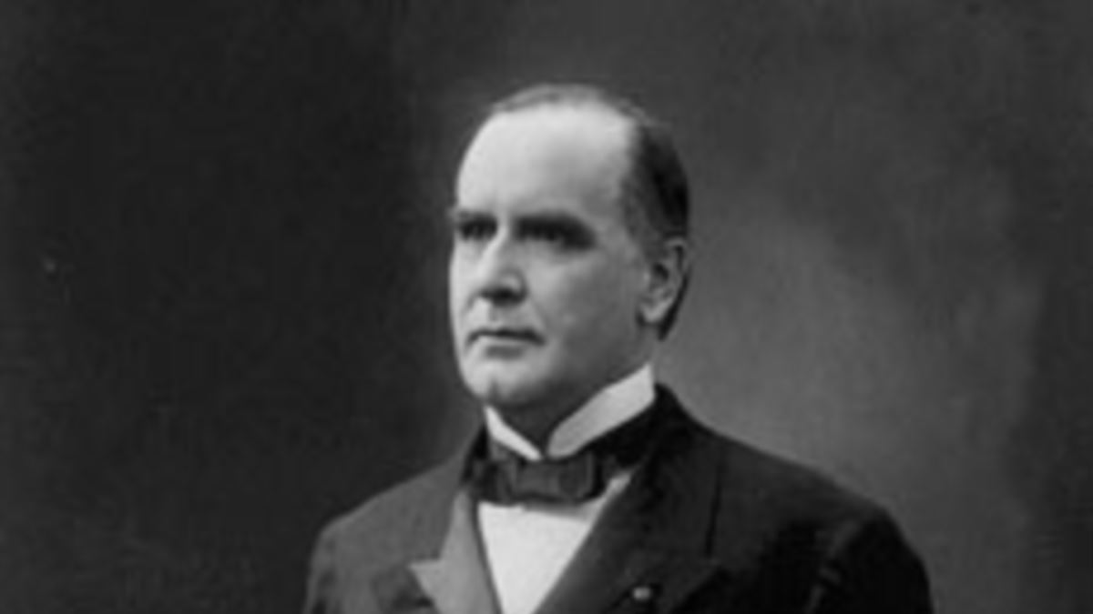
Coxey's Army and the pullman strike
Unemployed workers from the US marched in Washington DC in 1894
It is led by a famous marcher named General Jacob, Coxey
The marched was stopped and arrested by Law enforcements for trespassing a public property.
Pullman strike started when the pullman palace car company cut their wages.
American Railway Union refuse to run trains that contains pullman cars.]
Pullman strike was led by Eugene Debs that supports the strike.
Golden McKinley and silver Bryan
One issue in the election of 1896 is the nations money system.
Two candidates in the election is Republican William McKinley and Democrat Jennings debating if states should support the gold or silver currency in US.
Bryan delivered his cross gold speech which opposes the gold standard.
McKinley thinks that silver backed currency would harm the working class.

Slide 11
Class conflict plow holders versus bondholders
Bryan created panic among eastern conservatives with his threat of converting their holdings giving McKinley the advantage in the election
McKinley won the presidential election and opened the era of dominance of the republican party.
The election of 1896 also ended the old third party system and began fourth party system.
Fourth party system- Era of dominance of the republican party(1896 to 1932)
Republican stand-pattism enthroned
McKinley took the inaugural oath in 1897
US representative Nelson Dingley introduced the Dingley act of 1897 which raised tariffs in US to restrained the Wilson-Gorman tariff act of 1894 . The Wilson- Gorman tariff act of 1894 slightly reduced the US tariff rates from the numbers set in the 1890 McKinley Tariff .
The republican wants credit from solving the problem in the panic of 1893.
With the return of prosperity, The money issue that had overshadowed politics since the civil war gradually faded away.
Therefore, the gold standard act of 1900 was passed that provides that the paper currency be redeemed in gold

