Slide 1
Chapter 27
APUSH

Slide 2
Review: Chapters 23-26
The end of Reconstruction brought forth the Gilded Age, with a multitude of corrupt politicians and policies like the Chinese Exclusion Act and Plessy v. Ferguson’s “separate but equal” doctrine.
The growth of industry mechanizes the US with more railroads, steel, oil, factories, and more. This has both positive effects (labor unions, improved transportation) and negative effects (trusts, monopolies, “robber barons”) on the country.
This also means that cities are growing as that’s where the jobs are. Reform movements start to improve city life and workplace conditions. “New Immigrants” from Southern and Eastern Europe pour into cities sparking new nationalist movements with the help of the “yellow press”.
The frontier is “lost” as Americans continue to fill the west and terrorize Native Americans. The Dawes Act and the mining industry work to further organize the west, while farmers fight for their rights creating the Populist movement.

Slide 3
Imperialist Beginnings
US foreign policy changed to reflect the growth the country had gone through in the post-Civil War years.
Agricultural and industrial production boomed, creating the need for new markets.
Population and wealth had grown, creating both unrest and reform.
The “yellow press” promoted overseas adventures as a new way to gain glory.
New missionaries were eager to spread their religions and American values.
Social Darwinism was accepted by politicians to mean “that the earth belonged to the strong and the fit.”

Slide 4
Imperialism
What is imperialism?
Taking over another country politically, economically, socially, and/or culturally for your own benefit.

Slide 5
European Imperialism
1880s: the partitioning of Africa
1890s: More countries begin to take advantage of China.
The US believed that to demonstrate power, they must also become involved overseas as an imperial power.
They started slow with the Big Sister Policy, aimed at Latin America and working to promote trade and expand American markets.
The US holds the world to the Monroe Doctrine, especially Britain, sparking conflict but eventually leading to reconciliation which officially made Anglo-American friendship part of each country’s foreign policy.

Slide 6
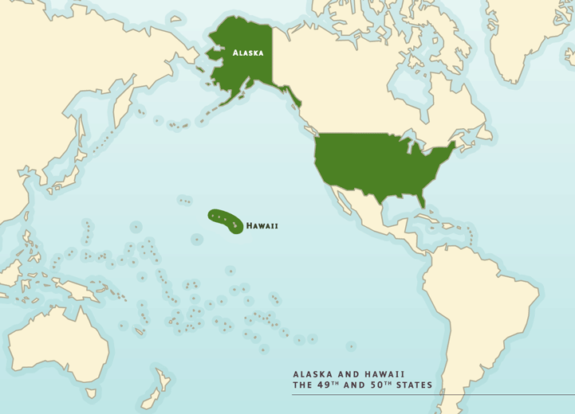
Hawaii
While missionaries and shippers began to infiltrate the islands in the 1820s, the US government didn’t begin an official stance on Hawaii until the 1840s when it formally began warning others to stay away.
1887: Native Hawaiian government allows for US naval base at Pearl Harbor.
The US was particularly fond of Hawaii because it was the perfect place to grow sugar. They felt this was the perfect reason to bring HI into the US, a plan that was foiled by the McKinley Tariff.
White plantation owners and businessmen, more specifically the Dole Company, on the island later organized a coup d'état deposing the Native Hawaiian government with the National Guard and sending word to Washington that HI had consented to be a part of the states.

Slide 7
Cuba
In the 1890s, the island of Cuba was at odds with its rulers in Spain to the point of burning their own fields to destroy the economy.
The US was sympathetic to the Cuban cause being former colonies themselves, and because they had invested some $50 million.
The Spanish stepped in to crush the rebellion in Cuba, which was quickly picked up yellow journalists who sensationalized what was happening, pushing America to join Cuba’s fight.
Yellow journalists like Hearst and Pulitzer published made-up atrocities and fabricated pictures to stir up the public.
The de Lome Letter: letter written by the Spanish ambassador to the US back to Spain criticizing President McKinley.

Slide 8
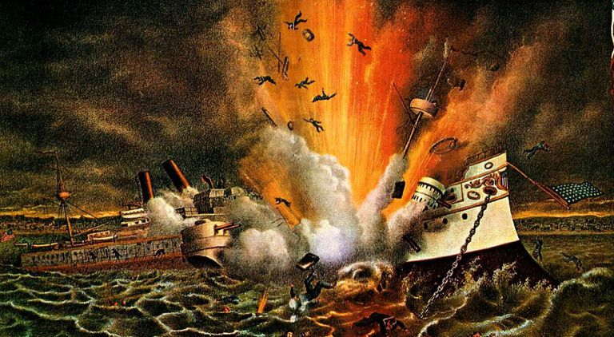
Cuba
In 1898, a US ship, the Maine, mysteriously sunk.

Slide 9
Cuba
Journalist claimed that the ship was blown up by the Spanish, causing Americans to push for war.
The US declared war on Spain and helped Cuba fight for their independence, beginning the Spanish-American War.
Teller Amendment: attached to the war declaration, it stated the US would give Cuba its independence once Spain was gone from the Western Hemisphere…or 1930, whichever the US said came first.

Slide 10
The Spanish-American War
VP Teddy Roosevelt was highly invested in the war, participating first-hand by sending his Rough Riders, a small squadron lacking discipline but not battle skills.
The rest of the US invasion of Cuba was a mess that just happened to end well.
The US sent some 17K troops to the small island, which overwhelmed the Spanish troops and fleet despite their disorganization. Many of the Spanish troops fled, and Santiago surrendered .
The US then made for two different Spanish colonies: Puerto Rico and the Philippines.

Slide 11
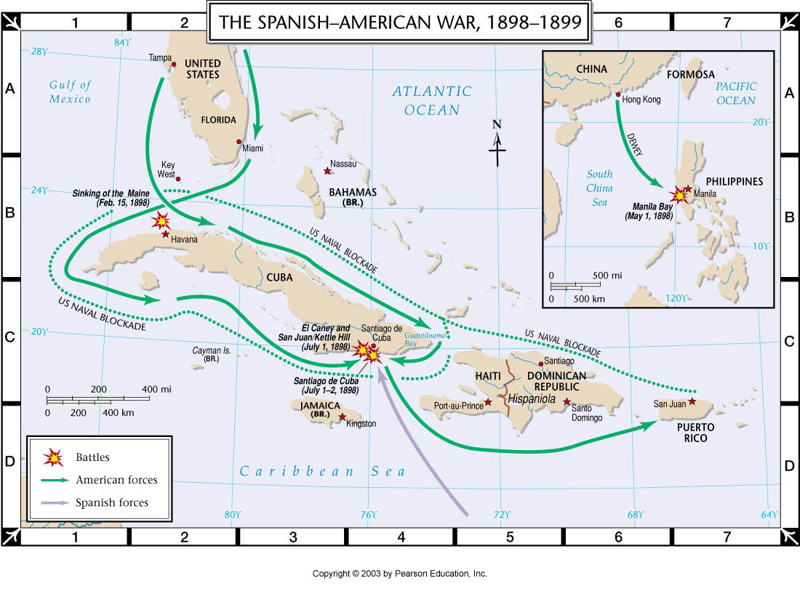

Slide 12
The Spanish-American war: The Philippines
Initial invasion happened alongside the Cuban invasion in early 1898.
John Dewey and the American fleet at Hong Kong cornered the much larger but outdated Spanish fleet, quickly destroying it.
Being naval ships and sailors, they could surround the capital of Manila on water, but not invade by land.
This was left to ground forces that would come in the summer, who with the assistance of Filipino troops captured the city and drove out the Spanish.

Slide 13
The Spanish-American war: The Philippines
The Americans then pulled a fast one: while working with Philippine troops to ensure victory, the US Congress pushed through a bill to formally annex the Philippines.
While not initially a part of the war, the US decided that it could not afford to give these islands back to Spain, or let another European power have them.

Slide 14
The Spanish-American War: Territories Acquired

Slide 15
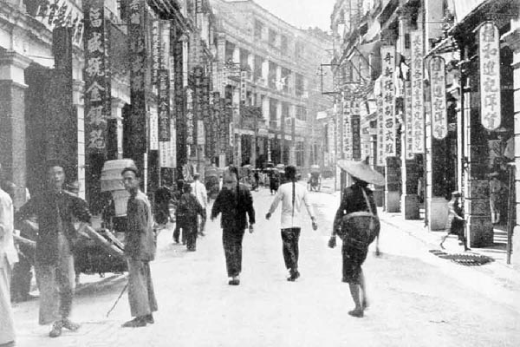
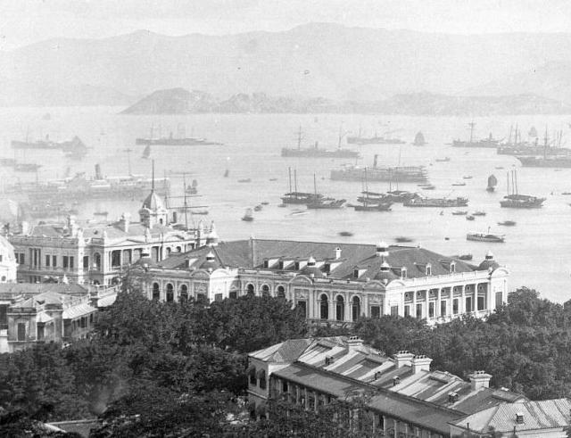
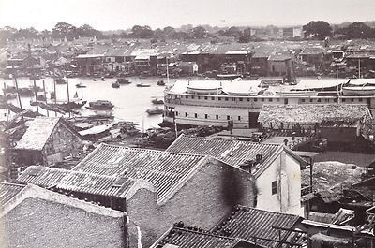
Imperialist vs. Anti-Imperialist
The Anti-Imperialism League: large lobbying organization that protested American imperialism.
They argued for Philippine independence more than anything else, stating that to imperialism was to invite despotism as imperialism was costly and in this case would get the US involved in the “political and military cauldron of East Asia.”
Pro-imperialists ignored these arguments and gained support for themselves stating their wish to make the Philippines the next Hong Kong.
They furthered the promotion of Imperialism as a “civilizing mission” aided in part by Rudyard Kipling’s poem “The White Man’s Burden.”

Slide 16
Keeping Territory
The Philippine Insurrection (1901): rebellion against American rule by the Filipinos, resulting in the massacre of 250K Filipinos.
Congress granted American citizenship to Puerto Rico in 1917, but still has not granted to the country its independence.
America withdrew the Teller Amendment in 1902, but forced the Cubans to write their own constitution, known as the Platt Amendment, which would keep Cuba under partial US control until the mid-1930s.

Slide 17
The US & the Rest of Asia
The Sp-Am War put the US on the world stage, as a world power, the retention of the Philippines kept them in Asia.
Open Door Policy: US would not establish a permanent sphere of influence in China like the European powers had, instead they would “leave a door open” for trade with China without trying to imperialize the country.
Most of the European powers would eventually agree to their own similar policies, but to China, the damage had been done.
Boxer Rebellion: uprising of nationalist Chinese group who attacked any foreign presence in China (economic, religious, etc.).

Slide 18
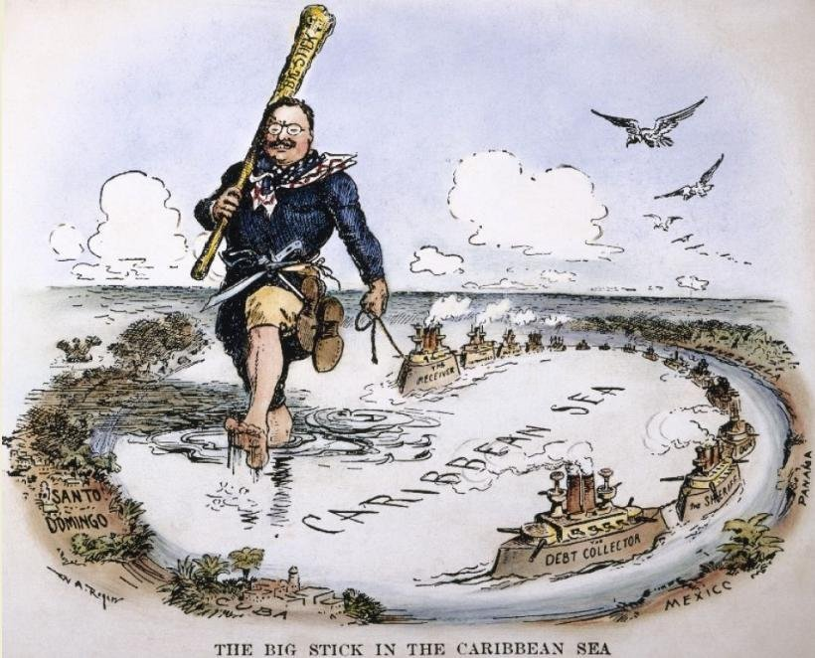
President Roosevelt
“Big Stick” Policy: based on Theodore Roosevelt’s favorite proverb, it meant that the US would continue its diplomacy while still preparing for threats.
Ex: The Great White Fleet

Slide 19
The Panama Canal
Congress purchased rights to the French canal company in the area in 1902, and received in formal writing no objections from the British via the Hay-Pauncefote Treaty.
The US then had to deal with the fact that the location for the abandoned French canal was in Panama, an extension of Colombia.
The US encouraged a rebellion in Panama against Colombia, and while they supported the Panamanians in their revolution, they acted like they had no idea how it got started.
With Panama separated, the US was able to easily acquire the land for the canal.
Canal construction began in 1904 and concluded in 1914.

Slide 20
TR and the Monroe Doctrine
Despite his quest to continue to make the US an imperial power, Roosevelt still had to uphold the Monroe Doctrine.
Roosevelt Corollary: an addition to the Monroe Doctrine which makes the US a police power in the western hemisphere.
This would allow the US to help Latin American countries while keeping Europe away from them.
This would prevent any imperialism in the western hemisphere…except the US.

Slide 21
The US & Japan
The Russo-Japanese War ended in 1905 with a Japanese victory. This came from out of nowhere to everyone else, but was absolutely crucial to Japan.
Both Russia and Japan wanted to take territory north of China.
The US was asked to help negotiate the end of the war that left both parties unhappy, sabotaging diplomatic relations between the US and Russia, and between the US and Japan.
This led to animosity between Americans and Japanese immigrants, which resulted in the “Gentlemen’s Agreement” in 1907: an informal understanding that the number of immigrants and incidents of discrimination would both decrease.
Root-Takahira Agreement (1908): agreement between the US and Japan to respect each other’s territory in the Pacific as well as the Open Door Policy with China.

