Slide 1
Chapter 29
APUSH | 15 slides

Slide 2
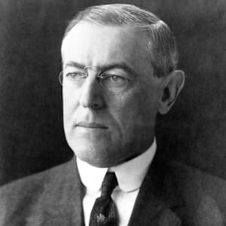
Wilson and the “Triple Wall of Privilege”
The new President and his New Freedom plan called for an assault on the “triple wall of privilege”: tariffs, banks, and trusts.
Called for and appeared before a Special Session of Congress to begin work on lowering tariffs, resulting in the Underwood Tariff
This tariff substantially lowered import fees, and stipulated a graduated income tax to supplement the 16th Amendment.
He also signed the Federal Reserve Act in 1913, “the most important piece of legislation between the Civil War and the New Deal.”
It created a system of 12 reserve districts placed under the authority of the Federal Reserve Board who demonstrated a measure of public control
Wilson’s attack on trusts came in the form of the Federal Trade Commission Act of 1914.
“The new law empowered a presidentially appointed commission to turn a searchlight on industries engaged in interstate commerce.”

Slide 3
Other Legislation
Clayton Anti-Trust Act (1914): an update of the Sherman Anti-Trust Act which increased the number of objectionable business practices to include price discrimination and holding companies.
It further said that labor unions were exempt from anti-trust prosecution as they were not directly an “article of commerce.”
Workingman’s Compensation Act (1916): granted federal assistance to federal employees during periods of disability.
Adamson Act (1916): established an 8-hour workday with extra pay as a condition of overtime.
Jones Act (1916): granted territorial status to the Philippines with the promise of independence upon the establishment of a “stable government”.

Slide 4
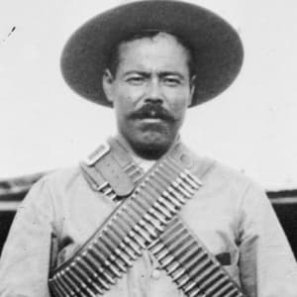
Diplomacy in Mexico
As a revolution began building in Mexico, Americans called for interference as American lives, property, and investments were threatened.
Wilson indirectly intervened by sending an aggressive ambassador to represent the US in Mexico, imposed an arms embargo, and refused to recognize the new government.
Arms were allowed across the border to rivals of that government, Venustiano Carranza and Pancho Villa.
The Tampico Incident prompted Wilson to send the US Navy to seize the port of Veracruz, but a full-scale battle was intercepted by the ABC powers, and Carranza was put in charge of the new government.
The new government was reluctantly supported by the US, while Pancho Villa crossed the border to provoke war between Mexico and the US.

Slide 5
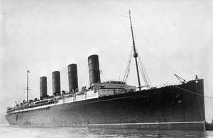
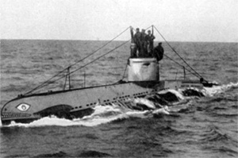
War in Europe
CAUSES
CATALYSTS
Militarism
Alliances
Imperialism
Nationalism
The assassination of Franz Ferdinand, heir to the Austrian throne.
German march through Belgium.
Sinking of the Lusitania.
The Zimmerman note.
Unrestricted submarine warfare.
Russian Revolution.

Slide 6
War in Europe
Central Powers: Germany, Austria-Hungary
Allied Powers: Britain, France, Russia
Wilson issues a neutrality proclamation to keep the far-removed US uninvolved, despite interference from both sides in Europe.
Wilson advocated that Americans be neutral in thought and action, which was relatively achieved; most Americans would say they were anti-German, though many more were just glad the conflict was over there.
This was not true of American businesses, which began filling orders for war supplies from France, Britain, and Germany.
American ships headed to Germany were soon harassed by British ships, virtually ending US trade with Germany.

Slide 7
War in Europe
As the British blockaded German ports, Germany announced the use of submarine warfare.
It was a German U-boat that fired on the British passenger ship Lusitania, sinking it, resulting in the deaths of nearly 1200 people (128 Americans) just 15 miles from the coast of Ireland.
Wilson chose a diplomatic route instead of declaring war, and Germany agreed “not to sink unarmed and unresisting passenger ships without warning.”
After Wilson’s re-election in 1916, and confirmation on American neutrality in early 1917, Germany announced their intended use of unrestricted submarine warfare—which called for the sinking of all ships they came across in a war zone, passenger, merchant, American, or otherwise.

Slide 8
War in Europe
The Russian Revolution came to a boiling point in 1917 with the execution of the Tsar, and forced the country to back out of the war effort.
Controlling the majority of the cables from Europe to the US gave Britain the upper hand in what news was delivered to the US about the war.
This often meant that the Allied powers were made to look brave while Central forces were beasts.
This also allowed the British to intercept a message from Germany to Mexico and deliver it to the US.
The Zimmerman Telegram sent by Germany was to encourage Mexico to join the Central Powers with the promise of restoring former-Mexican, now-US territory to Mexico, including Texas, Arizona, and New Mexico.

Slide 9
The US joins the War
Wilson asked Congress to declare war in April, 1917, but was quick to contrast American war aims with those of the others involved.
While others were fighting wars of conquest, the US was fighting to ensure democracy and peace.
Mobilizing the country for war would not have been possible without the help of the Committee on Public Information, who helped quiet dissent.
The Committee posted propaganda around the country to stir up support for the war and/or hatred of the enemy.
They depended on and created an aroused public passion and voluntary compliance, which would served as an example for later mobilization efforts.
The War Industries Board saw the government take a large role in economic planning, and got the public to join in voluntarily, while also issuing production quotas and allocating raw materials on their own.

Slide 10
Domestic Impact
The Espionage and Seditions Acts of 1917 & 1918 targeted those against the war and war effort, resulting in multiple trials against those who spoke out.
Schenck v. US: case in which the Supreme Court upheld the constitutionality of the Espionage Act and ruled Schenck’s actions dangerous as the country was at war.
Labor unions and wages both grew, as did the overall American labor force.
The Great Migration of African-Americans from the South to the North started during the war and would continue through the 1920s, despite leaving race riots in its wake.
The role of women in society grew as millions joined the workforce though the women’s movement split over the war.
The 19th Amendment passed in 1920, with the wholehearted support of the President.

Slide 11
Fighting the War
A draft was reluctantly passed to supply troops to the American Expeditionary Force (AEF), which was led by General John Pershing.
Women were admitted to the military for the first time, as well as African-Americans who fought in segregated units.
Most American troops, known as “doughboys,” were sent to France.
Larger training efforts were put on the back burner as Allied forces needed to be reinforced first.
Battle of Chateau Thierry (Spring 1918): American forces help stop the German advance through France; the first significant engagement of American troops.
Meuse-Argonne Offensive (Fall 1918): one of the last Allied assaults, it involved more than 1.2M American troops.
Meanwhile, Germany was feeling the effects of fighting a war (basically) alone, the British blockade on their supplies, and the efforts of Allied propaganda

Slide 12
US Casualties and Contributions
125,000 killed, 230,000 wounded.
Comparison 1: 550,000 Americans died during the 1918 flu epidemic.
Comparison 2: France—1.4M killed, 4.2M wounded, and 350K civilian deaths, which totaled about 5% of their overall population
The US was able to supply the food, arms, oil, and money/credit that really helped win the war.
Manpower should be considered an after-thought. Yes, it was needed, but the US did carry any victories or major battles.
US troops participated in roughly the last three months of the war.

Slide 13
Playing a Part in Peace
In early 1918, Wilson presented what would become known as the Fourteen Points.
Wilson hoped these alluring visions of a post-war peace would lead the official peace negotiations once the war was over. They called for freedom of the seas, free trade, anti-imperialism, and self-determination. The ultimate point was the creation of a “League of Nations” to provide and promote security between nations.
Wilson traveled to the official peace conference in Paris; the only leader there without legislative backing at home.
Wilson became part of the Big Four, and made his first task to prevent treaty-based revenge on Germany.
He also proposed the League of Nations, which his Big Four contemporaries supported.
A treaty was passed for Germany to sign in January 1919.

Slide 14
Treaty of Versailles
Despite Wilson’s best efforts, revenge dominated the conditions of the treaty.
Germany was all but forced to sign the treaty rather than rebut its contents.
B | Blame for the war would go to Germany
R | Reparations for war damages would be placed on Germany
A | Arms and munition stores would be greatly reduced in Germany
T | Territories and colonies of Germany would be given to Britain and France

Slide 15
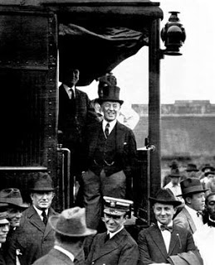
Treaty of Versailles
Upon his return, Wilson found the US still clinging to isolationism and critical of the Treaty of Versailles.
They saw the League of Nations as a permanent place for the US in foreign wars.
Some thought it was too harsh on Germany, while others felt it did too little.
Wilson went on tour with the treaty as it was debated in the Senate.
Senator Henry Cabot Lodge offered pro-American revisions to the treaty, but with Wilson’s urging against these revisions, it was voted down twice.
The US settled separately with the other powers involved in the war.

