Slide 1
Chapters 17-18
APUSH

Slide 2
Tyler Becomes President
After WH Harrison died, his VP John Tyler became president.
While the two ran on a Whig ticket, Tyler was more Democrat than Whig.
He vetoed the national bank every time the Whig Congress brought it up, and was eventually disowned by the Whigs publicly, which resulted in his entire cabinet resigning.
He did sign the Tariff of 1842, which was supported by the Whigs, but only after they had made a multitude of revisions and he came to the realization that the government needed money.

Slide 3
A Short Scuffle with Britain
Anti-British sentiment was growing again.
The Federalists were no longer around to present a pro-British perspective.
British visitors were highly critical of American society and culture.
America also supported uprisings in Canada.
Even though supposedly neutral, the American supply ship Caroline made its way to Canada to bolster these uprisings until it was attacked by British ships, set on fire, and sank on the American side of Niagara Falls.

Slide 4
A Short Scuffle with Britain
Tensions also grew over slavery.
Britain had outlawed slavery in 1808, whereas the US had only outlawed international slave trading in that same year.
In 1841, a group of VA slaves captured the US ship Creole and sailed to the British West Indies for asylum, which they were granted.

Slide 5
A Short Scuffle with Britain
Land disputes also tarnished the Anglo-American relationship.
Aroostook War (1839-1842): fought by lumberjacks over the US-Canada boundary near ME; the British wanted to protect travel routes along the St. Lawrence River and finally reached a compromise over the boundary in 1842 which would allow new British roads while giving the US more land in the area.
Oregon: the joint settlement of Oregon became heavily one-sided as more Americans moved to the area and attempted to push British settlers back into Canada.
Texas: Britain was heavily interested in TX as it would increase their own trade with both the US and Mexico, and place extreme checks on growing American power and the institution of slavery.

Slide 6
Texas Becomes a State
With all the conflict surrounding TX, it became a major election issue in 1844.
Tyler saw an opportunity to begin the American annexation of TX before the election was over, and it became the 28th state in 1845.
Mexico, who still considered TX their territory saw this as a hostile take over.

Slide 7
The Election of 1844
The two major contenders in the 1844 election were Henry Clay and James K. Polk.
Expansion was the main issue under the emotional name “Manifest Destiny,” which implied that it was God’s will for America to expand across North America.
Polk won, with no one expecting his victory.
The Liberty Party, an anti-slavery third party also gained significant votes for the day.

Slide 8
Polk’s Four Point Plan
Lower tariffs
Walker Tariff: lowered tariffs to pre-1842 levels and brought in substantial revenue to the government.
Create an independent treasury
Accomplished by 1846 after opposition from the Whigs.

Slide 9
Polk’s Four Point Plan
Oregon
Polk first proposed a boundary line at 49’ and then backed off. This allowed Britain time to think, but also come back with the exact same line.
Polk handed the decision over to the Senate, forcing them to settle the matter or let a low-level feud with Britain grow by their own doing.

Slide 10
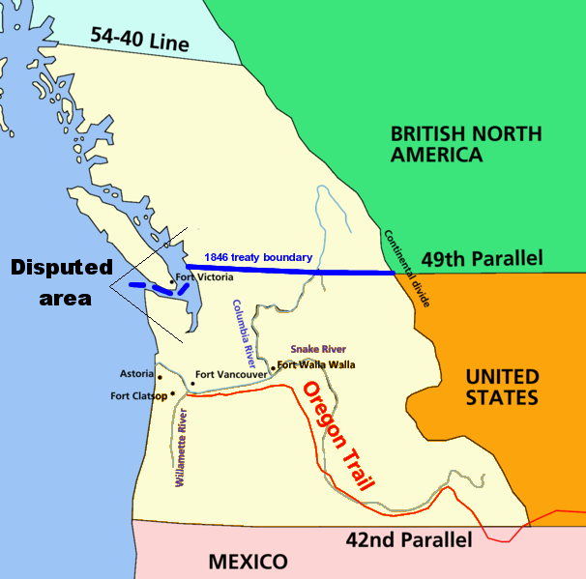
Where most Americans wanted the boundary to be…
Where both Polk and the British proposed to create the boundary

Slide 11
Polk’s Four Point Plan
California
Polk tried to follow in TJ’s footsteps and buy the land from Mexico. He sent an ambassador to Mexico with $25 million and the order to purchase CA and as much of the surrounding area as he could.
This ambassador was refused audience with the Mexican government, and any plan to purchase land was foiled.
Polk discussed going to war for the land, but his cabinet argued that the conflict would be unfounded unless Mexico were to fire the first shot.
Polk had already sent Gen. Zachery Taylor south with troops, and now had to remain oddly hopeful that they would be attacked.

Slide 12
Mexican-American War
Taylor’s troops were attacked in April, 1846, providing Polk the opportunity for war.
Polk presented to Congress the facts that Mexico still owed the US money in reparations over citizen assaults in TX, refused a peaceful ambassador, and attacked “peaceful, protective troops.”
Congress, whether they believed the same as Polk or not, agreed to the war.

Slide 13
Mexican-American War
US war efforts were highly successful.
Santa Fe was easily captured and held.
US troops just happened to be nearing CA when war broke out and rallied Americans there to fight to free the area from Mexico.
Highly improved Army, Navy, and Marine forces were employed everywhere and set up a crippling blockade around Mexican ports.
Gen. Taylor secured a decisive victory at Buena Vista (1847), allowing Gen. Winfield Scott to march to capture Mexico City.

Slide 14
Mexican-American War
The Treaty of Guadalupe Hidalgo was signed in February of 1848.
Gave the US what amounted to half of Mexico, including the rest of Oregon, California, and all remaining claims to Texas.
US paid Mexico $18 million: $15 honestly for the land, and $3 for Mexican debts to the US.

Slide 15
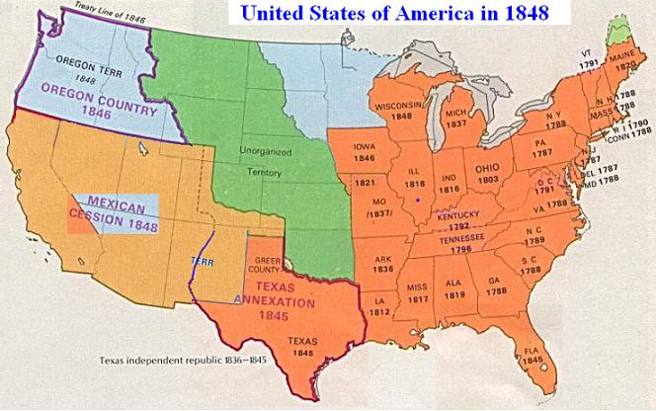

Slide 16
Results of the Mex-AM War
Testing ground for the US Civil War.
Many of the generals, strategies, and training programs used in the Civil War got their starts here.
A lot of the land that US troops would encounter would also make an appearance later.
Brought tensions over slavery to the forefront.
Wilmot Proviso (1846): proposed the prohibition of slavery from any territory gained from the Mex-Am War.

Slide 17
Results of the Mex-AM War
With many of the expansion issues settled, the US was only left with one major issue to tackle, slavery.
Neither major political party wanted to take a side, choosing to benefit from sectionalism rather than be destroyed by it.
They also chose to try out new candidates in the Election of 1848. The Democrats nominated Lewis Cass, while the Whigs nominated Zachery Taylor.

Slide 18
California
Gold is found at Sutter’s Mill in CA starting the California gold rush.
This dramatically increased the population of CA, but with mostly criminals.
This caused CA to applied for statehood early.
They did not meet the population requirement, but drafted a state constitution and submitted it to Congress in order to create a state government that could protect them.
Their state constitution excluded slavery from the territory.

Slide 19
The Expansion of Slavery
CA’s admission to the Union directly challenged the balance of slave states to free states.
Northerners were also pushing to get rid of slavery in Washington DC.
The Underground Railroad was also aiding runaways, causing losses for the South in labor, product, and profit.

Slide 20
Slavery & Congress
Much of the South’s support in Congress as their big name congressmen were aging.
Henry Clay, 73, proposed that concessions had to be made on both sides for the country to stay together.
John C. Calhoun, 68 and dying from TB, professed that the South’s rights needed to be protected though he agreed with the basis of Clay’s argument.
Daniel Webster, also 68, gave what became known as the “Seventh of March Speech” which pushed the North toward compromise despite much of his argument being unfounded.

Slide 21
Compromise of 1850
For the North
For the South
CA admitted as a free state
Disputed land between TX and NM given to NM
Abolition of slave trade in DC
NM and UT Territories created with slavery added on the basis of popular sovereignty
TX paid $10M in reparations
Fugitive Slave Law of 1850

Slide 22
The Election of 1852
As far as many Americans were concerned, the issue of slavery had been solved or at least shoved into the background for another decade or so.
The campaigns for the 1852 election turned back to expansion as their main issue.
The Democrats nominated Franklin Pierce, while the Whigs made Winfield Scott their choice.

Slide 23
Further Expansion
To the South
Clayton-Bulwer Treaty (1850): Britain and the US agreed to protect the neutrality of Central America
America made a run for Cuba, a luxurious plantation-based island with a hearty economy and large population of slaves.
The Pierce Administration originally proposed to buy the island for $100M. President Pierce also gathered his ambassadors from Spain, Britain, and France to come up with a plan for acquiring Cuba which became known as the Ostend Manifesto.
The documents within the Manifesto were somehow leaked, and the entire plan was scrapped after an uproar from the population.

Slide 24
Further Expansion
To the Far West
Treaty of Wangxia (1844): trade agreement between China and the US which gave the US “most favored nation status” along with similar trade rights Britain had in China after the Opium Wars but accomplished without war.
Treaty of Kanagawa (1854): trade agreement between the US and Japan regarding trade which also opened Japan to the world economically and granted the US a consulate in Japan

Slide 25
Further Expansion
To the Not-so-far West
Gadsden Purchase: the purchase of territory just south of the NM Territory for $10M with the purpose of building a Southern transcontinental railroad.
Kansas-Nebraska Act (1854): created the separate territories of KS and NE while revoking the MO Compromise by basing slavery in these territories on popular sovereignty.

