Slide 1
Chapter 19
APUSH

Slide 2
Literary Battles
Uncle Tom’s Cabin by Harriet Beecher Stowe
Painted a ugly picture of the South and slavery.
Written on religious grounds as Stowe was highly influenced by the Second Great Awakening.
While Stowe later admitted to never having witnessed slavery, the damage was done.
The Impending Crisis of the South
Argued that slavery hurt whites in the South more than it helped.
No one in the South, including non-slave owning whites, bought this argument.
Passed out by Republicans as campaign literature.

Slide 3
Bleeding Kansas
Emigrants from both the North and the South settled in KS to influence its decision on slavery.
More pro-slavery voters appeared in KS and the territorial legislature became pro-slavery.
A second legislature was set up alongside this one that was anti-slavery.
Radical abolitionist John Brown attacks Lawrence.
There was so much violence in KS that it’s said this is actually where the Civil War started.
KS applies for statehood in 1857 with the Lecompton Constitution.

Slide 4
Lecompton Constitution
Provided for the protection of slavery that already existed in KS even if the popular sovereignty vote went against slavery.
Abolitionists in the are were so outraged that they refused to vote on the constitution until a better one was made.
Pro-slavery folks on the other hand, voted heartily for the constitution, and it was sent to Congress for approval.
Congress debated KS’s statehood and still had yet to make a decision by the time the Civil War started in 1861.

Slide 5
The Election of 1856
Both parties struggled to find a candidate with a wide appeal that was far enough removed from the KS issue.
This election also saw a comeback on anti-foreignism, as many were displeased with the growing immigrant population and their political influence.
Democrat James Buchanan wins.
The Republicans are not really upset by this; Southerners threatened secession if the Republicans won, which left many in the North with no choice but to vote for Buchanan.

Slide 6
Scott v. Sanford
Supreme Court case that tested the boundaries of the institution of slavery.
The Court ruled:
Scott was a slave and could therefore not bring a lawsuit before a federal court.
A slave is property, and as such, can be moved by their owner—even to a free territory, and still be held in bondage.
The MO Compromise was never constitutional to begin with. It was not the federal government’s place to regulate personal property.

Slide 7
Panic of 1857
Impacted the North more than the South.
The North had been growing excess grain to send to Europe during the Crimean War.
Land and rail speculation.
Northerners pushed for a “homestead act” that would increase farmland by giving it to pioneers for free. This was vetoed by Buchanan.
The tariff of 1857 dropped rates to pre-1812 values, the lowest they had been since then.
Cotton was fine. The South was fine.

Slide 8
IL Senatorial Election of 1858
Pitted “Little Giant” Stephen Douglas against newcomer Abraham Lincoln.
Set up a series of debates between the two.
Freeport Question: “Can the people of a Territory in any lawful way…exclude slavery from their limits prior to the formation of a State constitution?”
Freeport Doctrine: Yes, that’s what popular sovereignty is there for. A law that the people don’t get behind will be difficult to enforce.

Slide 9
IL Senatorial Election of 1858
While most agree that Douglas won the debates, it may have cost him a presidential nomination.
Douglas’ firm stance on many divisive issues only further split the Democratic party.
Lincoln was supported by many more and thrust into the national spotlight as one of only a few men who could go head-to-head with Douglas.

Slide 10
John Brown’s Raid on Harper’s Ferry
John Brown, known for violence in KS, and a small band of followers marched to Harper’s Ferry, VA in 1859.
Backed monetarily by abolitionists in the North, they were able to secure firearms in their attempt to create a slave uprising which would take the federal arsenal in Harper’s Ferry.
Brown and his crew were able to put up a fight, but were ultimately captured by Marines in the area. Further disheartening to Brown and his followers was the fact that almost all slaves in the area had no idea the raid was going on.

Slide 11
John Brown’s Raid on Harper’s Ferry
Notes:
Video link: https://www.youtube.com/watch?v=UZ-gctIcKQo

Slide 12
John Brown’s Raid on Harper’s Ferry
Brown was tried and convicted for murder and treason.
He was later executed, and became a martyr for the abolitionist cause.
The South blamed the North for Brown’s actions, and while many Northerners felt Brown was out of line, they still supported abolitionism.

Slide 13
The Election of 1860
The Democrats were split on sectional lines, and wound up nominating two candidates, one from the North (Stephen Douglas) and one from the South (John Breckinridge).
The Dem’s split almost guaranteed Republican victory.
Republicans nominated Abraham Lincoln, and created a platform that would appeal to as much of the country as possible including former free-soilers, manufacturers opposed to the tariff of 1857, and homesteaders.
Southerners, just like the previous election, made it clear that Lincoln’s victory would result in secession.

Slide 14
The Election of 1860
Even with Lincoln’s victory, the South and the Democrats still held a majority.
The Congress was majority Democrat.
The Supreme Court was 5-4 Southern.
Most states were located in the South, and could easily vote down any proposed constitutional amendment on slavery or anything else for that matter.

Slide 15
Secession
In 1860, South Carolina voted to leave the US.
Crittenden amendments: created a new line across the country with territories to the north of which slavery would be prohibited, and to the south protected; states admitted after the compromise would use popular sovereignty.
This proposed compromise implied that federal protection of slavery to the south of the line would allow slavery to expand everywhere south of that line.

Slide 16
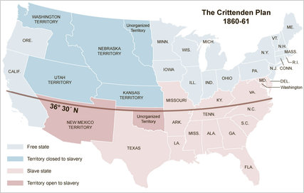

Slide 17
Secession
As the Crittenden compromise neared failure, more states fled the Union.
In order after SC were MS, FL, AL, GA, LA, TX; with more to follow.

Slide 18
Chapter 20
APUSH

Slide 19
President Lincoln
Lincoln’s inauguration takes place in March, 1861.
By this time, the Confederate States of America had established a government in Montgomery, Alabama.
Seven states had seceded, several more were on their way out.
Union became Lincoln’s priority.

Slide 20
Fort Sumter
Only two US forts of importance remained in the CSA, one of which was Fort Sumter located in Charleston, SC.
The Fort was struggling to maintain itself. The US decided to send a naval ship with supplies to the fort.
This was seen as an act of aggression by the Confederate states.
SC began firing canons at Fort Sumter, a bombardment that lasted 34 hours, and resulted in the fort’s surrender.

Slide 21
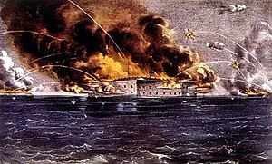
Fort Sumter—Aftermath
Lincoln responded by calling for volunteers for the military, and taking steps to blockade the South.
This was also seen as an aggressive act, prompting more states to vote on secession.
VA, TN, AR, and NC, all of whom had their first votes on secession fail, now voted to leave the US and join the Confederacy.
The Confederate capital was moved to Richmond, VA to intimidate Washington, DC.

Slide 22
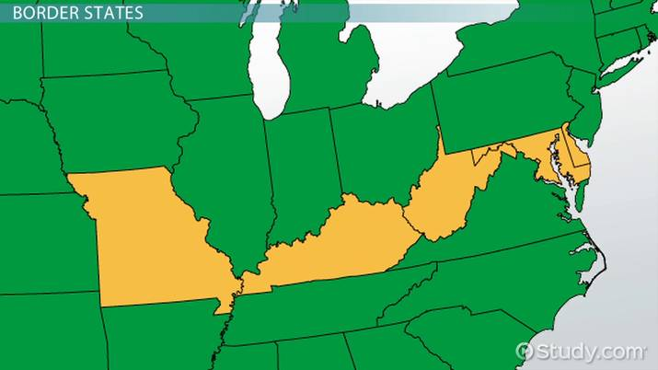
The Border State Phenomena
Several states acted as a buffer between the US and the Confederacy.
The majority of these “border states” were slave states who remained loyal to the Union, with exception of the new territory of West Virginia who opted to be a free territory.

Slide 23
What is this About?
War was declared shortly after the Confederate attack on Fort Sumter in April, 1861.
It would have been unwise to say the war was about slavery at this point; the attack on Fort Sumter was what actually prompted the war, and Lincoln’s priority was keeping the US together.
Saying this was a war for abolition would have alienated many states still in the Union, including the crucial Midwest states, which were heavily populated by farmers who sympathized with family in the South (and were largely racist).

Slide 24
CSA—Advantages and disadvantages
Advantages
Disadvantages
Defensive war: it was on their turf and fighting would be largely dictated by the Confederate military.
Cause: they had a reason to fight that was not about revenge, but about their livelihood on multiple levels.
Talented officers: Robert E. Lee, Stonewall Jackson, JEB Stuart, and more were from the South and joined the Confederacy as their states did.
Lifestyle: Southerners spent more time around horses and were used to traveling great distances.
Weak economy: largely agrarian and highly dependent on slave labor, trade, and long-range transportation.
Supply lines: low population density meant that supply lines ran across vast empty spaces.

Slide 25
US—Advantages and Disadvantages
Advantages
Disadvantages
Diverse economy: part farm part industry, and able to support a large number of people.
Navy: The North generally maintained more ports than the South, which created a superior Navy based in the North.
Population: 22 million vs. 12.5 million (including slaves).
Discipline: unaccustomed to “soldiering” and unprepared for military life.
Trial-and-error leadership: Lincoln switched out generals as quick as Union soldiers wore through their shoes.

Slide 26
Foreign Intervention
The Confederate states were counting on this, as many other countries had done in wars before.
Many European governments were sympathetic to the Southern cause, as they just generally hated the “American experiment” and wanted to see it fail this spectacularly.
However, the European people had already been swayed by Uncle Tom and other works, so there was an unlikely chance Europe would get involved quickly.

Slide 27
Foreign Intervention
The Confederacy counted on Britain getting involved above all others.
Britain was reliant on Southern cotton for their textile mills and clothing factories.
However, the cotton crop in the antebellum years was so great, that most factories had surplus supplies, meaning Britain could afford to wait to get involved.
Britain would only feel the effects of the US Civil War around 1863, the same year Lincoln brought slavery directly into the causes for war. Britain was not about to go to war to defend slavery.
Notes:
Egyptian and Indian cotton took up the slack.

Slide 28
Foreign Intervention
The Trent Affair (1861): a Union ship stopped the British ship Trent and captured two Confederate diplomats heading for Europe.
Britain as a Confederate port: the US ship Alabama flew the Confederate flag, had Confederate officers, but was otherwise a British ship which left its guns in the CSA and never enter a port there. It instead picked up weapons from some islands off the coast of Africa and razzed US ships before heading to Britain. It finally met its US match in 1864 and was sunk off the coast of France.

Slide 29
Foreign Intervention
While the Confederacy hoped to get European countries involved in the war somehow, the US worked to do the opposite, with Europe working to take advantage of both sides.
France invaded Mexico City in 1863 and establishes an Austrian puppet government there.
Canada becomes the semi-independent Dominion of Canada in 1867.

Slide 30
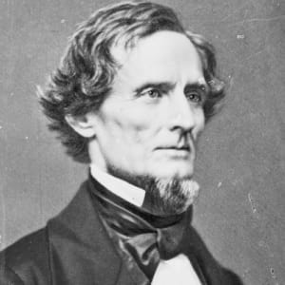
The Confederate Government
President Jefferson Davis and the Richmond government struggled with another major issue of the war: states’ rights.
Davis was not popular, though a capable leader, and neither was his vision of a well-knit Confederate government.
Some states threatened to secede further, even though this was the entire Confederacy’s fight for independence. Others refused to send state troops to war.
This meant that the states’ rights issue was just as damaging to the union of the Confederacy as it had been to the union of the United States.

Slide 31
Wartime Liberties in the US
Lincoln often took liberties with the Constitution, that Congress rarely disagreed with.
Congress was not in session when the war started, so Lincoln took it upon himself to increase the size of the military and begin his blockade.
He suspended the writ of habeas corpus.
He allowed for voting to be “supervised” in the border states, and suspended the publication of certain newspapers and the arrest of their editors under claims of obstruction.
He justified many of these moves by saying that they would not extend past the war.
Lincoln’s moves to exert arbitrary power made him a stronger leader than Davis.

Slide 32
“A Rich Man’s War But A Poor Man’s Fight”
The US military was manned solely by volunteers; states had to maintain a quota of troops to send to battle based on population.
Around 1863, the US enacted their first conscription (draft) law.
The draft became increasingly unfair to the poor as the rich could hire substitutes or purchase exemption.
Riots over the draft broke out in NY, led by “underprivileged and anti-black Irish Americans” and lasted for several days.
The draft was more often met with resentment than riots like those in NY.

Slide 33
“A Rich Man’s War But A Poor Man’s Fight”
The Confederacy ran out of manpower much faster than the US, enacting their draft in 1862.
Exemptions and draft dodging was also common in the Confederacy; the wealthy could purchase a substitute, an exemption, or send a slave in their place.
There were no riots in the Confederacy like there were in NY, however officials found it in their best interest to avoid areas where sharpshooters could hide.

Slide 34
War Funds
Morrill Tariff Act (1861): passed after Southern secession, raised excise taxes on products to 1846 levels with some product taxes jumping 5-10% at once, in order to raise money for war.
Greenbacks, a form of paper money, were issued by the US government.
Value fluctuated with US success in the war.
The government indirectly made money with Greenbacks, but made even more by selling bonds.
Congress established a national banking system in 1863.
Mainly established to sell bonds and issue paper money, it had the long-lasting effect of stabilizing and standardizing US currency.

Slide 35
War Funds
All of this led to an increase in manufacturing and businesses in the US, and greater socio-economic distinction.
Businesses were protected by tariffs and inflation which caused soaring prices, with many gaining profits from cheating the war effort.
This meant the average laborer had to work more to buy everyday goods.
A millionaire class was created for the first time American history.

Slide 36
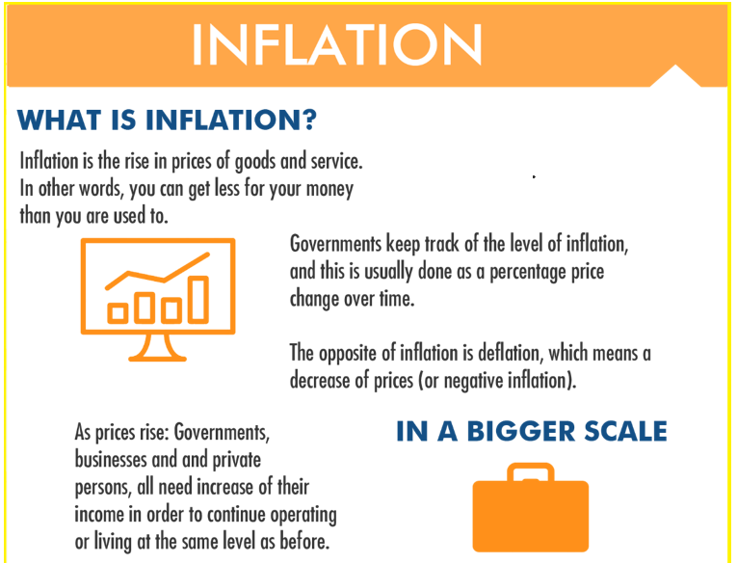
War Funds
The Confederacy’s economy weakened quickly during the war.
The Confederate government sold bonds at home and overseas.
Taxes increased often, and levies for the war followed.
The Confederacy was also responsible for their own tariffs, which like those of the US, sharply increased.
The government printed money “with complete abandon” causing “runaway inflation.”

Slide 37
Other Policies
Homestead Act of 1862: sold up to 160 acres of public land for $30 provided that it was settled and improved
Sanitary Commission (1861): agency that helped train female nurses, collected medical supplies, and equipped hospitals with staff and goods during the war.

Slide 38
Chapter 21
APUSH

Slide 39
“A Ninety-Day War”
There was initial belief from both sides that this would be a short war.
The Battle of Bull Run proved this wrong.
Fought in July 1861, resulting in Confederate victory.

Slide 40
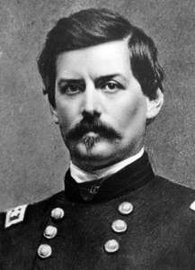
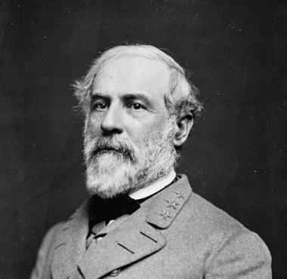
Union Strategy
The main goal of the US early in the war was to capture the Confederate capital of Richmond.
To do this, Lincoln appointed George McClellan to command the Union forces in the Peninsula Campaign.
The campaign never reached Richmond, being routed by Robert E. Lee in the Seven Days’ Battles.
Lincoln often felt that McClellan was overly cautious, resulting in his suspension from command on multiple occasions.

Slide 41
Union Strategy
By 1862 included 6 parts
Blockade the South
Control the MS River
March through strongholds like GA & SC
Capture Richmond
Undermine Southern economy by liberating slaves
Confederate military exhaustion

Slide 42
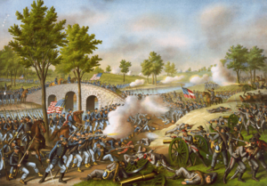
Confederate Strategy
Fairly straight-forward: outlast the Union forces to gain independence.
Secured another victory at the Second Battle of Bull Run in 1862, and forced a draw at the Battle of Antietam a month later.
Despite a military draw at Antietam, McClellan was able to stop Lee’s forces from advancing, allowing Lincoln to claim a “victory.”
Notes:
This is where photographs made the war a reality for many.

Slide 43
Emancipation Proclamation
Issued January 1, 1863.
Effectively freed slaves in the Confederacy.
Lincoln felt confident in releasing the document after Antietam, with the blockade holding steady, and the border states not being affected by the document.
What this meant in practice was that slaves that “freed themselves” would be protected if they could make it to a Union camp.

Slide 44
Reactions
Reactions to the Emancipation Proclamation were mixed at best.
Several states felt that Lincoln had gone too far. They questioned if the move would not provoke further war from the border states.
Others felt Lincoln wasn’t going far enough, and called for the complete destruction of the Confederacy and everything they stood for.
The South feared that Lincoln was starting the race war they had always cautiously avoided.

Slide 45
Causes of the War
By 1863 the causes for the war and/or its continuation had expanded:
Preservation of the Union
States’ rights
Slavery
Territorial expansion
Economic expansion

Slide 46
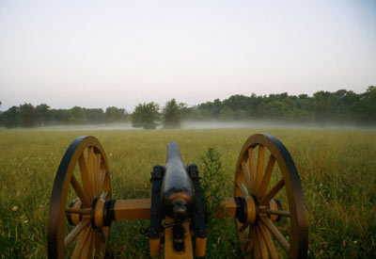
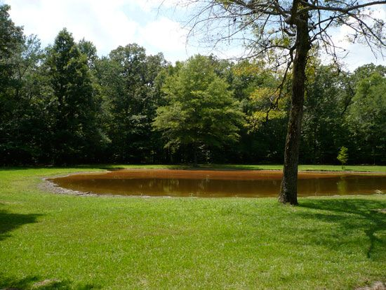
More Battles
Shiloh, TN, April 1862: Union victory.
Fredericksburg, VA, Dec. 1862: Confederate victory.
Chancellorsville, VA shortly thereafter was basically a repeat.
Gettysburg, PA, July 1863: Confederate invasion of the North that resulted in a casualty-heavy Union victory.
Included the ill-fated Pickett’s Charge.
About 50K casualties on each side.

Slide 47
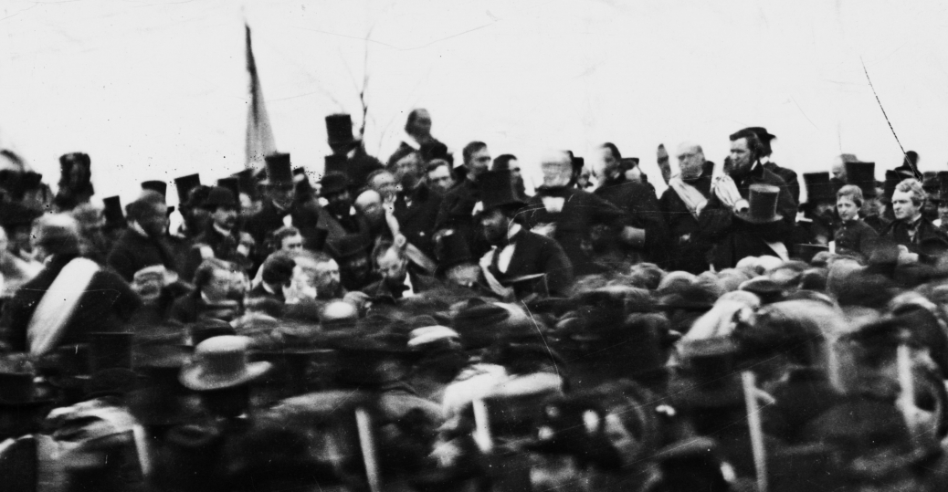
Gettysburg Address
Speech given by Lincoln at the dedication of the cemetery placed there after the battle.
Two minutes and just under 300 words in total, Lincoln wrote it on the train to Gettysburg.
Argued to be one of the most important documents to American history for its dedication to American values and liberty as put forth by the Declaration of Independence and US Constitution.

Slide 48
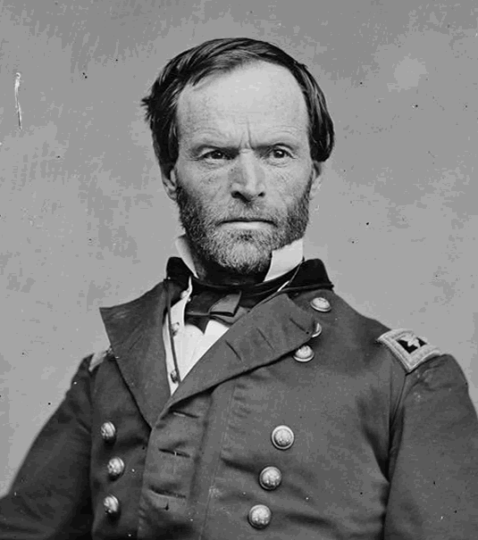
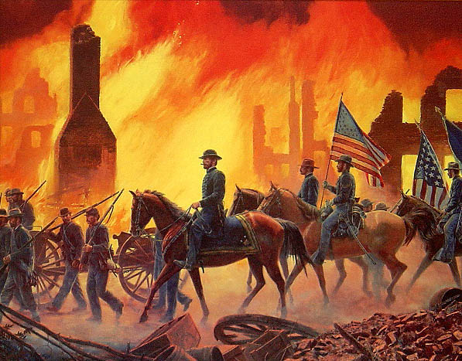
More Battles
Vicksburg, MS, July 1863: back-to-back Union victories when paired with Gettysburg.
Sherman’s March, 1864-1865: destructive march of the Union forces through GA, SC, NC.
Targeted infrastructure and private property to destroy supply lines and morale.
Brought into practice a concept of “total war” accompanied by a scorched-earth policy.

Slide 49
Election of 1864
Democrats split further after the death of Stephen Douglas in 1861.
Peace Democrats wanted an end to the war. War Democrats thought the war should be fully won.
Copperheads were Democrats were more sympathetic to the South and sought to obstruct the war and Lincoln’s policies.
Republicans joined with the War Democrats to form the Union Party. They formally nominated Lincoln, who won re-election.
His running mate was Andrew Johnson, from TN, chosen to appease a Democratic call for balance in the White House between North and South.

Slide 50
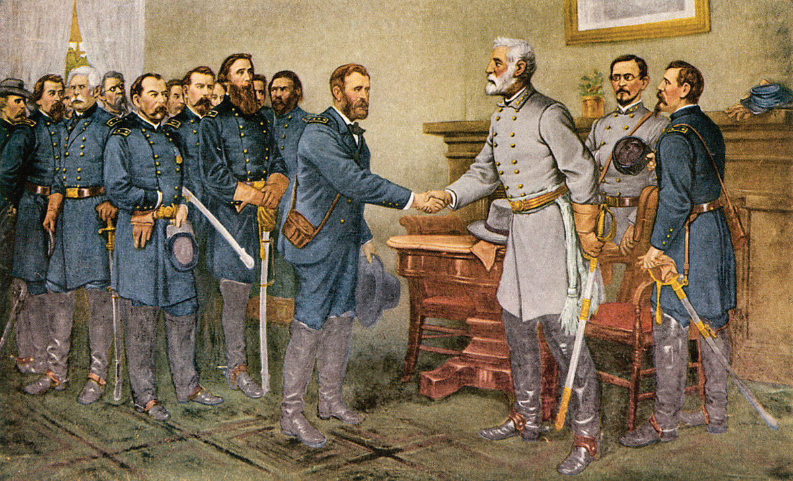
Final Battles
Wilderness Campaign,1864-1865: series of clashes between Grant and Lee in the VA wilderness.
Appomattox Courthouse, April 9, 1865: site of Lee’s formal surrender and the end of the war.

Slide 51
Lincoln’s Assassination
April 14, 1865 at Ford’s Theater.
At the time, many former Confederates cheered, but soon realized that Lincoln would have been more willing to listen and create a fair end to the war.
Claims circulated that Jefferson Davis or another Confederate official was actually behind the assassination.

Slide 52
Impact
American democracy was intact, and inspiring others.
British Reform Bill of 1867.
$15 billion—not considering bonds, soldiers’ pensions, reparations destruction of property and more.
600K casualties, more than any other war for the US.
Changed warfare for the US for almost 100 years.
Extended family members often met on the battlefield.
New technologies gave a new meaning to “war is hell” since medical technology could not keep up.
War was no longer seen as an opportunity to gain credibility, but a horrible way to meet a bloody end.

