Slide 1
Chapters 30 & 31
APUSH
Ch 30: 9 Slides | Ch 31: 7 Slides

Slide 2
Isolation & Prosperity
The 1920s saw the US return to isolationism and brought about an age of prosperity.
There were new consumer goods and ways to buy them.
There were new forms of entertainment and media.
There were also plenty of growing concerns about immigrants, “un-American” lifestyles, and the future of the country.

Slide 3
The First Red Scare
The Russian Revolution spawned American (and international) concern about communism.
Also known as the Bolshevik Revolution, it was largely manned by the working class. Many Americans began jumping to the conclusion that labor disputes in the US were somehow being organized by Bolshevik communists.
The result was a nationwide crusade against anyone whose “Americanism” was suspect.
Efforts were led by Atty. Gen. Palmer and the newly founded Federal Bureau of Investigation.
“Palmer raids” were conducted throughout the country on suspected communists and immigrants, leading to the unjustified deportation of over 200 immigrants and a handful of natural-born American citizens.
Businesses soon joined in, using red scare tactics to win the upper hand against labor, while labor responded in kind against unions calling for the “open shop” as the true American plan for business.
Making a reappearance at this time was the KKK, who was now antiforeign, anti-Catholic, anti-Jewish, anti-communist, and well, the list goes on.

Slide 4
Slowing Immigration
Emergency Quota Act of 1921: reduced immigration from nationalities based on the 1890 Census rather than a more recent one from 3% to 2%.
The Immigration Act of 1924 reduced the total immigration to the US to just over 150K/yr.
Immigrant communities in the US were socially isolated more than ever, and even employers began to play with “ethnic rivalries to keep their workers divided and powerless”.
America’s anti-foreign and anti-communist would soon be reflected for the whole world to see in Sacco and Vanzetti case in which two Italian, atheist, anarchist immigrants were convicted and executed for murder without evidence.

Slide 5
Prohibition
18th Amendment (1919): prohibits the sale, manufacture, and transportation of alcohol.
Volstead Act: Congressional law promoting the enforcement of the 18th Amendment.
Southern whites saw it as a way to keep “stimulants” out of the hands of African-Americans, while the West saw a way to win their battle against lawless saloon towns.
What began instead was a decade of hypocrisy and non-enforcement.
Poor workers and small shop owners could no longer sell or buy liquor, while the “idle rich could buy all the illicit alcohol they wanted.”
Meanwhile the lawmakers ignored that they could not “make a crime overnight out of something that millions of people [had] never regarded as a crime.”
Prohibition also gave way to the rise of organized crime and racketeering; cities like New York and Chicago saw immigrant rivalries turn into gang wars involving Al Capone and “Lucky” Luciano.

Slide 6
Consumerism
By the 1920s businesses had largely overcome their problems of production, churning out new goods quickly for the public.
Mass production: the ability to produce a large quantity of goods rapidly. This was spurred by the adaptation and adoption of the assembly line in various industries.
Industries expanded creating new ones, namely advertising.
Automobiles led to the expansion of roads, advertising promoted the farming industry and leisure travel.
More people were also opting to buy on credit, which touted the mantra of “possess today, pay tomorrow.”
New products and technology: cars, gas stations, in-home refrigeration, vacuum cleaners, radios, suburbs, passenger airplanes.

Slide 7
Entertainment & Mass Media
The radio made significant educational and cultural contributions to society in the 1920s.
They would eventually broadcast entertainment programs, sporting events, political speeches, and live music to homes across the nation.
Along with films, radio brought about a standardized culture that promoted certain behaviors, wants, and ways of speaking.
Films also intrigued audiences across the US.
First with silent films, then with sound by the late 20s, and color by the end of the 30s. Audiences were quick to advocate for censorship efforts.
Larger sporting events also proved an affordable leisure activity for many.
Baseball was the number #1 sport.
Celebrities were found in film and radio actors, sports figures, and other embodiments of American triumph.
Stars like baseball player Babe Ruth, pilot Charles Lindbergh, and more graced the front pages of newspapers and featured in radio news stories.

Slide 8
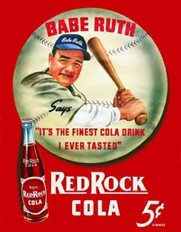
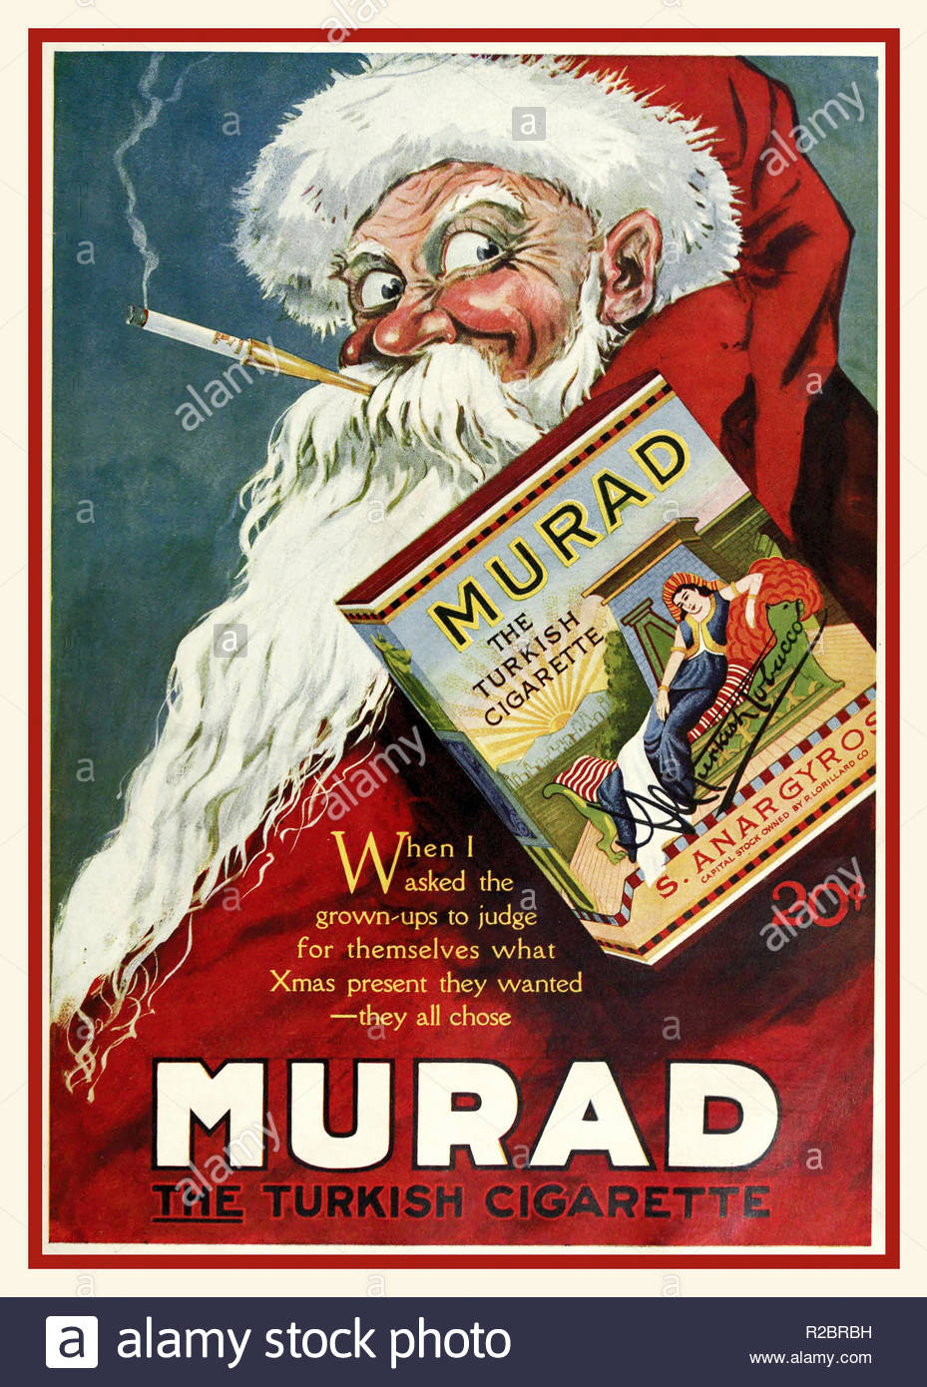
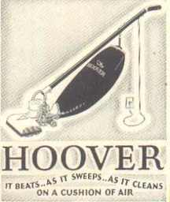
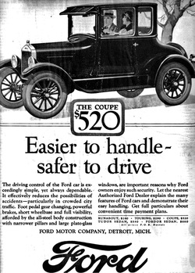
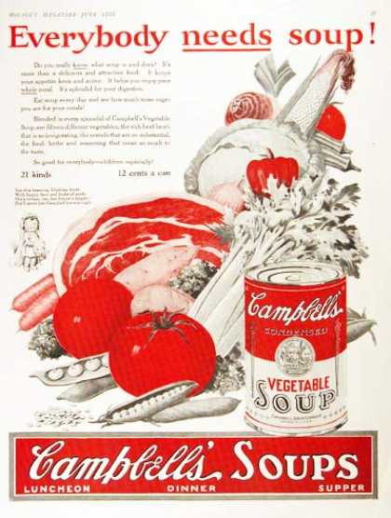
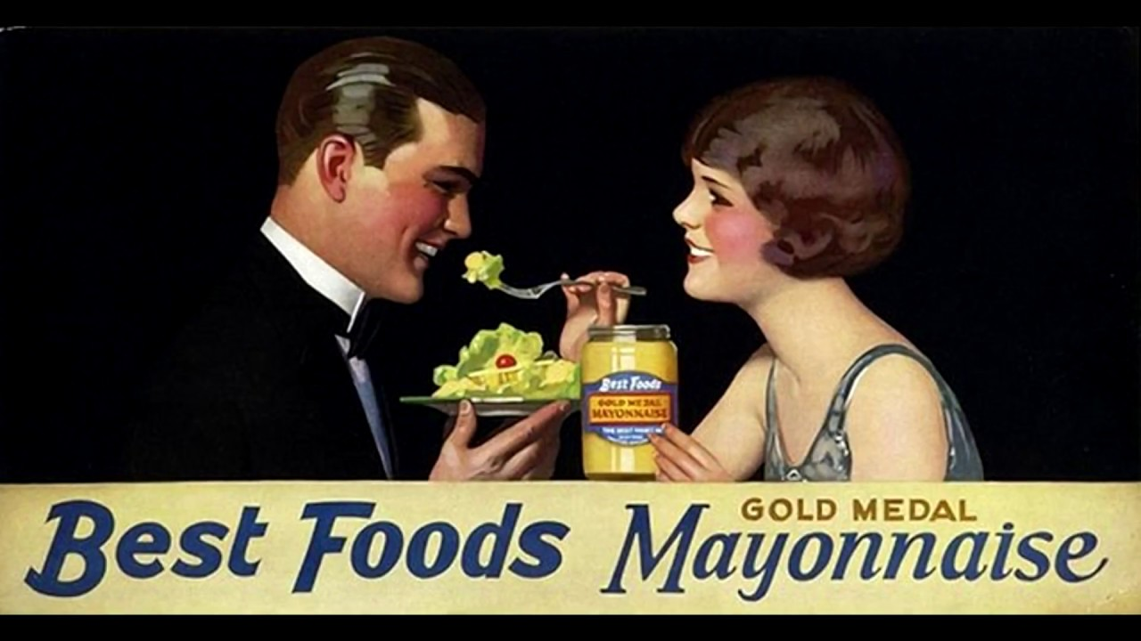
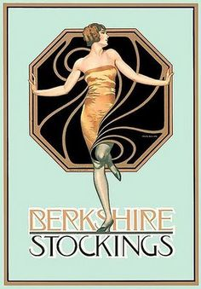
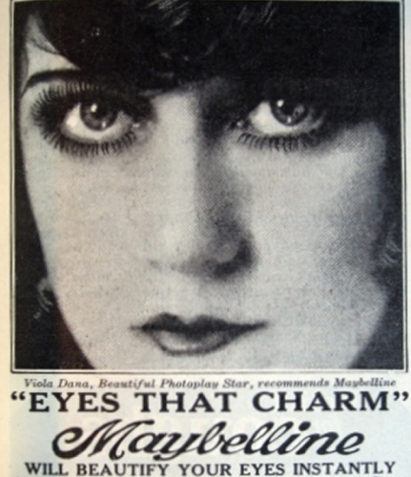
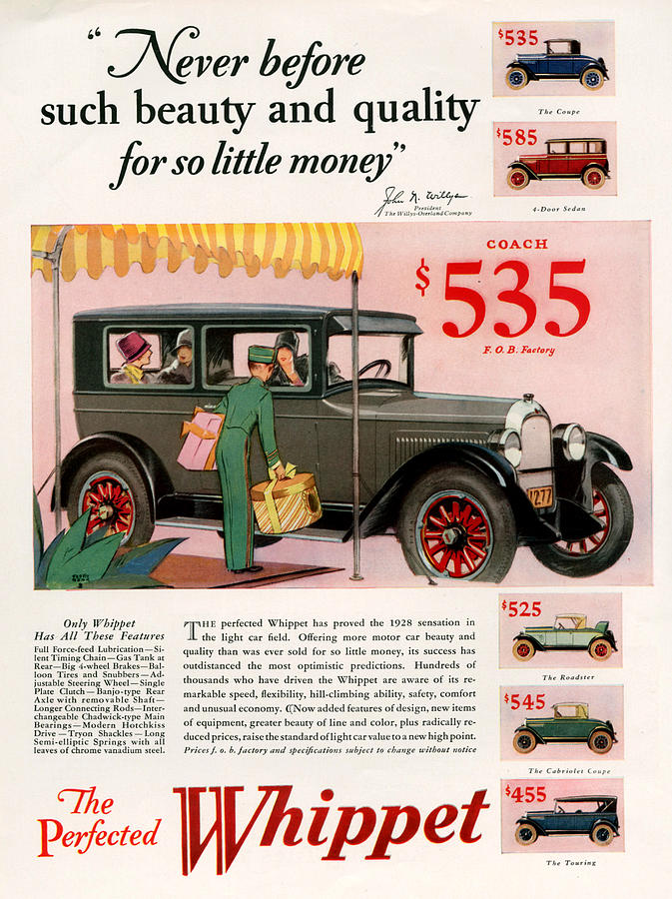

Slide 9
Traditional vs. Modern
Scopes Trial (1924): legal trial in TN for teacher John Scopes violated the law by teaching evolution, he was found guilty but faced no punishment.
Harlem Renaissance: African-American creative movement that produced works of art, poetry, literature, and music to bring attention, celebration, and pride to African-American culture.
Modernism is best seen in the youth movements of the 1920s—the flappers, the Jazz Age, the “Lost Generation”—which questioned not only authority, but also social conventions made outdated by the 20th Century.
Most Americans lived in cities than in rural areas.
The entertainment industry was quick to promote white bands, while most young Americans preferred black jazz music.
Cars furthered this by giving women, and to a lesser extent teens, a sense of freedom to literally leave the house on their own.

Slide 10
Stocks and Credit
Land and real estate speculation of the past decades were nothing compared to the amount of speculation to be had through the stock market.
Stocks are pieces of a company that are up for sale. If that company does well, its stock will increase.
Stocks should be bought when low and sold when high, creating more earnings for the person selling.
Buying on margin: buying stocks with a down payment and then using profits made with stock upon its sale to pay back the remainder of the debt.
Congress created the Bureau of the Budget to help the president keep tabs on and reduce the national debt.
Taxes placed during WWI were reduced, shifting much of the tax burden from the wealthy to the middle class.
This ultimately left more wealthy to invest in the stock market, and more of the middle class to invest on margin.

Slide 11
Republican Return
Republicans regained control of the White House with the 1920 election of Warren Harding.
Many Republicans at the time were interested in undoing many Progressive reforms, including bringing back laissez-faire policy.
War-based economic policies were eliminated in favor of privatization, and labor unions wilted under the hostile environment.
Adkins v. Children’s Hospital (1923) overturned workplace protections for women, and created a debate over workplace protections not only for women, but other minorities as well that would last for the remainder of the century.
Court stacking helped void child labor laws while refusing to enforced anti-trust laws allowing for the return of corporations.
The relationship between business and government became one about efficiency rather than protection or promotion; Republicans were fine with whatever laws the Democratic Congress passed as long as they (the Republicans) were enforcing them.

Slide 12
Government Scandals
The US Naval program continued to build long after the war, prompting calls for disarmament from Europe, resulting in an international conference to reduce arms in the US and Asia.
Nine-Power Treaty (1922): sought to preserve limited arms in the Pacific and hold nine countries to uphold the Open Door Policy.
Kellogg-Briand Pact/Pact of Paris (1928): linked 62 countries in “outlawing” war.
Tariffs increased beyond pre-wartime measures with the Fordney-McCumber Tariff Law.
Teapot Dome Scandal: oil reserves belong to the Navy were signed over to the Dept. of the Interior who promptly leased them to private businesses for bribes.
Harding died in office in 1923, prompting the Vice President Calvin Coolidge to step up.
Coolidge was cautious enough to continue laissez-faire type policies, but moral enough to replace scandalous officials.

Slide 13
Coolidge & Hoover
Coolidge went on to be elected in his own right in 1924.
He oversaw American disarmament halfheartedly but defused diplomatic issues between the US and Latin America, and worked to straighten out the world’s war debts.
Herbert Hoover was elected president in 1928.
A self-made millionaire from the West, Hoover was the ideal businessman’s candidate as he shunned the suggestion of economic planning.
Agricultural Marketing Act (1929): a law to help farmers help themselves, it created a fund to be split between farm organization in order to buy, sell, and/or store agricultural surpluses.
Hawley-Smoot Tariff (1930): the highest protective tariff established during peace, raised import duties from 38% to 60%.

Slide 14
The Stock Market Crash
Speculation on stocks was high as prices continued to climb as a result of speculation.
This caused stocks to look more successful than they were.
Foreign interest rates on US investments were raised in late October 1929, causing many investors to sell stock in order to get back some money.
This continued to drive prices up, and on October 29, 1929, large amounts of stock were sold at once, causing the market to crash.
Over $5 million was lost in the first hours of the stock market crash. By the end of the year, more money had been lost in the stock market than during the entirety of WWI.
Bank runs: after the crash, people around the country ran to their banks to withdraw all of their funds for fear of losing all they had. The problem with this is that banks only hold so much money at any given time, and if everyone withdraws at once, that money is gone before everyone can empty their accounts. Banks closed and left many stranded without cash.

Slide 16
Causes of the Great Depression
Stock market crash of 1929: Through buying outright and buying on margin, a large portion of the population lost money, went into debt, or both.
If the stock market crash was the only thing hurting the economy at the time, the US would have been able to bounce back within the next year. The US would not feel the weight of the Great Depression lighten until 1939.
Overproduction: Mass production within businesses had caused an excess of different products around the country. Buying on credit alleviated some of this problem, but the large tariff duties made it difficult to sell in overseas markets. Stores on “unsellable” goods were piling up, driving down demand for products.
Credit: The idea of “buy now, pay later” had taken off, leaving many with products they wanted and only a few way to pay for them. When people lost money in the stock market, or couldn’t retrieve their money from a bank, those options to pay were gone, leaving people with products that could be repossessed and debts that couldn’t be repaid.
Unemployment: Businesses who overproduced and then couldn’t sell were forced to make up the difference somehow. This was usually done through getting rid of employees, which could result in a quick save of funds for businesses, but resulted in a loss for that person and usually further debt.

Slide 17
Hoover Battles the Great Depression
Hoover feared that a government take-over to weaken the impact of the Great Depression would weaken American society and its economy overall. He soon realized that the welfare of the majority of the population was in fact a direct concern of the federal government.
When things got to be too much to ignore, Hoover opted to assist businesses to promote a “trickle-down” effect. He reasoned that if businesses could be restored, they would have to hire workers and start producing again.
Reconstruction Finance Corporation: gov’t lending bank designed to give indirect relief to companies, farms, and even state and local governments, but no individual loans.
Norris-La Guardia Anti-Injunction Act (1932): prevent the filing of injunctions against strikers, boycotts, and peaceful picketing.
When the “Bonus Army” of WWI vets marched on Washington for their deferred pay, Hoover ordered the army to dislodge them from Washington as a bill regarding their pay failed to pass through Congress.
Hoover largely abandoned his thoughts on “rugged individualism,” paving the way for the New Deal. However, he was limited in what he could actually get done by an uncooperative Congress.

Slide 18
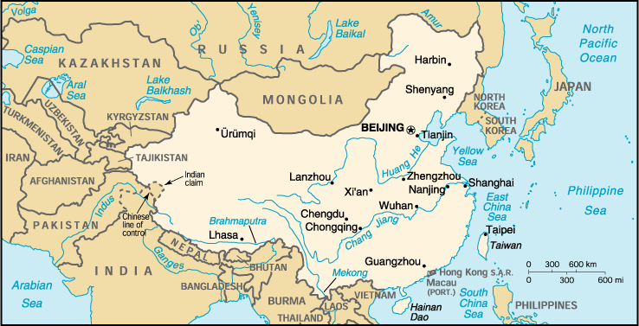
Broken Peace
1910: Japan annexes Korea.
1931, Mukden Incident: Japan stages an assault against their own railroad in Manchuria, allowing for a subsequent invasion and take over of the area.
The League of Nations, still mostly recovering from WWI, couldn’t do much to stop them. The US issued a declaration that they would not recognize territorial acquisitions gained by force.
The following year, Japan made a move for Shanghai, and the rest of the world did nothing.

