Slide 1
APUSH
Chapter 32: 11 slides
Chapter 33: 11 slides

Slide 2
FDR and the Three Rs
Franklin D. Roosevelt won the election of 1932.
“Democrats had only to harness the national grudge [against Republicans] and let it pull them to victory.”
During his first hundred days in office, FDR and the Democratic Congress created a large amount of remedial legislation, inspired by both earlier Progressivism and the current needs of the country.
Roosevelt’s legislative program, named the New Deal, was aimed at providing the country with the three Rs: relief, recovery, and reform.
Relief: to make things better
Recovery: to make sure things get back to where they were
Reform: to change things

Slide 3
The First New Deal
Banking Holiday 3/6-10/1933
Glass-Steagall Banking Reform Act: created the Federal Deposit Insurance Corporation (FDIC) and ended an epidemic of bank failures.
Fireside Chats: radio broadcasts by the president to restore public confidence.
Reforming the Gold Standard: FDR ordered all private holdings of gold be surrendered to the Treasury in exchange for paper currency, the government continued to buy gold but removed the gold standard.
This increased the circulation of paper currency which, once the gold standard was reinstated in 1934, would be backed by gold while increasing the value of US international trade.

Slide 4
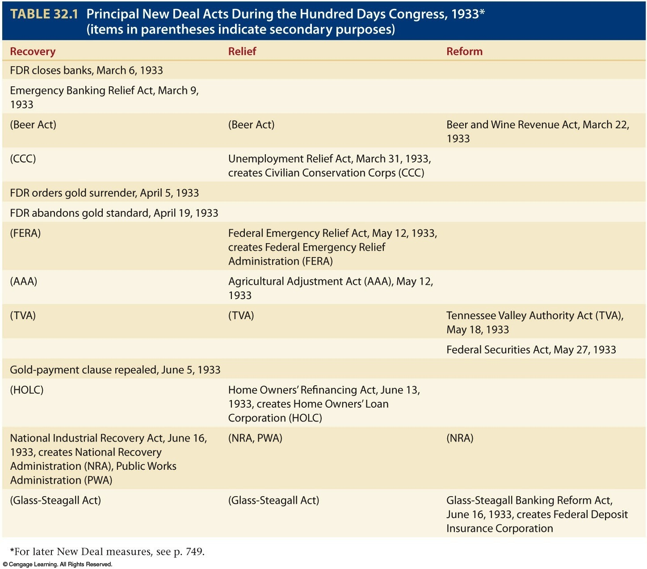
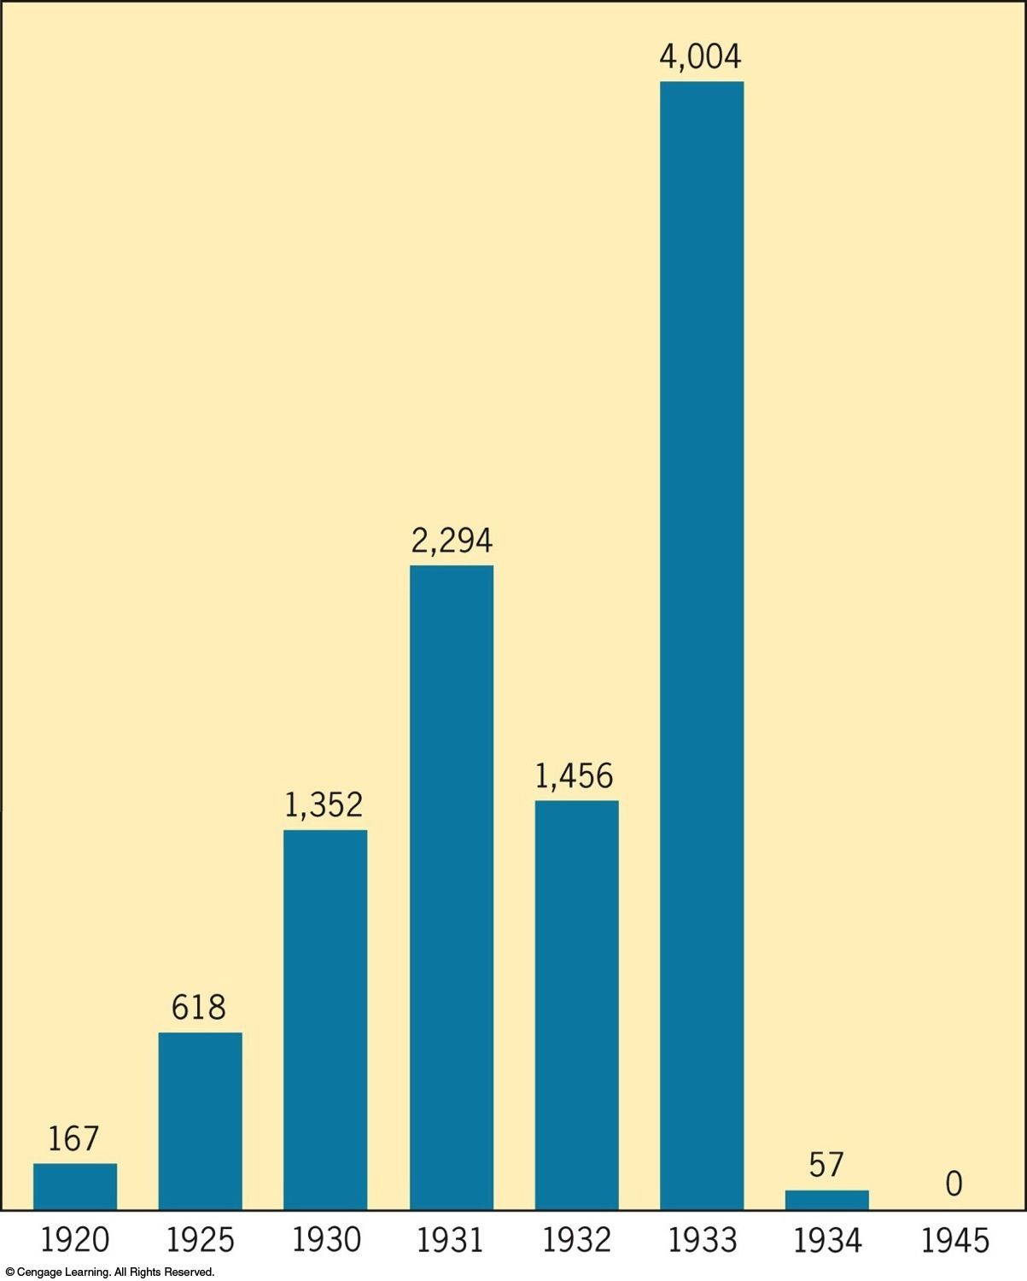

Slide 5
The First New Deal
Civilian Conservation Corps: provided employment and housing to young men on natural works projects (reforestation, flood prevention, etc.) in an effort to combine conserving human and natural resources.
Beer and Wine Revenue Act: after the ratification of the 21st Amendment, allowed for the taxation of alcoholic beverages by the federal and state governments.
TN Valley Authority: produced various jobs in the TN Valley as it worked to modernize the region and act as a electricity provider to TN and surrounding states.
Agricultural Adjustment Act: created artificial scarcity and paid farmers not to farm by selling crops and livestock directly to the government.
Public Works Administration: responsible for large-scale public works such as roads, schools, hospitals, etc.

Slide 6
Radical Reformers
While the New Deal programs provided immediate relief, results did not appear long-lasting, upsetting many politicians and others to speak out.
Fr. Charles Coughlin from MI began preaching anti-New Deal speeches, that were also highly anti-Semitic and fascist.
Huey Long of LA also sought political fame outside his state with his “Share Our Wealth” program, which would provide every family with $5000, and promoted super-Progressivism.
Many Americans, after the appearances of these radical reformers, began to question the connection between economic relief and total state control.
Germany was on the rise under a new democratically-elected dictator, and some believed the US was drawing a similar future.
The government sought to calm public fears with the WPA, which provided 9M jobs over 8 years rather than hand outs.

Slide 7
Changing Roles of Women
First Lady Eleanor Roosevelt became known as the “conscience of the New Deal” as she kept it her mission to “battle for the impoverished and the oppressed.”
FDR appointed the first female cabinet member; Frances Perkins became Secretary of Labor in 1933.
She helped lead the WPA, its successor the Federal Works Agency, the Social Security Act, the Fair Labor Standards Act, and the National Industrial Recovery Act.

Slide 8
The Dust Bowl
Overuse of and mineral depletion in the exhausted soil of the Plains region allowed for a static charge to build causing the creation of huge dust storms.
North Dakota south through Texas, east to New York and the Atlantic.
Caused an exodus of farmers in the region to the West, particularly CA.
Resettlement legislation was put in place to provide support for farmers, which led to Indian Reorganization Act of 1934 which encouraged self-government and preservation of traditions.

Slide 9
The Second New Deal
National Recovery Administration: sought to combine immediate relief with long-range recovery and reform by bringing together labor, business, and government to set “fair prices and practices.”
Social Security Act: provided “old-age” and unemployment insurance to cushion future depressions and force responsibility for all citizens on the federal government.
Reciprocal Trade Agreements Act: allowed for the lowering of federal tariffs on international trade as long as the other country(ies) involved would reduced tariffs the same amount.

Slide 10
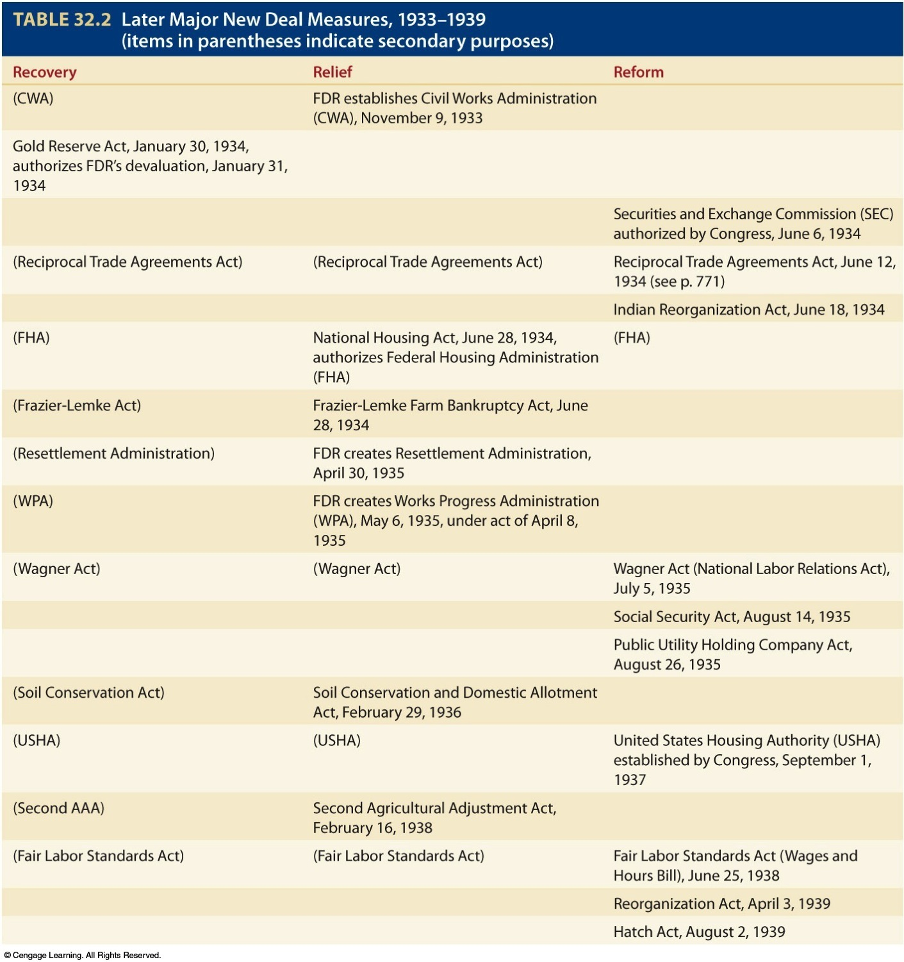

Slide 11
In-house Reform
FDR won re-election in 1936, and Democrats continued to hold on to the majority in Congress after the midterm election of 1934.
The Supreme Court remained staunchly conservative.
Court-packing plan: In 1937, in effort to increase the size of the Supreme Court, FDR asked Congress to allow him to add more Justices to the Court since they were “behind on their work.”
While Congress said no, the Court took the hint: some conservative Justices began to switch sides, or voicing different opinions altogether.

Slide 12
American Keynesianism
In the late 1930s, with the New Deal losing much of its initial momentum and Congress becoming more conservative, FDR made a bold move in suggesting deficit spending.
Deficit spending: spending more money than you have, and therefore running a deficit/debt.
This was a philosophy promoted by economist John Maynard Keynes, who believed the government had a role in promoting consumer spending by spending on its own.
Critics argued that FDR’s “alphabet soup” programs had done nothing, and this latest move would compound the national debt further.
“Roosevelt, like Jefferson, provided bold reform without a bloody revolution at a time in history when some foreign nations were suffering armed uprisings…[and] helped preserve democracy in American at a time when democracies abroad were disappearing.”

Slide 13
FDR and Foreign Policy
London Economic Conference (1933): conference to help relieve the global economic depression. The US did not send a delegation, opting instead for focusing on their own monetary recovery.
Tydings-McDuffie Act (1934): established independence for the Philippines by 1946.
Motivated by trade, FDR formally recognized the Soviet Union in 1933.
Good Neighbor Policy (1934): removed US forces/imperialist policies from Latin America to focus on consultation and nonintervention in order to put the Americas on good terms with each other to protect the Western Hemisphere together.

Slide 14
FDR and Foreign Policy
Reciprocal Trade Agreements Act (1934): aimed at both relief and recovery and activate low tariffs to promote American trade.
Would be used in conjunction with the Good Neighbor Policy.
Johnson Debt Default Act (1934): prevented countries who had dodged or defaulted on their debts to the US from borrowing again.
Neutrality Acts of 1935, 1936, and 1937: “when the president proclaimed the existence of a foreign war, certain restrictions would automatically go into effect.”
“Americans falsely assumed that the decision for peace lay in its own hands…it failed to recognize that it might have used its enormous power to shape international events.”

Slide 15
Post-War Europe
A wave of totalitarian governments swept through Europe.
Joseph Stalin emerged as a dictator in the Soviet Union.
Italy succumbed to Fascist power in 1922 under Benito Mussolini.
Adolf Hitler was elected to power in 1933, which he held onto after Germany shifted away from democracy.
Rome-Berlin Axis: the official (but illegal) German-Italian alliance.
Spanish Civil War (1936-1939): fight between the republican government and fascist overthrow.
It soon spread across to Asia and Africa.
Japan terminated their end of the Naval Treaty.
Italy invaded Ethiopia.
The League of Nations refused to step in.

Slide 16
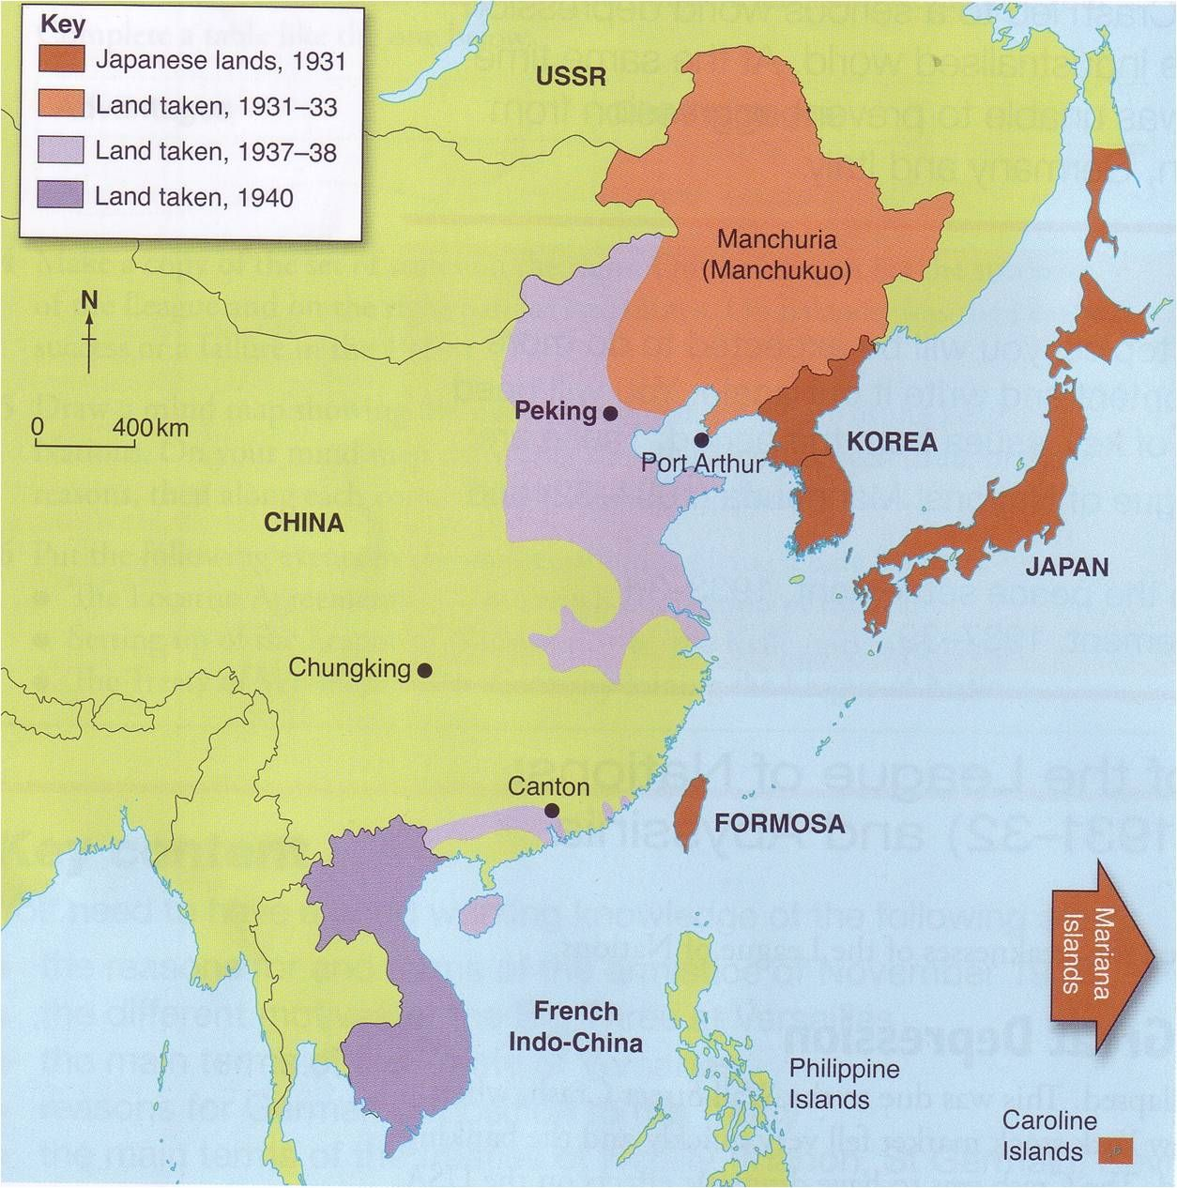
Appeasement…
Appease: to pacify through concession, often at the sacrifice of principles.
1937: Japan launches a full-scale invasion of China.
FDR gives the Quarantine Speech, in which he called for possible action to “quarantine” the aggressors. After much outcry, he was forced to look at indirect options.
1935: Germany institutes compulsory military service, and later marches into the Rhineland.
1938: Austria elects to become German territory, as do the Sudetenland and Czechoslovakia.
The other European powers, through the Munich Agreement, agreed to Germany’s occupation of the Sudetenland, throwing Czechoslovakia under the bus too, to quell the country’s need for territorial acquisition.

Slide 17
…Doesn’t Work
After promising that the Sudetenland would be Germany’s last acquisition, Germany bullied Czechoslovakia into becoming part of German territory.
Hitler-Stalin Pact/Nazi-Soviet Pact (1939): nonaggression pact between Germany and the Soviet Union, which freed Germany to move freely in Europe without fear of threat.
Germany invades Poland, September, 1939.
Britain and France had promised to defend Poland, and now their honor was on the line.
However they lacked the supplies to properly defend it, but declared war anyway. Stalin also pressured Hitler to split Poland between their countries.

Slide 18
Outside of the War
Britain and France were desperate to buy war materiel from the US, but were stopped short by the Neutrality Act of 1937.
The new Neutrality Act of 1939 set forth the precedent of “cash-and-carry” while keeping the US neutral and isolationist.
Cash-and-Carry: European democracies could purchase war supplies from the US provided they paid in cash and transported them on their own.
This gave Britain and France the opportunity to purchase supplies, but hurt China who had been effectively blockaded by the Japanese. The US would be free of foreign loans and would boost their economy at the same time.

Slide 19
The Fall of France
After securing Poland, Germany sent troops to France.
On their way to France, Germany was able to bring Denmark and Norway under its wing before moving on to attack Belgium and the Netherlands.
Italy joined Germany in attacking France, forcing it to surrender.
After evacuating their army from Dunkirk, Britain becomes the last Allied stronghold in Europe even in the face of German air raids.
The US will change it’s plans after the fall of France in 1940.
The fall of Western Europe would directly threaten US security.
The US soon began work on a two-ocean navy, air fleets, and conscription laws.

Slide 20
Responses to Anti-Semitism
Kristallnacht (11/9/1938): mobs in Germany, inspired by propaganda minister Joseph Goebbels, ransacked nearly every Jewish-owned shop and synagogue.
This led to increased attention in Germany on separating the Jews from everyone else, creating more concentration camps and isolated ghettos.
The St. Louis and Refugees: Full of Jewish refugees, the St. Louis was refused port in Cuba, the US, and Canada, before dropping its passengers off in Britain, France, and Belgium.
War Refugees Board (1942): established to help Jewish refugees from Hungary, Germany, and Austria make it to the US; amounted to only around 150K.

Slide 21
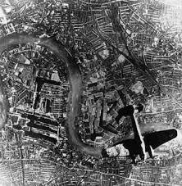
An End to Neutrality?
The US realized it had to take a firm stance on neutrality—or to get rid of it—after the fall of France.
Battle of Britain (Jul. –Oct. 1940): air battle between the German Luftwaffe and the British Royal Air Force. First major battle fought entirely in the air.
The Blitz: Almost 24-hr air raids by the Luftwaffe.
British victory which bolstered American support for war-torn Britain.
Roosevelt decided to provided Britain with “all aid short of war.”
The US would transfer 50 old-model destroyers in exchange for eight locations for US defensive bases.

Slide 22
An End to Neutrality?
Lend-Lease Bill: made America the “arsenal of democracy” by sending limitless supplies of arms to victims of aggression who would later return them or their equivalent.
Made a clear show of abandoning neutrality—it was there to defend nations/democracies who were being attacked.
America was more willing to take this risk and help bolster Britain than let Britain fall and the war spread across the Atlantic.

Slide 23
More War Happenings
1940: Fall of France
1941: German invasion of the Soviet Union
Neither trusted each other so no one was exactly surprised when Hitler ordered an invasion of the Soviet Union. Many other countries now believed it was still possible for the two to take each other out, causing the end of the war.
1941: Atlantic Charter
Agreed to by Britain and the US, it outlined the aspirations of democratic governments in eight points, including the rights of individuals, opposing imperial annexation, and upholding self-determination of countries.
German U-Boats attack American and British ships.
US-Japan negotiations reach an impasse over American embargos on metals and gasoline.

